Slide 2
Technician License Course Chapter 4
Propagation

Slide 3
Radio Wave Propagation: Getting from Point A to Point B
Radio waves propagate in many ways depending on…
Frequency of the wave
Characteristics of the environment
We will discuss three basic ways:
Line of sight
Ground wave
Sky wave

Slide 4
Line-of-Sight
Radio energy can travel in a straight line from a transmitting antenna to a receiving antenna – called the direct path
There is some attenuation of the signal as the radio wave travels due to spreading out
This is the primary propagation mode for VHF and UHF signals.
Notes:
Line-of-sight is probably the easiest propagation mode for students to understand. You can use a laser pointer to demonstrate line-of-sight. You will probably have to refresh the students memory on UHF and VHF definitions and their position on the RF spectrum. Also these bands will be the primary operating bands of the new hams.
The maximum distance for line-of-sight transmissions with two people standing on the surface of the earth is about (roughly) 25 miles, this is due to the curvature of the earth. You can extend this discussion by briefly brining up repeaters and how they extend the line-of-sight range.

Slide 5
Ground Wave
At lower HF frequencies radio waves can follow the Earth’s surface as they travel.
These waves will travel beyond the range of line-of-sight.
Range of a few hundred miles on bands used by amateurs.
Notes:
Point out that this propagation mode is the one used by AM broadcast stations in the day light hours. You can connect with the students experiences with receiving AM broadcast stations using ground waves that fade with distance during the day.

Slide 6
Reflect, Refract, Diffract
Radio waves are reflected by any conductive surface
Ground, water, buildings
Refraction or bending occurs when waves encounter a medium having a different speed of light, such as water or an electrical feed line.
Notes:
Good time for a demonstration of reflection, refraction, and diffraction using a laser pointer.

Slide 7
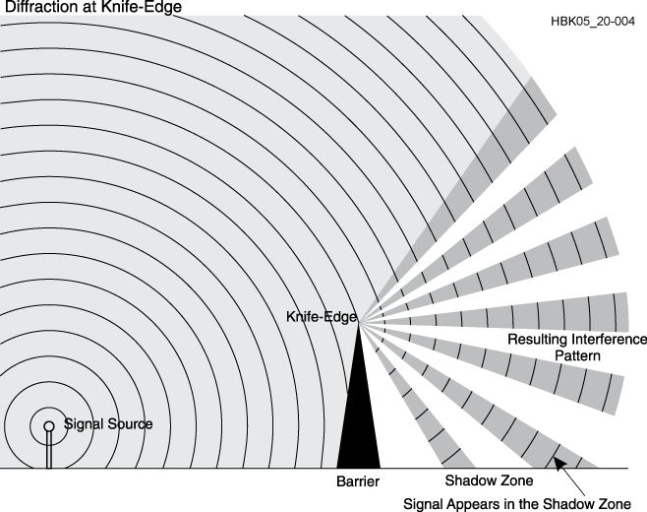
Reflect, Refract, Diffract
Diffraction occurs when a wave encounters a sharp edge (knife-edge propagation) or corner

Slide 8
VHF and UHF Propagation
Range is slightly better than visual line of sight due to gradual refraction (bending), creating the radio horizon.
UHF signals penetrate buildings better than HF/VHF because of the shorter wavelength.
Buildings may block line of sight, but reflected and diffracted waves can get around obstructions.
Multi-path results from reflected signals arriving at the receiver by different paths and interfering with each other.
Picket-fencing is the rapid fluttering sound of multi-path from a moving transmitter
Notes:
The maximum distance for line-of-sight transmissions with two people standing on the surface of the earth is about (roughly) 25 miles, this is due to the curvature of the earth. The radio horizon is about 10 percent farther due to gradual bending of the waves in the atmosphere.

Slide 9
“Tropo” - Tropospheric Propagation
The troposphere is the lower levels of the atmosphere – to about 30 miles high
Radio waves can be reflected or scattered by clouds, rain, and density variations in the troposphere – range up to about 300 miles
Temperature inversions and weather fronts can form ducts that trap and conduct VHF and UHF radio waves for hundreds of miles
Notes:
Note that tropospheric propagation allows TV and FM signals to sometimes be receiver far beyond their normal range.

Slide 10
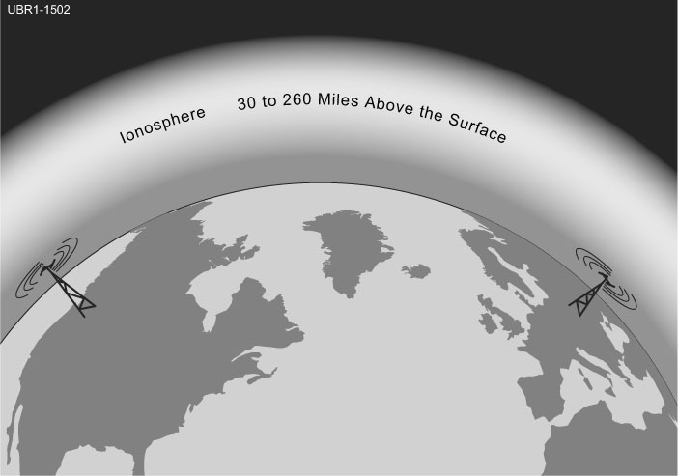
The Ionosphere
A region from 30 to 260 miles above the surface of the Earth
Atmosphere thin enough for atoms to be ionized by solar ultraviolet radiation
Ions are electrically conductive
Notes:
You may have to tap into some old science lessons and vocabulary that the students haven’t thought about in years.
Define ions and explain how radiation can remove electrons from an atom, creating an ion.

Slide 11
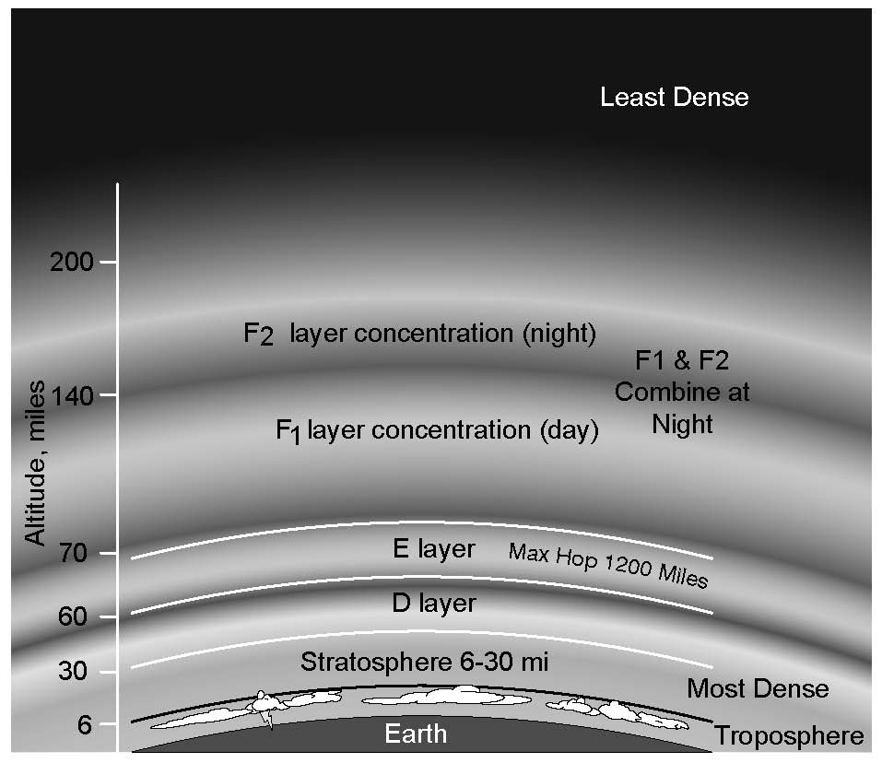
Ionospheric Levels
Because of varying density, the ionosphere forms layers with different amounts of ionization
Ionization varies with solar illumination (hour to hour) and intensity of solar radiation
Higher ionization refracts or bends radio waves more strongly
Notes:
The concept of temporarily stripping away the electrons is important. Discuss the time it takes for the ionization to dissipate during the evening and night time hours when sunlight is blocked.

Slide 12
Sunspot Cycle
The level of ionization depends on the intensity of radiation from the Sun.
Radiation from the Sun varies with the number of sunspots on the Sun’s surface.
High number of sunspots results in high levels of ionizing radiation emitted from the Sun.
Sunspot activity follows an 11-year cycle.
Notes:
Here is a good place to discuss the sunspot cycle, some of the students might make the connection between this practical application of science and the study of the Sun and to some things they have heard about sunspots and solar phenomena. Refer them to the spaceweather.com website.

Slide 13
The Ionosphere – An RF Mirror
The ionosphere can refract (bend) radio waves back to Earth – acts like reflection
Most refraction of amateur frequencies occurs in the F layer
Notes:
Explain how gradual refraction creates an apparent reflection. This is sky-wave or skip propagation.

Slide 14
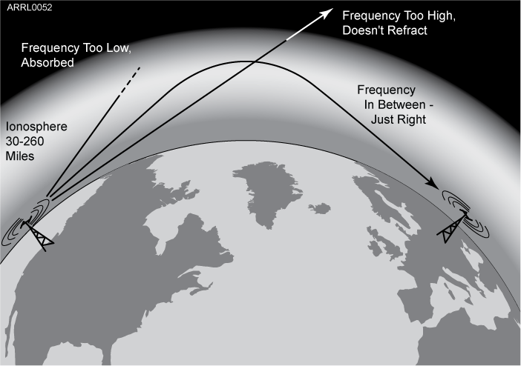
The Ionosphere – An RF Mirror
Reflection depends on frequency and angle of incidence.
Too high a frequency or angle and the waves are lost to space.
Notes:
If the angle is too steep, the waves go right through.
If the frequencies are too high, the refraction is insufficient to return the wave to Earth, creating a reflection or skip.
For low frequencies, signals can be absorbed by ionization in the lower layers (D and E), blocking propagation.
The varying amount of ionization through the day creates maximum and minimum usable frequencies for sky-wave propagation. (Explain MUF and LUF.) Hams interested in DX (you might have to explain DX) adjust their operating bands to take advantage of those frequencies that can be reflected by the ionosphere.

Slide 15
The Ionosphere – An RF Mirror
Sky-wave or skip propagation is responsible for most over-the-horizon propagation on HF and low VHF (10 and 6 meters) during peaks of the sunspot cycle.
Skip is very rare on the 144 MHz and higher UHF bands.
Each ground-to-sky-to-ground trip is called a hop.
Notes:
Explain the F-layer skip on 10 and 6 meters requires a very high MUF that usually occurs only during the peak years of the sunspot cycle.
The MUF rarely exceeds 70 MHz so sky-wave propagation from the F layer above 6 meters is also rare.

Slide 16
The Ionosphere – An RF Mirror
Signals can take many paths through the ionosphere.
Randomly combining at the receiving antenna, signals can partially cancel, creating irregular fading as the ionosphere changes.
The resulting echo and flutter distort speech and CW.
Fading causes data errors for digital signals.
Notes:
The ionosphere is constantly changing, so signals take many paths to arrive at the receive antenna. They can add together or subtract from each other, creating fading. The different lengths of the paths creates echo and flutter. (A recording of a polar path signal would be instructive.) This distortion is very hard on digital signals, creating a lot of errors.

Slide 17
Sporadic E (Es) and Aurora
Highly ionized patches of the E layer can reflect HF and VHF signals – best on 10, 6, and 2 meters.
Aurora near the north and south poles can also reflect VHF and UHF waves with a distinctive distorted sound.
Notes:
Explain that sporadic E “clouds” form in the E layer and if they are dense enough act to reflect signals back to Earth. Sporadic E propagation can occur at any time of the sunspot cycle.
Aurora is caused by charged particles flowing to the Earth’s surface. This creates a conductive vertical sheet that can reflect radio waves. The sheet’s surface is constantly moving, causing distortion to the signals it reflects.

Slide 18
Meteor Scatter
Thousands of meteors enter the Earth’s atmosphere every day – most quite small.
Meteors leave trails of highly ionized gas that last for several seconds.
Trails can reflect radio waves – called meteor scatter. The best band for this is 6 meters.
Mostly in the E layer, meteor scatter and sporadic E supports contacts up to about 1500 miles.
Notes:
Meteor scatter contacts are very short – a few seconds. Sophisticated software is used to exchange data during a single “ping” although sometimes an intense trail can support a quick voice contact lasting several seconds. Most meteor trails occur in the E layer so the communication distance is about the same as for sporadic E.

Slide 19
Practice Questions

Slide 20
What should you do if another operator reports that your station’s 2 meter signals were strong just a moment ago, but now they are weak or distorted?
A. Change the batteries in your radio to a different type
B. Turn on the CTCSS tone
C. Ask the other operator to adjust his squelch control
D. Try moving a few feet, as random reflections may be causing multi-path distortion
T3A01 HRLM (4-2)

Slide 21
What should you do if another operator reports that your station’s 2 meter signals were strong just a moment ago, but now they are weak or distorted?
A. Change the batteries in your radio to a different type
B. Turn on the CTCSS tone
C. Ask the other operator to adjust his squelch control
D. Try moving a few feet, as random reflections may be causing multi-path distortion
T3A01 HRLM (4-2)

Slide 22
Why might the range of VHF and UHF signals be greater in the winter?
A. Less ionospheric absorption
B. Less absorption by vegetation
C. Less solar activity
D. Less tropospheric absorption
T3A02 HRLM (4 - 2)

Slide 23
Why might the range of VHF and UHF signals be greater in the winter?
A. Less ionospheric absorption
B. Less absorption by vegetation
C. Less solar activity
D. Less tropospheric absorption
T3A02 HRLM (4 - 2)

Slide 24
What term is commonly used to describe the rapid fluttering sound sometimes heard from mobile stations that are moving while transmitting?
A. Flip-flopping
B. Picket fencing
C. Frequency shifting
D. Pulsing
T3A06 HRLM (4-3)

Slide 25
What term is commonly used to describe the rapid fluttering sound sometimes heard from mobile stations that are moving while transmitting?
A. Flip-flopping
B. Picket fencing
C. Frequency shifting
D. Pulsing
T3A06 HRLM (4-3)

Slide 26
Which of the following is a likely cause of irregular fading of signals received by ionospheric reflection?
A. Frequency shift due to Faraday rotation
B. Interference from thunderstorms
C. Random combining of signals arriving via different paths
D. Intermodulation distortion
T3A08 HRLM (4-2)

Slide 27
Which of the following is a likely cause of irregular fading of signals received by ionospheric reflection?
A. Frequency shift due to Faraday rotation
B. Interference from thunderstorms
C. Random combining of signals arriving via different paths
D. Intermodulation distortion
T3A08 HRLM (4-2)

Slide 28
What may occur if data signals propagate over multiple paths?
A. Transmission rates can be increased by a factor equal to the number of separate paths observed
B. Transmission rates must be decreased by a factor equal to the number of separate paths observed
C. No significant changes will occur if the signals are transmitting using FM
D. Error rates are likely to increase
T3A10 HRLM (4-3)

Slide 29
What may occur if data signals propagate over multiple paths?
A. Transmission rates can be increased by a factor equal to the number of separate paths observed
B. Transmission rates must be decreased by a factor equal to the number of separate paths observed
C. No significant changes will occur if the signals are transmitting using FM
D. Error rates are likely to increase
T3A10 HRLM (4-3)

Slide 30
How might fog and light rain affect radio range on the 10 meter and 6 meter bands?
A. Fog and rain absorb these wavelength bands
B. Fog and light rain will have little effect on these bands
C. Fog and rain will deflect these signals
D. Fog and rain will increase radio range
T3A12 HRLM (4 - 2)

Slide 31
How might fog and light rain affect radio range on the 10 meter and 6 meter bands?
A. Fog and rain absorb these wavelength bands
B. Fog and light rain will have little effect on these bands
C. Fog and rain will deflect these signals
D. Fog and rain will increase radio range
T3A12 HRLM (4 - 2)

Slide 32
What weather condition would decrease range at microwave frequencies?
A. High winds
B. Low barometric pressure
C. Precipitation
D. Colder temperatures
T3A13 HRLM (4 - 2)

Slide 33
What weather condition would decrease range at microwave frequencies?
A. High winds
B. Low barometric pressure
C. Precipitation
D. Colder temperatures
T3A13 HRLM (4 - 2)

Slide 34
Which part of the atmosphere enables the propagation of radio signals around the world?
A. The stratosphere
B. The troposphere
C. The ionosphere
D. The magnetosphere
T3A11 HRLM (4-3)

Slide 35
Which part of the atmosphere enables the propagation of radio signals around the world?
A. The stratosphere
B. The troposphere
C. The ionosphere
D. The magnetosphere
T3A11 HRLM (4-3)

Slide 36
Why are direct (not via a repeater) UHF signals rarely heard from stations outside your local coverage area?
A. They are too weak to go very far
B. FCC regulations prohibit them from going more than 50 miles
C. UHF signals are usually not reflected by the ionosphere
D. UHF signals are absorbed by the ionospheric D layer
T3C01 HRLM (4-4)

Slide 37
Why are direct (not via a repeater) UHF signals rarely heard from stations outside your local coverage area?
A. They are too weak to go very far
B. FCC regulations prohibit them from going more than 50 miles
C. UHF signals are usually not reflected by the ionosphere
D. UHF signals are absorbed by the ionospheric D layer
T3C01 HRLM (4-4)

Slide 38
Which of the following is an advantage of HF vs VHF and higher frequencies?
A. HF antennas are generally smaller
B. HF accommodates wider bandwidth signals
C. Long distance ionospheric propagation is far more common on HF
D. There is less atmospheric interference (static) on HF
T3C02 HRLM (4 - 4)

Slide 39
Which of the following is an advantage of HF vs VHF and higher frequencies?
A. HF antennas are generally smaller
B. HF accommodates wider bandwidth signals
C. Long distance ionospheric propagation is far more common on HF
D. There is less atmospheric interference (static) on HF
T3C02 HRLM (4 - 4)

Slide 40
What is a characteristic of VHF signals received via auroral reflection?
A. Signals from distances of 10,000 or more miles are common
B. The signals exhibit rapid fluctuations of strength and often sound distorted
C. These types of signals occur only during winter nighttime hours
D. These types of signals are generally strongest when your antenna is aimed west
T3C03 HRLM (4-4)

Slide 41
What is a characteristic of VHF signals received via auroral reflection?
A. Signals from distances of 10,000 or more miles are common
B. The signals exhibit rapid fluctuations of strength and often sound distorted
C. These types of signals occur only during winter nighttime hours
D. These types of signals are generally strongest when your antenna is aimed west
T3C03 HRLM (4-4)

Slide 42
Which of the following propagation types is most commonly associated with occasional strong over-the-horizon signals on the 10, 6, and 2 meter bands?
A. Backscatter
B. Sporadic E
C. D layer absorption
D. Gray-line propagation
T3C04 HRLM (4-4)

Slide 43
Which of the following propagation types is most commonly associated with occasional strong over-the-horizon signals on the 10, 6, and 2 meter bands?
A. Backscatter
B. Sporadic E
C. D layer absorption
D. Gray-line propagation
T3C04 HRLM (4-4)

Slide 44
Which of the following might cause radio signals to be heard despite obstructions between the transmitting and receiving stations?
A. Knife-edge propagation
B. Faraday rotation
C. Quantum tunneling
D. Doppler shift
T3C05 HRLM (4-2)

Slide 45
Which of the following might cause radio signals to be heard despite obstructions between the transmitting and receiving stations?
A. Knife-edge propagation
B. Faraday rotation
C. Quantum tunneling
D. Doppler shift
T3C05 HRLM (4-2)

Slide 46
What mode is responsible for allowing over-the-horizon VHF and UHF communications to ranges of approximately 300 miles on a regular basis?
A. Tropospheric scatter
B. D layer refraction
C. F2 layer refraction
D. Faraday rotation
T3C06 HRLM (4-3)

Slide 47
What mode is responsible for allowing over-the-horizon VHF and UHF communications to ranges of approximately 300 miles on a regular basis?
A. Tropospheric scatter
B. D layer refraction
C. F2 layer refraction
D. Faraday rotation
T3C06 HRLM (4-3)

Slide 48
What band is best suited for communicating via meteor scatter?
A. 10 meters
B. 6 meters
C. 2 meters
D. 70 cm
T3C07 HRLM (4-4)

Slide 49
What band is best suited for communicating via meteor scatter?
A. 10 meters
B. 6 meters
C. 2 meters
D. 70 cm
T3C07 HRLM (4-4)

Slide 50
What causes tropospheric ducting?
A. Discharges of lightning during electrical storms
B. Sunspots and solar flares
C. Updrafts from hurricanes and tornadoes
D. Temperature inversions in the atmosphere
T3C08 HRLM (4-3)

Slide 51
What causes tropospheric ducting?
A. Discharges of lightning during electrical storms
B. Sunspots and solar flares
C. Updrafts from hurricanes and tornadoes
D. Temperature inversions in the atmosphere
T3C08 HRLM (4-3)

Slide 52
What is generally the best time for long-distance 10 meter band propagation via the F layer?
A. From dawn to shortly after sunset during periods of high sunspot activity
B. From shortly after sunset to dawn during periods of high sunspot activity
C. From dawn to shortly after sunset during periods of low sunspot activity
D. From shortly after sunset to dawn during periods of low sunspot activity
T3C09 HRLM (4-4)

Slide 53
What is generally the best time for long-distance 10 meter band propagation via the F layer?
A. From dawn to shortly after sunset during periods of high sunspot activity
B. From shortly after sunset to dawn during periods of high sunspot activity
C. From dawn to shortly after sunset during periods of low sunspot activity
D. From shortly after sunset to dawn during periods of low sunspot activity
T3C09 HRLM (4-4)

Slide 54
Why do VHF and UHF radio signals usually travel somewhat farther than the visual line of sight distance between two stations?
A. Radio signals move somewhat faster than the speed of light
B. Radio waves are not blocked by dust particles
C. The Earth seems less curved to radio waves than to light
D. Radio waves are blocked by dust particles
T3C11 HRLM (4-2)

Slide 55
Why do VHF and UHF radio signals usually travel somewhat farther than the visual line of sight distance between two stations?
A. Radio signals move somewhat faster than the speed of light
B. Radio waves are not blocked by dust particles
C. The Earth seems less curved to radio waves than to light
D. Radio waves are blocked by dust particles
T3C11 HRLM (4-2)

Slide 56
Which of the following bands may provide long distance communications during the peak of the sunspot cycle?
A. Six or ten meters
B. 23 centimeters
C. 70 centimeters or 1.25 meters
D. All of these choices are correct
T3C10 HRLM (4-4)

Slide 57
Which of the following bands may provide long distance communications during the peak of the sunspot cycle?
A. Six or ten meters
B. 23 centimeters
C. 70 centimeters or 1.25 meters
D. All of these choices are correct
T3C10 HRLM (4-4)

Slide 58
Technician License Course Chapter 4
Antenna Fundamentals, Feed Lines & SWR
Notes:
Make sure you bring in samples of different kinds of feed lines as you are going through this lesson.

Slide 59
The Antenna System
Antenna: Transforms current into radio waves (transmit) and vice versa (receive).
Feed line: Connects your station to the antenna.
Test and matching equipment: Allows you to monitor and optimize antenna system performance.
Notes:
Talk about the whole antenna system, starting from the transmitter and working out to the antenna.

Slide 60
The Antenna (Some Vocabulary)
Element: The conducting part or parts of an antenna designed to radiate or receive radio waves.
Driven element: The element supplied directly with power from the transmitter.
Array: An antenna with more than one element.
Notes:
Use a small VHF Yagi to illustrate each word.

Slide 61
The Antenna (Some Vocabulary)
Parasitic element: Elements not connected directly to a feed line.
Resonant: An antenna is resonant when its feed point impedance has zero reactance.
Feed point: Where the transmitted energy enters the antenna.
Radiation: NOT radioactivity! An antenna emitting electromagnetic waves.
Notes:
Show the parasitic vs driven elements on the VHF Yagi.

Slide 62
Electromagnetic Waves
Radio waves are electromagnetic waves
Electric and magnetic fields are at right angles to each other, oscillating at the wave’s frequency
Spread out into space from the antenna
Are created by ac current
Wave and current have the same frequency
Notes:
Make the analogy to ripples on the surface of water. Stress that the current in the antenna determines the frequency of the radiated wave. Conversely, current in a receiving antenna has the same frequency as that of the received wave.

Slide 63
Wave Polarization
Orientation of the wave’s electric field component with respect to the surface of the Earth
Vertical or horizontal – determined by elements
Can be circular if the orientation twists as the wave spreads through space
Combinations of polarization are called elliptical polarization

Slide 64
Cross-Polarization
Antenna and wave polarization must match for maximum reception.
Cross-polarized: antenna elements and the wave’s electric field are at right angles
Can reduce reception by a factor of 100
For elliptically polarized waves (such as HF sky-wave) any antenna will respond at least partially.
Notes:
Use two pairs of Polaroid sunglasses to illustrate cross-polarization. Note that light is also an electromagnetic wave with a much shorter wavelength than radio waves.

Slide 65
The Decibel (dB)
A ratio expressed as an power of 10 to make large numbers easier to work with.
dB = 10 log (power ratio)
dB = 20 log (voltage ratio)
Positive values in dB indicate ratios > 1 and negative values of dB are for ratios < 1.
Antenna gain is discussed in terms of dB.
Notes:
Refer students to the decibel tutorial on the HRLM website.
The concept of decibels can be a difficult and scary concept for class members not comfortable with math. Don’t spend a lot of time on this, just get them used to the use of dB as a way of expressing the gain or comparisons between one antenna and another. Note that dB values always require a reference – “dB with respect to what?” is a good question.
An important specific gain value to remember is 3. For every 3 dB of gain, the apparent power advantage is doubled (5 watts seems like 10 with 3 dB of gain). You also could mention that -3 dB is halving the power…10 watts becomes 5 watts when there is a -3 dB of gain (this is significant when students are looking at the performance of the rubber duck antenna versus a ¼ wave whip). Make a worksheet of all exam questions about dB for them to work out.

Slide 66
The Antenna (Some Vocabulary)
Gain: Apparent increase in power in a particular direction by focusing radiation in that direction. Measured in decibels (dB).
Isotropic: Equal radiation in all directions.
Omnidirectional: No preferred horizontal direction.
Directional: Antenna that focuses radiation in specific directions.
Notes:
The concept of gain is an important concept to make sure the students understand. Gain does not increase the amount of power being transmitted, gain gives the appearance of increased power because the transmitted energy (and received energy) is focused in a specific direction by the antenna elements at the expense of energy that would have been send in other directions. A good way to illustrate this is to use the balloon demonstation.

Slide 67
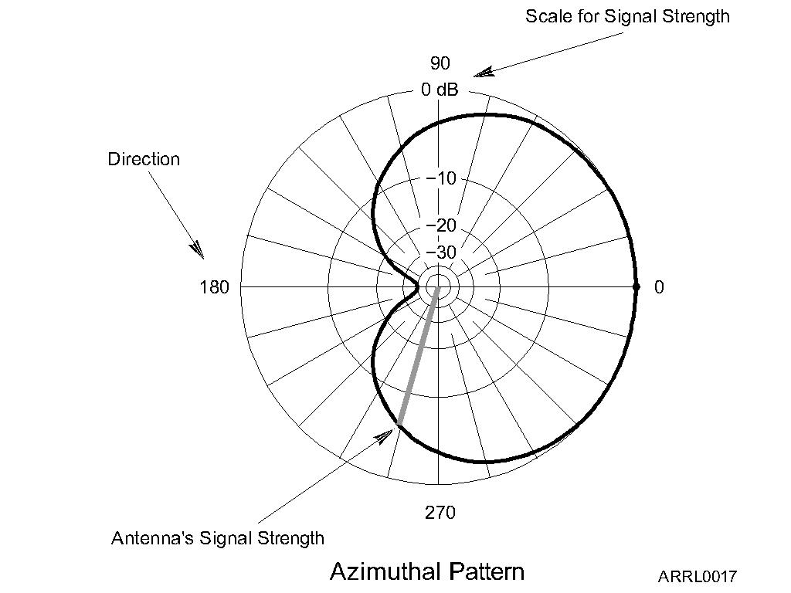
Antenna Radiation Patterns
Radiation patterns are a way of visualizing antenna performance.
The further the line is from the center of the graph, the stronger the signal at that point.
Graph calibrated in dB.
Notes:
This is an opportunity for you to expand on the concept of gain. Walk your students through how to interpret the antenna radio pattern plots by using the small VHF Yagi and a receiver to display signal strengths as the antenna is pointed in different directions. A good time to introduce fox-hunting, too!

Slide 68
Radiation Pattern Vocabulary
Nulls: Directions of minimum gain
Lobes: Regions between nulls
Main lobe: Lobe with highest gain
Side lobe: Any lobe other than the main lobe
Forward gain: Gain in the direction assigned as forward
Notes:
Illustrate each point on a radiation pattern in the HRLM or from an advertiser’s or magazine article’s antenna pattern.

Slide 69
Radiation Pattern Vocabulary
Azimuth pattern: Radiation pattern showing gain in all horizontal directions around the antenna.
Elevation pattern: Radiation pattern showing gain at all vertical angles from the antenna.
Often restricted to angles above horizontal
Notes:
Reinforce that azimuth means direction on the surface of the Earth and elevation means angle above the surface of the Earth.

Slide 70
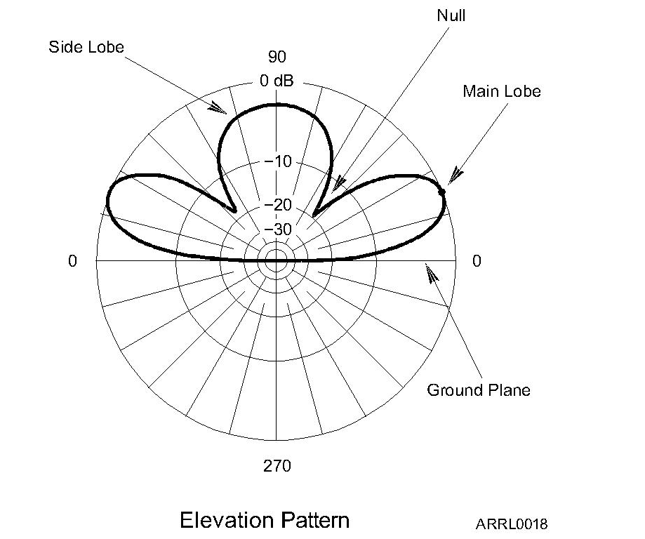
Azimuth
Pattern
Elevation
Pattern

Slide 71
Radiation Pattern Vocabulary
Front-to-back ratio: Ratio of forward gain to gain in the opposite direction.
Front-to-side ratio: Ratio of forward gain to gain at right angles to the forward direction.
Notes:
Show the ratios on a radiation pattern.

Slide 72
Feed Lines
The purpose of the feed line is to get RF power from your station to the antenna.
Basic feed line types
Coaxial cable (coax)
Open-wire line (OWL) also called ladder line or window line
Power lost as heat in the feed line is called loss and it increases with frequency.
Notes:
It would be very helpful to have physical examples of the two basic kinds of feed line.

Slide 73
Feed Line Vocabulary
Center conductor: Central wire
Dielectric: Insulation surrounding center conductor
Shield: Braid or foil surrounding dielectric
Jacket: Protective outer plastic coating
Forward (reflected) power: RF power traveling toward (away from) a load such as an antenna
Notes:
Show what each word refers to in a coaxial cable.

Slide 74
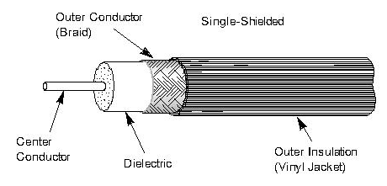
Coaxial Cable
Most common feed line
Easy to use
Not affected by nearby materials
Has higher loss than open-wire line at most frequencies
Air-insulated “hard line” has lowest loss
Notes:
Discuss why coax is so common and emphasize how it can be installed near metal and next to materials.

Slide 75
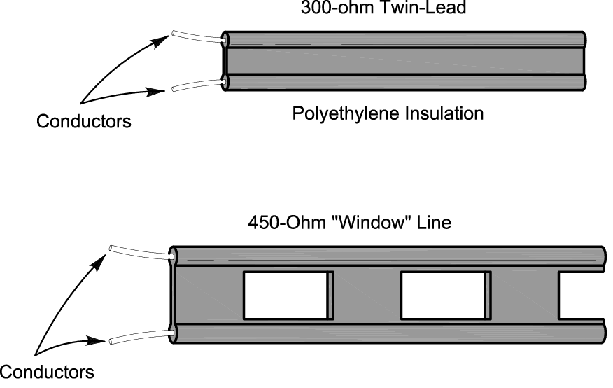
Open-Wire Line
Lighter and less expensive than coax
Has lower loss than coax at most frequencies
More difficult to use since it is affected by nearby materials
Requires impedance matching equipment to use with most transceivers
Notes:
Discuss some applications where ladder line is practical, such as a dipole used on multiple bands (really an HF thing). Note that an impedance matching unit is required to transform the feed line impedance to 50 ohms to match the transceiver’s required output impedance..

Slide 76
Characteristic Impedance
The impedance presented to a wave traveling through a feed line
Given in ohms (Ω), symbolized as Z₀
Depends on how the feed line is constructed and what materials are used
Coax: 50 and 75 Ω
OWL: 300, 450, and 600 Ω
Notes:
Use the demo of puffing air through a very thin straw (coffee stirrer) and through a fat straw (milk shake straw) to illustrate the difference in characteristic impedance.

Slide 77
Standing Wave Ratio (SWR)
If the antenna feed point and feed line impedances are not identical, some RF power is reflected back toward the transmitter.
Called a mismatch
Forward and reflected waves create a pattern of standing waves of voltage and current in the line
SWR is the ratio of standing wave max to min
Measured with an SWR meter or SWR bridge.
Notes:
Recall the jump rope demonstration of frequency vs wavelength and the standing waves created when the rope was shaken.

Slide 78
Standing Wave Ratio (SWR)
Reflected power is re-reflected at the transmitter and bounces back and forth.
Some RF power is lost as heat on each trip back and forth through the feed line
All RF power is eventually lost as heat or transferred to the antenna or load
High SWR means more reflections and more loss of RF power (less transferred to the antenna or load).

Slide 79
Nothing Is Perfect
SWR equals the ratio of feed point (or load) and feed line impedance, whichever is greater than 1 (SWR always greater than 1:1).
What is an acceptable SWR?
1:1 SWR is perfect – no power reflected
Up to 2:1 SWR is normal
Modern radios lower transmitter output power for protection when SWR is above 2:1

Slide 80
Nothing Is Perfect
SWR above 3:1 is considered high in most cases.
Erratic SWR readings may indicate a faulty feed line, faulty feed line connectors, or a faulty antenna.
High SWR can be corrected by
Tuning or adjusting the antenna or
With impedance matching equipment at the transmitter
Called an antenna tuner or transmatch
Does not change SWR in the feed line

Slide 81
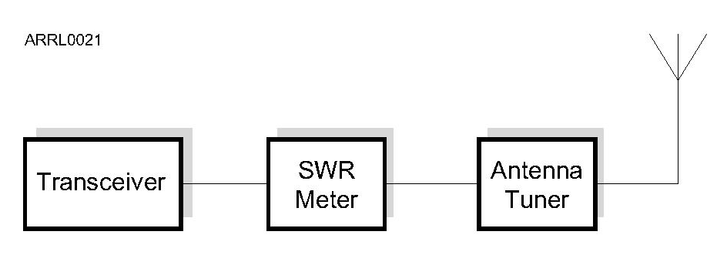
Adjusting SWR
An SWR meter is inserted in the feed line and indicates the mismatch at that point.
Either adjust the antenna to minimize the reflected power or adjust the antenna tuner for minimum SWR at the transceiver.
Notes:
Have an example of an SWR meter on hand to show the students. You can also discuss how SWR meters are now commonly included as a meter function of a transceiver.

Slide 82
Dummy Loads
A dummy load is a resistor and a heat sink
Used to replace an antenna or other piece of equipment during testing.
Dummy loads dissipate signals in the feed line as heat
Allows transmitter testing without sending a signal over the air
Helpful in troubleshooting an antenna system
Notes:
Have an example of a dummy load to show the students. Note that it must be able to dissipate the entire power output of the transmitter or amplifier, although it can stand short overloads.

Slide 83
Practice Questions

Slide 84
What can happen if the antennas at opposite ends of a VHF or UHF line of sight radio link are not using the same polarization?
A. The modulation sidebands might become inverted
B. Signals could be significantly weaker
C. Signals have an echo effect on voices
D. Nothing significant will happen
T3A04 HRLM (4-6)

Slide 85
What can happen if the antennas at opposite ends of a VHF or UHF line of sight radio link are not using the same polarization?
A. The modulation sidebands might become inverted
B. Signals could be significantly weaker
C. Signals have an echo effect on voices
D. Nothing significant will happen
T3A04 HRLM (4-6)

Slide 86
What type of wave carries radio signals between transmitting and receiving stations?
A. Electromagnetic
B. Electrostatic
C. Surface acoustic
D. Magnetostrictive
T3A07 HRLM (4-6)

Slide 87
What type of wave carries radio signals between transmitting and receiving stations?
A. Electromagnetic
B. Electrostatic
C. Surface acoustic
D. Magnetostrictive
T3A07 HRLM (4-6)

Slide 88
What property of a radio wave is used to describe its polarization?
A. The orientation of the electric field
B. The orientation of the magnetic field
C. The ratio of the energy in magnetic field to the energy in the electric field
D. The ratio of the velocity to the wavelength
T3B02 HRLM (4-6)

Slide 89
What property of a radio wave is used to describe its polarization?
A. The orientation of the electric field
B. The orientation of the magnetic field
C. The ratio of the energy in magnetic field to the energy in the electric field
D. The ratio of the velocity to the wavelength
T3B02 HRLM (4-6)

Slide 90
What are the two components of a radio wave?
A. AC and DC
B. Voltage and current
C. Electric and magnetic fields
D. Ionizing and non-ionizing radiation
T3B03 HRLM (4-6)

Slide 91
What are the two components of a radio wave?
A. AC and DC
B. Voltage and current
C. Electric and magnetic fields
D. Ionizing and non-ionizing radiation
T3B03 HRLM (4-6)

Slide 92
A radio wave is made up of what type of energy?
A. Pressure
B. Electromagnetic
C. Gravity
D. Thermal
T5C07 HRLM (4 - 6)

Slide 93
A radio wave is made up of what type of energy?
A. Pressure
B. Electromagnetic
C. Gravity
D. Thermal
T5C07 HRLM (4 - 6)

Slide 94
What is the gain of an antenna?
A. The additional power that is added to the transmitter power
B. The additional power that is lost in the antenna when transmitting on a higher frequency
C. The increase in signal strength in a specified direction when compared to a reference antenna
D. The increase in impedance on receive or transmit compared to a reference antenna
T9A11 HRLM (4-7)

Slide 95
What is the gain of an antenna?
A. The additional power that is added to the transmitter power
B. The additional power that is lost in the antenna when transmitting on a higher frequency
C. The increase in signal strength in a specified direction when compared to a reference antenna
D. The increase in impedance on receive or transmit compared to a reference antenna
T9A11 HRLM (4-7)

Slide 96
Which of the following is a common effect of "skip" reflections between the Earth and the ionosphere?
A. The sidebands become reversed at each reflection
B. The polarization of the original signal is randomized
C. The apparent frequency of the received signal is shifted by a random amount
D. Signals at frequencies above 30 MHz become stronger with each reflection
T3A09 HRLM (4-7)

Slide 97
Which of the following is a common effect of "skip" reflections between the Earth and the ionosphere?
A. The sidebands become reversed at each reflection
B. The polarization of the original signal is randomized
C. The apparent frequency of the received signal is shifted by a random amount
D. Signals at frequencies above 30 MHz become stronger with each reflection
T3A09 HRLM (4-7)

Slide 98
What is the approximate amount of change, measured in decibels (dB), of a power increase from 5 watts to 10 watts?
A. 2 dB
B. 3 dB
C. 5 dB
D. 10 dB
T5B09 HRLM (4-8)

Slide 99
What is the approximate amount of change, measured in decibels (dB), of a power increase from 5 watts to 10 watts?
A. 2 dB
B. 3 dB
C. 5 dB
D. 10 dB
T5B09 HRLM (4-8)

Slide 100
What is the approximate amount of change, measured in decibels (dB), of a power decrease from 12 watts to 3 watts?
A. -1 dB
B. -3 dB
C. -6 dB
D. -9 dB
T5B10 HRLM (4-8)

Slide 101
What is the approximate amount of change, measured in decibels (dB), of a power decrease from 12 watts to 3 watts?
A. -1 dB
B. -3 dB
C. -6 dB
D. -9 dB
T5B10 HRLM (4-8)

Slide 102
What is the amount of change, measured in decibels (dB), of a power increase from 20 watts to 200 watts?
A. 10 dB
B. 12 dB
C. 18 dB
D. 28 dB
T5B11 HRLM (4-8)

Slide 103
What is the amount of change, measured in decibels (dB), of a power increase from 20 watts to 200 watts?
A. 10 dB
B. 12 dB
C. 18 dB
D. 28 dB
T5B11 HRLM (4-8)

Slide 104
What happens to power lost in a feed line?
A. It increases the SWR
B. It comes back into your transmitter and could cause damage
C. It is converted into heat
D. It can cause distortion of your signal
T7C07 HRLM (4-9)

Slide 105
What happens to power lost in a feed line?
A. It increases the SWR
B. It comes back into your transmitter and could cause damage
C. It is converted into heat
D. It can cause distortion of your signal
T7C07 HRLM (4-9)

Slide 106
What is the impedance of most coaxial cables used in amateur radio installations?
A. 8 ohms
B. 50 ohms
C. 600 ohms
D. 12 ohms
T9B02 HRLM (4-9)

Slide 107
What is the impedance of most coaxial cables used in amateur radio installations?
A. 8 ohms
B. 50 ohms
C. 600 ohms
D. 12 ohms
T9B02 HRLM (4-9)

Slide 108
Why is coaxial cable the most common feed line selected for amateur radio antenna systems?
A. It is easy to use and requires few special installation considerations
B. It has less loss than any other type of feed line
C. It can handle more power than any other type of feed line
D. It is less expensive than any other type of feed line
T9B03 HRLM (4-9)

Slide 109
Why is coaxial cable the most common feed line selected for amateur radio antenna systems?
A. It is easy to use and requires few special installation considerations
B. It has less loss than any other type of feed line
C. It can handle more power than any other type of feed line
D. It is less expensive than any other type of feed line
T9B03 HRLM (4-9)

Slide 110
In general, what happens as the frequency of a signal passing through coaxial cable is increased?
A. The characteristic impedance decreases
B. The loss decreases
C. The characteristic impedance increases
D. The loss increases
T9B05 HRLM (4 - 9)

Slide 111
In general, what happens as the frequency of a signal passing through coaxial cable is increased?
A. The characteristic impedance decreases
B. The loss decreases
C. The characteristic impedance increases
D. The loss increases
T9B05 HRLM (4 - 9)

Slide 112
Which of the following types of feed line has the lowest loss at VHF and UHF?
50-ohm flexible cable
Multi-conductor unbalanced cable
Air-insulated hard line
75-ohm flexible coax
T9B11 HRLM (4-9)

Slide 113
Which of the following types of feed line has the lowest loss at VHF and UHF?
50-ohm flexible cable
Multi-conductor unbalanced cable
Air-insulated hard line
75-ohm flexible coax
T9B11 HRLM (4-9)

Slide 114
What, in general terms, is standing wave ratio (SWR)?
A. A measure of how well a load is matched to a transmission line
B. The ratio of high to low impedance in a feed line
C. The transmitter efficiency ratio
D. An indication of the quality of your station’s ground connection
T7C03 HRLM (4-11)

Slide 115
What, in general terms, is standing wave ratio (SWR)?
A. A measure of how well a load is matched to a transmission line
B. The ratio of high to low impedance in a feed line
C. The transmitter efficiency ratio
D. An indication of the quality of your station’s ground connection
T7C03 HRLM (4-11)

Slide 116
What reading on an SWR meter indicates a perfect impedance match between the antenna and the feed line?
A. 2 to 1
B. 1 to 3
C. 1 to 1
D. 10 to 1
T7C04 HRLM (4-11)

Slide 117
What reading on an SWR meter indicates a perfect impedance match between the antenna and the feed line?
A. 2 to 1
B. 1 to 3
C. 1 to 1
D. 10 to 1
T7C04 HRLM (4-11)

Slide 118
Why do most solid-state amateur radio transmitters reduce output power as SWR increases?
A. To protect the output amplifier transistors
B. To comply with FCC rules on spectral purity
C. Because power supplies cannot supply enough current at high SWR
D. To improve the impedance match to the feed line
T7C05 HRLM (4 - 11)

Slide 119
Why do most solid-state amateur radio transmitters reduce output power as SWR increases?
A. To protect the output amplifier transistors
B. To comply with FCC rules on spectral purity
C. Because power supplies cannot supply enough current at high SWR
D. To improve the impedance match to the feed line
T7C05 HRLM (4 - 11)

Slide 120
What does an SWR reading of 4:1 indicate?
A. Loss of -4 dB
B. Good impedance match
C. Gain of +4 dB
D. Impedance mismatch
T7C06 HRLM (4-11)

Slide 121
What does an SWR reading of 4:1 indicate?
A. Loss of -4 dB
B. Good impedance match
C. Gain of +4 dB
D. Impedance mismatch
T7C06 HRLM (4-11)

Slide 122
What can cause erratic changes in SWR readings?
The transmitter is being modulated
A loose connection in an antenna or a feed line
The transmitter is being over-modulated
Interference from other stations is distorting your signal
T9B09 HRLM (4-11)

Slide 123
What can cause erratic changes in SWR readings?
The transmitter is being modulated
A loose connection in an antenna or a feed line
The transmitter is being over-modulated
Interference from other stations is distorting your signal
T9B09 HRLM (4-11)

Slide 124
Why is it important to have low SWR when using coaxial cable feed line?
A. To reduce television interference
B. To reduce signal loss
C. To prolong antenna life
D. All of these choices are correct
T9B01 HRLM (4-11)

Slide 125
Why is it important to have low SWR when using coaxial cable feed line?
A. To reduce television interference
B. To reduce signal loss
C. To prolong antenna life
D. All of these choices are correct
T9B01 HRLM (4-11)

Slide 126
Which of the following describes a simple dipole oriented parallel to the Earth’s surface?
A. A ground-wave antenna
B. A horizontally polarized antenna
C. A rhombic antenna
D. A vertically polarized antenna
T9A03 HRLM (4-12)

Slide 127
Which of the following describes a simple dipole oriented parallel to the Earth’s surface?
A. A ground-wave antenna
B. A horizontally polarized antenna
C. A rhombic antenna
D. A vertically polarized antenna
T9A03 HRLM (4-12)

Slide 128
In which direction does a half-wave dipole antenna radiate the strongest signal?
A. Equally in all directions
B. Off the ends of the antenna
C. Broadside to the antenna
D. In the direction of the feed line
T9A10 HRLM (4-12)

Slide 129
In which direction does a half-wave dipole antenna radiate the strongest signal?
A. Equally in all directions
B. Off the ends of the antenna
C. Broadside to the antenna
D. In the direction of the feed line
T9A10 HRLM (4-12)

Slide 130
What is an advantage of using a properly mounted 5/8 wavelength antenna for VHF or UHF mobile service?
A. It has a lower radiation angle and more gain than a 1/4 wavelength antenna
B. It has very high angle radiation for better communicating through a repeater
C. It eliminates distortion caused by reflected signals
D. It has 10 times the power gain of a 1/4 wavelength design
T9A12 HRLM (4 - 12)

Slide 131
What is an advantage of using a properly mounted 5/8 wavelength antenna for VHF or UHF mobile service?
A. It has a lower radiation angle and more gain than a 1/4 wavelength antenna
B. It has very high angle radiation for better communicating through a repeater
C. It eliminates distortion caused by reflected signals
D. It has 10 times the power gain of a 1/4 wavelength design
T9A12 HRLM (4 - 12)

Slide 132
Which of the following describes a type of antenna loading?
A. Inserting an inductor in the radiating portion of the antenna to make it electrically longer
B. Inserting a resistor in the radiating portion of the antenna to make it resonant
C. Installing a spring in the base of a mobile vertical antenna to make it more flexible
D. Strengthening the radiating elements of a beam antenna to better resist wind damage
T9A02 HRLM (4 - 13)

Slide 133
Which of the following describes a type of antenna loading?
A. Inserting an inductor in the radiating portion of the antenna to make it electrically longer
B. Inserting a resistor in the radiating portion of the antenna to make it resonant
C. Installing a spring in the base of a mobile vertical antenna to make it more flexible
D. Strengthening the radiating elements of a beam antenna to better resist wind damage
T9A02 HRLM (4 - 13)

Slide 134
How would you change a dipole antenna to make it resonant on a higher frequency?
A. Lengthen it
B. Insert coils in series with radiating wires
C. Shorten it
D. Add capacitive loading to the ends of the radiating wires
T9A05 HRLM (4-13)

Slide 135
How would you change a dipole antenna to make it resonant on a higher frequency?
A. Lengthen it
B. Insert coils in series with radiating wires
C. Shorten it
D. Add capacitive loading to the ends of the radiating wires
T9A05 HRLM (4-13)

Slide 136
What is the approximate length, in inches, of a quarter-wavelength vertical antenna for 146 MHz?
A. 112
B. 50
C. 19
D. 12
T9A08 HRLM (4-13)

Slide 137
What is the approximate length, in inches, of a quarter-wavelength vertical antenna for 146 MHz?
A. 112
B. 50
C. 19
D. 12
T9A08 HRLM (4-13)

Slide 138
What is the approximate length, in inches, of a half-wavelength 6 meter dipole antenna?
A. 6
B. 50
C. 112
D. 236
T9A09 HRLM (4-13)

Slide 139
What is the approximate length, in inches, of a half-wavelength 6 meter dipole antenna?
A. 6
B. 50
C. 112
D. 236
T9A09 HRLM (4-13)

Slide 140
What is a disadvantage of using a handheld VHF transceiver, with its integral antenna, inside a vehicle?
A. Signals might not propagate well due to the shielding effect of the vehicle
B. It might cause the transceiver to overheat
C. The SWR might decrease, decreasing the signal strength
D. All of these choices are correct
T9A07 HRLM (4 - 15)

Slide 141
What is a disadvantage of using a handheld VHF transceiver, with its integral antenna, inside a vehicle?
A. Signals might not propagate well due to the shielding effect of the vehicle
B. It might cause the transceiver to overheat
C. The SWR might decrease, decreasing the signal strength
D. All of these choices are correct
T9A07 HRLM (4 - 15)

Slide 142
What is a disadvantage of the “rubber duck” antenna supplied with most handheld radio transceivers when compared to a full-sized quarter-wave antenna?
A. It does not transmit or receive as effectively
B. It transmits only circularly polarized signals
C. If the rubber end cap is lost, it will unravel very quickly
D. All of these choices are correct
T9A04 HRLM (4-15)

Slide 143
What is a disadvantage of the “rubber duck” antenna supplied with most handheld radio transceivers when compared to a full-sized quarter-wave antenna?
A. It does not transmit or receive as effectively
B. It transmits only circularly polarized signals
C. If the rubber end cap is lost, it will unravel very quickly
D. All of these choices are correct
T9A04 HRLM (4-15)

Slide 144
Technician License Course Chapter 4
Practical Antennas

Slide 145
The Dipole
Most basic antenna
Total length is ½ wavelength (½ λ)
Usual construction:
Two equal halves of wire, rod, or tubing
Feed line connected in the middle
Length (in feet) usually estimated
468 / frequency (in MHz) – often too short
Notes:
Note that the 468/f formula is rarely right – start long (use 490/f, for example) and learn to adjust length to suit the specific installation.

Slide 146
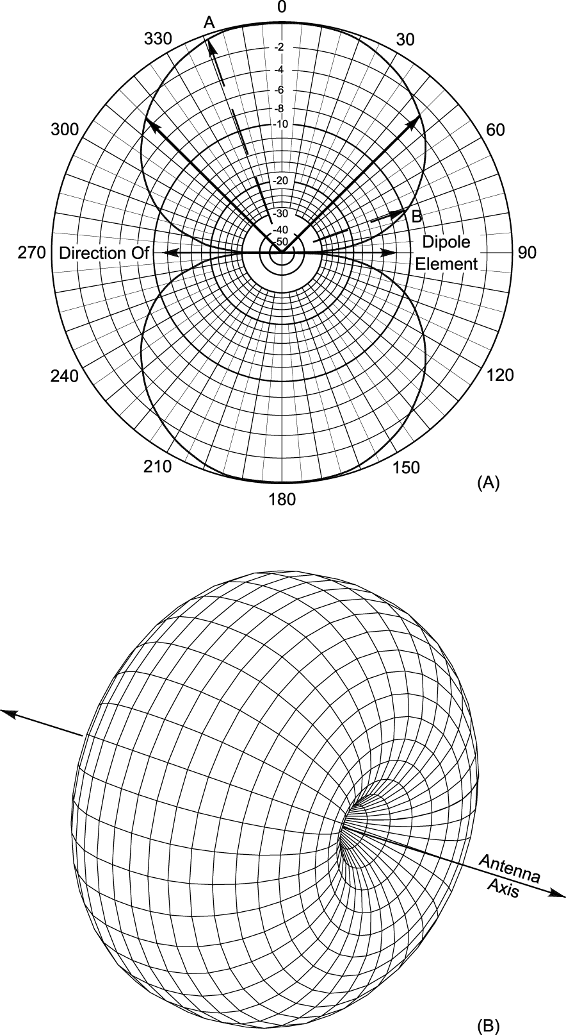
The Dipole
Radiates strongest broadside to the dipole, weakest off the ends
If oriented horizontally, the radiated waves are horizontally polarized
3D radiation pattern looks like a donut or bagel
This is a free-space picture
Notes:
Review radiation pattern if necessary. Discuss free-space as “absence of ground”.

Slide 147
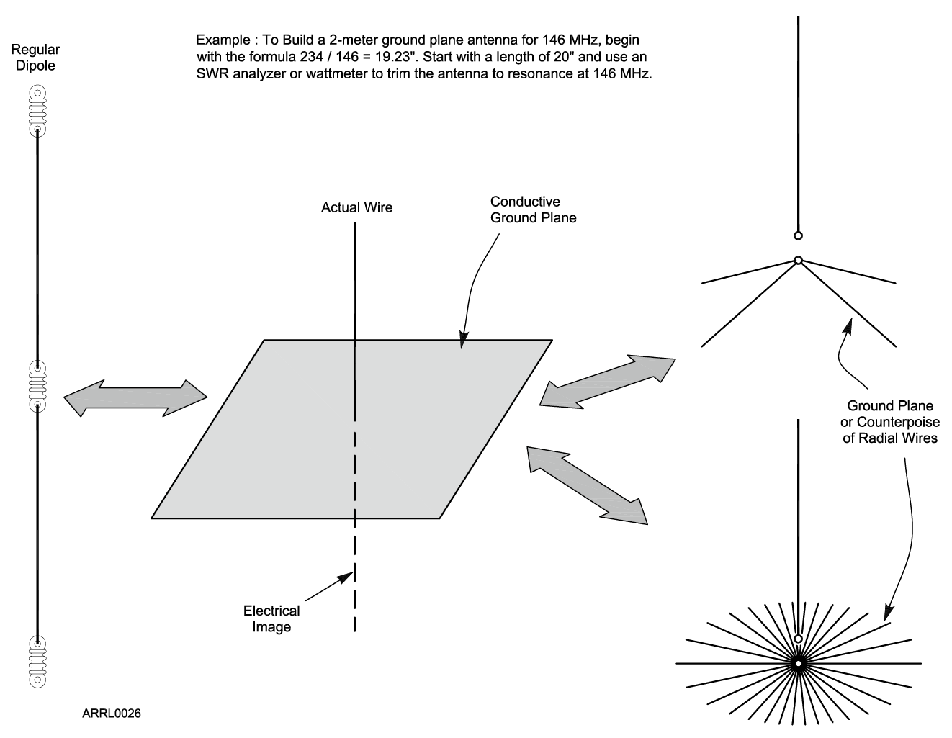
The Ground-Plane

Slide 148
The Ground-Plane
One-half of a dipole (1/4-wavelength long) oriented perpendicularly to a ground plane that acts as an “electrical mirror”
Replaces the dipole’s missing half
Any conducting surface can act as the ground-plane, including the ground!
Car roof or trunk, or other metal surface
Radial wires
Notes:
Show examples of ground-plane mag-mount antenna and maybe a homebrew ¼-wave whip for VHF/UHF.

Slide 149
The Rubber Duck
Coiled wire coated in tough plastic
Convenient size, rugged enough for handheld use
The radio and operator make up the ground plane
Small size equals compromise performance
Hold vertically to maximize range
Doesn’t work well inside vehicles due to metal body shielding signal
For mobile use, replace rubber duck with an external magnet-mount or permanent antenna
Notes:
Explain why the students will get better results from replacing a handheld’s rubber duck with a mag-mount or other external antenna whenever it is practical to do so.

Slide 150
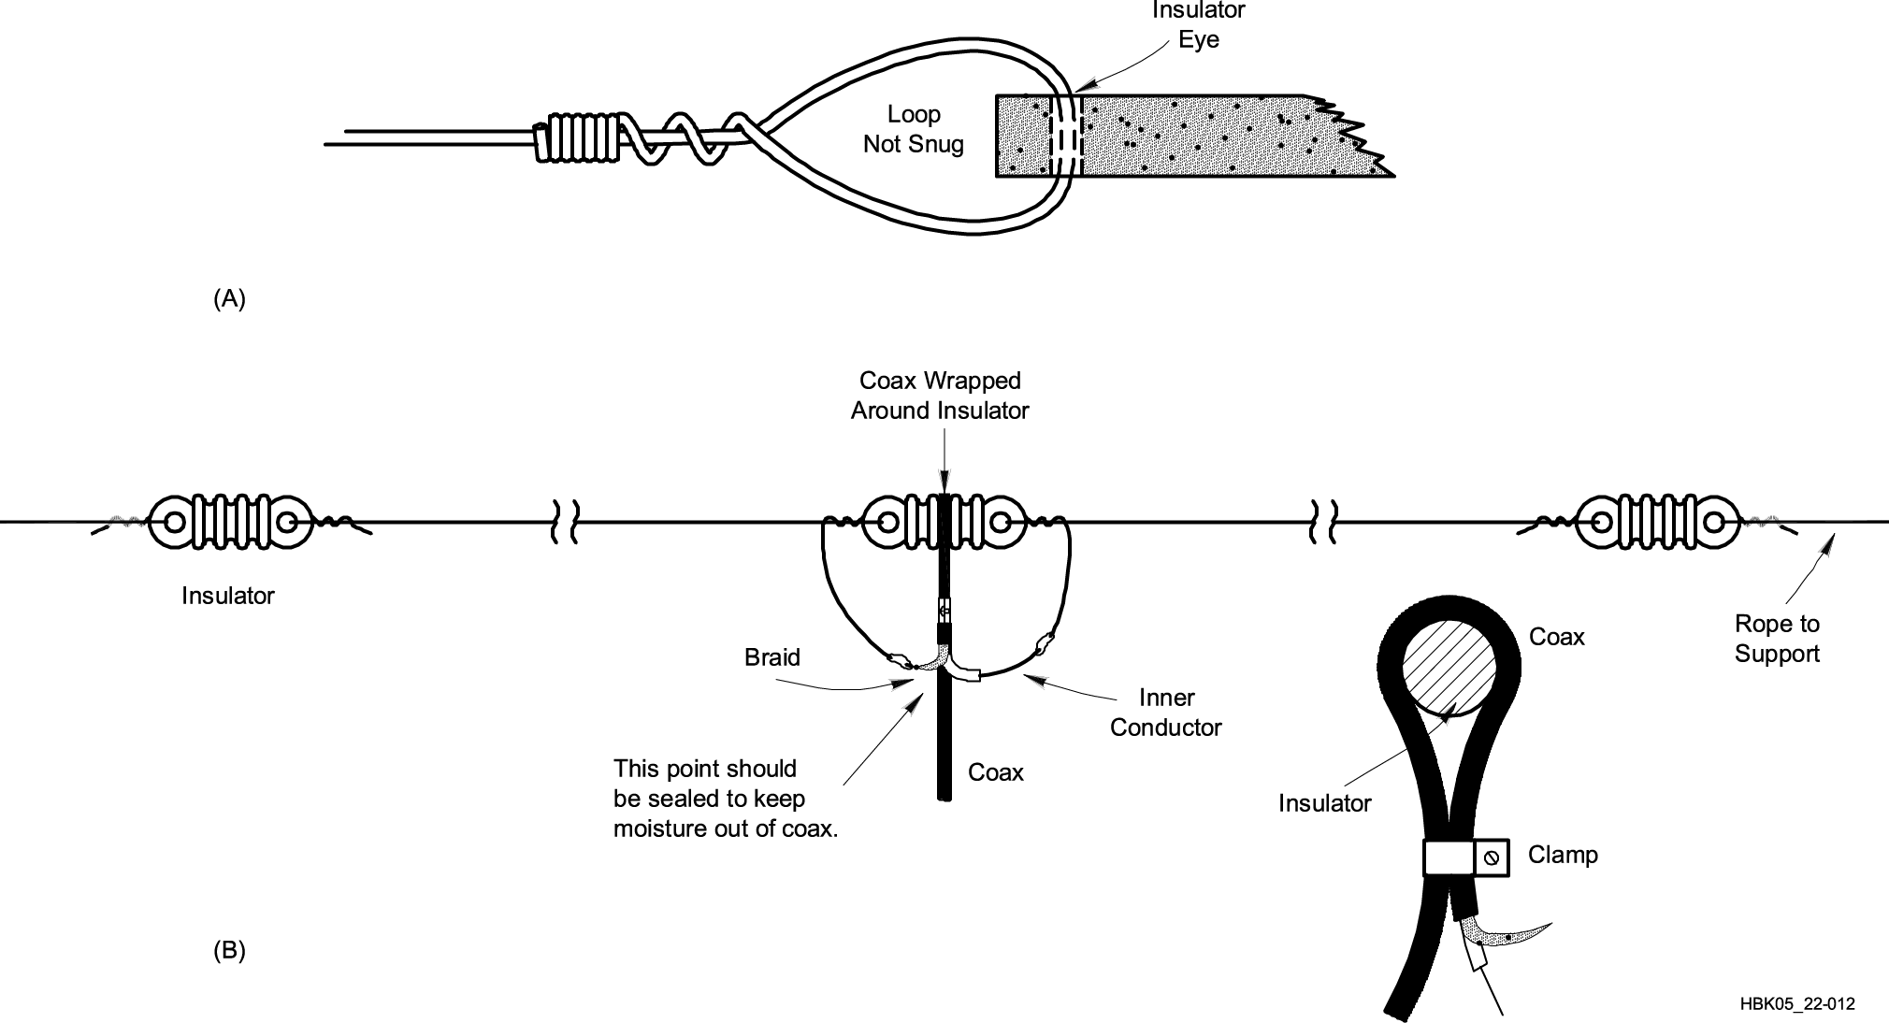
Dipole Construction
Start with excess length (490 / f) and adjust
To raise resonant frequency, shorten each half equally
Notes:
Mention that there are variations of the dipole antenna (inverted V, folded, off-center fed) and that there are advantages and disadvantages of each. Have a pre-made dipole and examples of insulators to show as examples.

Slide 151
Ground-Plane Construction
Length (in feet) usually estimated
234 / frequency (in MHz) – often short, start long and trim to length
Thickness of whip or rod also affects calculated length
Vertical ground-plane antennas are omni-directional
Mount mobile whips in center of roof or trunk for best coverage

Slide 152
Ground-Plane Construction
Lengthening a ¼-wavelength VHF/UHF ground-plane to ⁵/8 wavelengths focuses more signal toward the horizon which usually improves range.
At HF, vertical antenna size is quite large.
40 meter ¼-wavelength whip is about 32 feet
Inserting an inductor makes the antenna longer electrically
Reduces physical length required

Slide 153
Directional (Beam) Antennas
Beam antennas focus or direct RF energy in a desired direction.
Gain improves range
Reduces reception in unwanted directions
Reduces interference to and from other stations
Directional characteristics are the same for receiving as they are for transmitting.
Notes:
Go over the concept of gain again with the students and emphasize that there is no increase in power from the transmitter, only an apparent increase in power because the available power is focused or directed in the desired direction at the expense of that power that would have been transmitted in the un-desired directions.
Also note that the same is true when receiving signals. Noise and signals from unwanted directions are rejected.

Slide 154
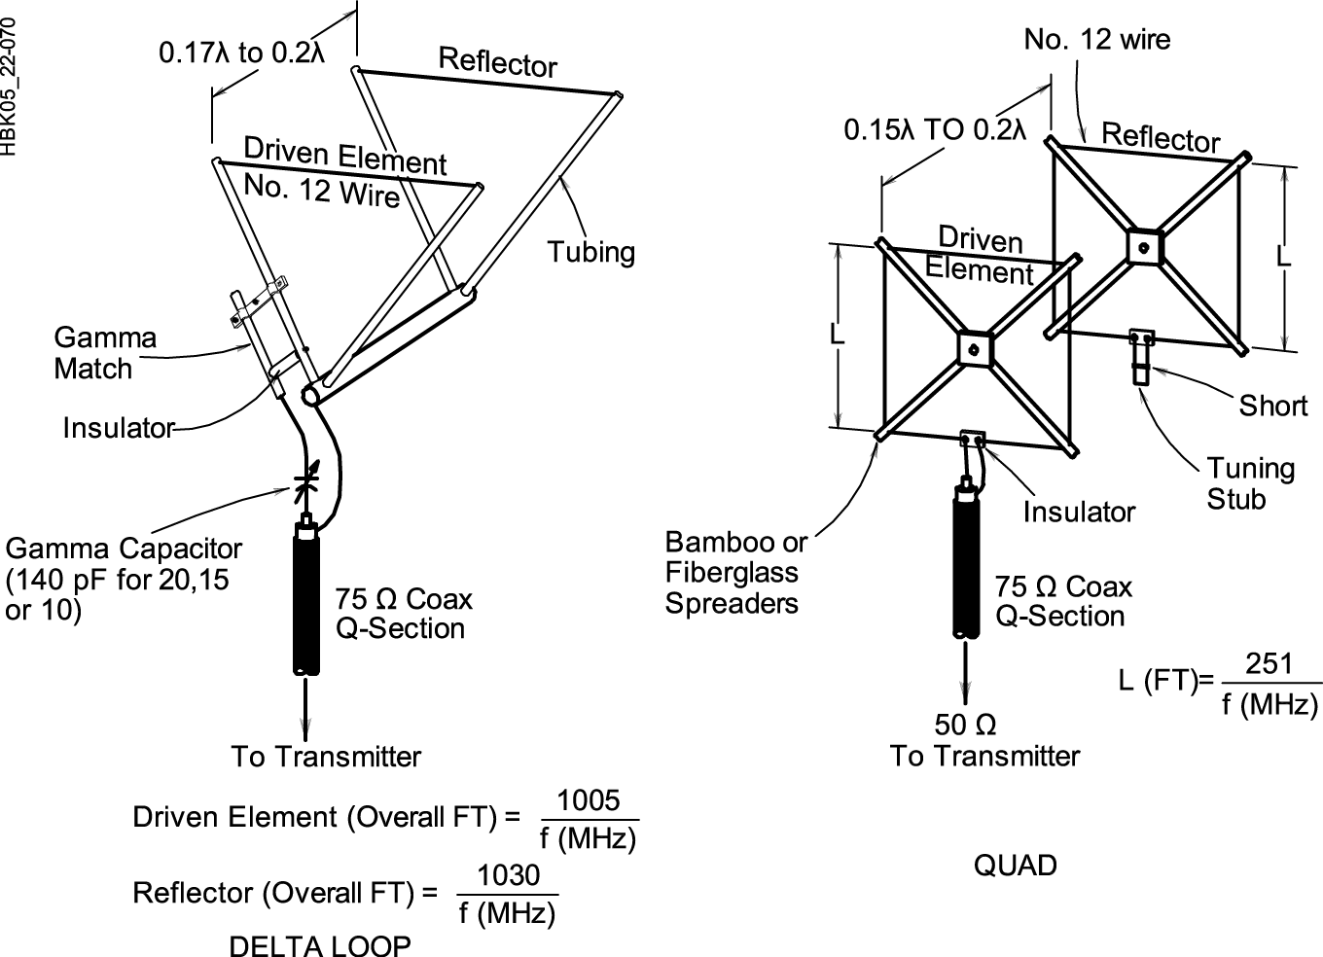
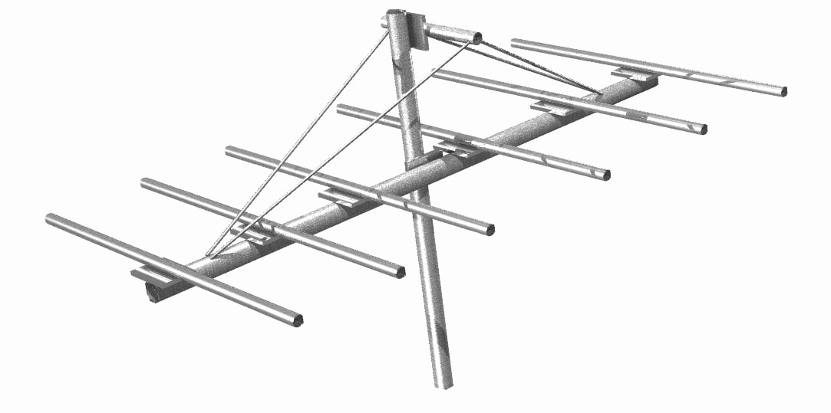
Directional (Beam) Antennas
Yagi
Quads
Notes:
Have on hand photos or examples of the two common beam antennas, Yagi and Quad to illustrate examples. A couple of QST or other ham magazines will have plenty of examples. Show the boom, driven element, and the parasitic elements (directors and reflectors).

Slide 155
Directional (Beam) Antennas
Used for “DXing” to obtain maximum range for contacts
Can be used at VHF/UHF to avoid multi-path and bypass obstructions
Use vertical elements for repeaters and FM simplex contacts
Use horizontal elements for CW and SSB contacts to reduce ground losses

Slide 156
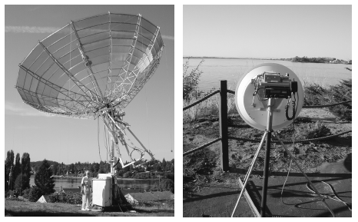
Directional (Beam) Antennas
At microwave frequencies (above 1 GHz) it becomes practical to use a dish antenna
Short wavelength
High gain
Small size
Notes:
Point out the big dish’s feed point above the surface of the dish. Explain that the dish uses a small feed antenna and a very large reflector – like a flashlight – to achieve focusing power and gain. The surface of the dish must be many wavelengths in diameter, making them impractical for amateurs below about 1 GHz.

Slide 157
Practical Feed Lines
Coaxial cables
Larger diameter cables have lower loss
Loss is measured in dB/foot
Loss increases with frequency
Keep water out! Protect the jacket from cuts and cracks and ultraviolet exposure.
Some cable is UV-rated
Notes:
Briefly discuss the purpose and application of each kind of feed line device that the students may encounter or read about in the literature. Physical examples of each type of feed line would be helpful during the presentation.

Slide 158
Common Coaxial Cables
RG-174: miniature, short connections only
RG-58: 0.2" OD, lossy at VHF/UHF
RG-8X: 0.25" OD, good through low VHF
RG-8/RG-213; 0.4" OD, used through UHF
Hard line: ½" to multiple inch OD, used through microwave
Most coax is 50 Ω or 75 Ω
Notes:
Go over the different types and grades of coax; examples to show would be helpful. Talk with the students about relative losses and power handling capabilities of each type of coax along with the price.

Slide 159
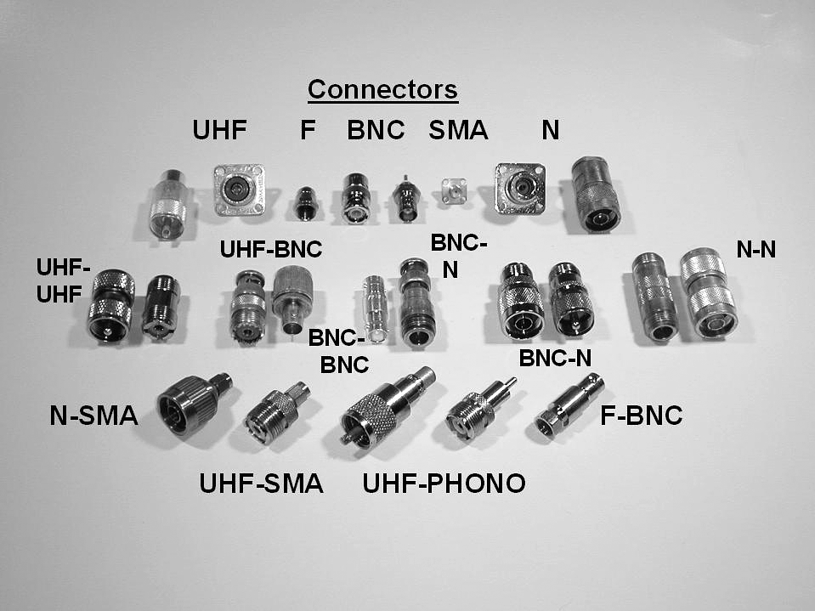
Coaxial Connectors
UHF
SO-239/PL-259
BNC
N
SMA
F (cable TV)
Notes:
Explain that there are connector “families” that all connect to each other, similarly to plumbing fittings. Explain what adapters are – also similar to plumbing.

Slide 160
Installing Coaxial Connectors
Soldering is the traditional way
Use rosin-core solder and avoid “cold” solder joints
See The Art of Soldering on the ARRL website
Crimp connectors are becoming widely used by hams
Obtain and learn to use proper crimping tools
Notes:
Show a soldered and a crimped PL-259.

Slide 161
Waterproofing Connectors
MUST be waterproofed for use outdoors
Type N are waterproof but still usually protected anyway
Use good-quality electrical tape first, then a layer of self-vulcanizing tape, then another covering of electrical tape
Air-core coaxial cable requires special connectors and techniques to waterproof
Notes:
Show a waterproofed PL-259/SO-239 connector or demonstrate the basic process.

Slide 162
Practical Feed Lines
Open-wire feed lines
Flexing will eventually break conductors
Vulnerable to abrasion and twisting
Rain, snow, and ice do affect the line
Lower loss than coax, generally
Higher impedance may complicate use
Notes:
Show examples of twinlead, window line, and plastic-covered ladder line.

Slide 163
Feed Line Equipment
Wattmeters
SWR Meters
Antenna Tuners
Antenna Analyzers
Notes:
Show physical examples of each device and give a short overview of the function of each.
Suggest that the SWR meter or antenna analyzer is probably one of the first pieces of test equipment they would want to add to their station. SWR meters are usually built in to HF transceivers and antenna tuners.

Slide 164
Wattmeters
Most wattmeters are directional
Sensitive to direction of power flow
Read forward and reflected power
Use a sensing element
SWR is computed from power values
Table or formula
Notes:
Relate SWR and forward/reflection power without getting into the equation. Note that higher reflected power means higher SWR. Wattmeters are generally more accurate (and more expensive) than SWR meters.

Slide 165
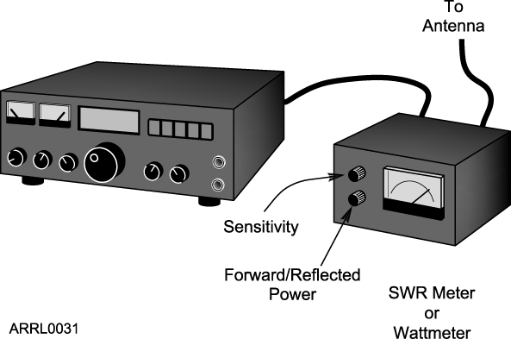
SWR Meters
Measure SWR directly by sensing power flow in the line
Usually installed at the transmitter
Notes:
SWR meters are really wattmeters in disguise but perform the calculation of SWR internally. The “calculation” can also be done as a meter’s calibrated scale.

Slide 166
Antenna Tuners
Don’t really “tune the antenna”
Transform impedances at the end of the feed line to 50 Ω which reduces SWR to 1:1
Antenna feed point impedance unchanged
Feed line SWR unchanged
Also called impedance matchers, transmatches, matchboxes, other trade names
Notes:
Talk about the “tune the antenna” misnomer so that students understand that the device is really an impedance converter not a “tuner.” Use the HRLM’s analogy of the gearbox as an impedance converter that changes one combination of torque and speed that make the engine happy to another combination to torque and speed that suit the wheels and road conditions.

Slide 167
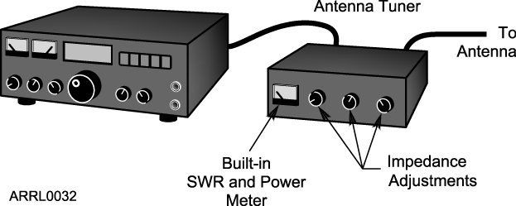
How to Use an Antenna Tuner
Transmit a low-power signal
Monitor the SWR meter
Adjust the tuner until minimum SWR is achieved

Slide 168
Antenna Analyzers
Low-power signal source, frequency counter, and SWR meter in one package
Makes antenna and cable measurements without transmitting a full-power signal
Available for HF through UHF and microwave
Very handy for adjusting and troubleshooting antennas and feed lines
Notes:
An antenna analyzer combines the SWR meter with the low-power signal source and frequency counter. This makes adjusting and troubleshooting far easier and more convenient than when using separate equipment at higher power.

Slide 169
Practice Questions

Slide 170
What is a beam antenna?
A. An antenna built from aluminum I-beams
B. An omnidirectional antenna invented by Clarence Beam
C. An antenna that concentrates signals in one direction
D. An antenna that reverses the phase of received signals
T9A01 HRLM (4-16)

Slide 171
What is a beam antenna?
A. An antenna built from aluminum I-beams
B. An omnidirectional antenna invented by Clarence Beam
C. An antenna that concentrates signals in one direction
D. An antenna that reverses the phase of received signals
T9A01 HRLM (4-16)

Slide 172
What type of antennas are the quad, Yagi, and dish?
A. Non-resonant antennas
B. Log periodic antennas
C. Directional antennas
D. Isotropic antennas
T9A06 HRLM (4-16)

Slide 173
What type of antennas are the quad, Yagi, and dish?
A. Non-resonant antennas
B. Log periodic antennas
C. Directional antennas
D. Isotropic antennas
T9A06 HRLM (4-16)

Slide 174
What antenna polarization is normally used for long-distance weak-signal CW and SSB contacts using the VHF and UHF bands?
A. Right-hand circular
B. Left-hand circular
C. Horizontal
D. Vertical
T3A03 HRLM (4-16)

Slide 175
What antenna polarization is normally used for long-distance weak-signal CW and SSB contacts using the VHF and UHF bands?
A. Right-hand circular
B. Left-hand circular
C. Horizontal
D. Vertical
T3A03 HRLM (4-16)

Slide 176
When using a directional antenna, how might your station be able to access a distant repeater if buildings or obstructions are blocking the direct line of sight path?
A. Change from vertical to horizontal polarization
B. Try to find a path that reflects signals to the repeater
C. Try the long path
D. Increase the antenna SWR
T3A05 HRLM (4-16)

Slide 177
When using a directional antenna, how might your station be able to access a distant repeater if buildings or obstructions are blocking the direct line of sight path?
A. Change from vertical to horizontal polarization
B. Try to find a path that reflects signals to the repeater
C. Try the long path
D. Increase the antenna SWR
T3A05 HRLM (4-16)

Slide 178
What is the electrical difference between RG-58 and RG-8 coaxial cable?
A. There is no significant difference between the two types
B. RG-58 cable has two shields
C. RG-8 cable has less loss at a given frequency
D. RG-58 cable can handle higher power levels
T9B10 HRLM (4 - 17)

Slide 179
What is the electrical difference between RG-58 and RG-8 coaxial cable?
A. There is no significant difference between the two types
B. RG-58 cable has two shields
C. RG-8 cable has less loss at a given frequency
D. RG-58 cable can handle higher power levels
T9B10 HRLM (4 - 17)

Slide 180
Which of the following is the most common cause for failure of coaxial cables?
A. Moisture contamination
B. Gamma rays
C. The velocity factor exceeds 1.0
D. Overloading
T7C09 HRLM (4-17)

Slide 181
Which of the following is the most common cause for failure of coaxial cables?
A. Moisture contamination
B. Gamma rays
C. The velocity factor exceeds 1.0
D. Overloading
T7C09 HRLM (4-17)

Slide 182
Why should the outer jacket of coaxial cable be resistant to ultraviolet light?
A. Ultraviolet resistant jackets prevent harmonic radiation
B. Ultraviolet light can increase losses in the cable’s jacket
C. Ultraviolet and RF signals can mix together, causing interference
D. Ultraviolet light can damage the jacket and allow water to enter the cable
T7C10 HRLM (4-17)

Slide 183
Why should the outer jacket of coaxial cable be resistant to ultraviolet light?
A. Ultraviolet resistant jackets prevent harmonic radiation
B. Ultraviolet light can increase losses in the cable’s jacket
C. Ultraviolet and RF signals can mix together, causing interference
D. Ultraviolet light can damage the jacket and allow water to enter the cable
T7C10 HRLM (4-17)

Slide 184
What is a disadvantage of air core coaxial cable when compared to foam or solid dielectric types?
A. It has more loss per foot
B. It cannot be used for VHF or UHF antennas
C. It requires special techniques to prevent water absorption
D. It cannot be used at below freezing temperatures
T7C11 HRLM (4-18)

Slide 185
What is a disadvantage of air core coaxial cable when compared to foam or solid dielectric types?
A. It has more loss per foot
B. It cannot be used for VHF or UHF antennas
C. It requires special techniques to prevent water absorption
D. It cannot be used at below freezing temperatures
T7C11 HRLM (4-18)

Slide 186
Which of the following types of solder is best for radio and electronic use?
A. Acid-core solder
B. Silver solder
C. Rosin-core solder
D. Aluminum solder
T7D08 HRLM (4-18)

Slide 187
Which of the following types of solder is best for radio and electronic use?
A. Acid-core solder
B. Silver solder
C. Rosin-core solder
D. Aluminum solder
T7D08 HRLM (4-18)

Slide 188
What is the characteristic appearance of a cold solder joint?
A. Dark black spots
B. A bright or shiny surface
C. A grainy or dull surface
D. A greenish tint
T7D09 HRLM (4-18)

Slide 189
What is the characteristic appearance of a cold solder joint?
A. Dark black spots
B. A bright or shiny surface
C. A grainy or dull surface
D. A greenish tint
T7D09 HRLM (4-18)

Slide 190
Which of the following connectors is most suitable for frequencies above 400 MHz?
A. A UHF (PL-259/SO-239) connector
B. A Type N connector
C. An RS-213 connector
D. A DB-25 connector
T9B06 HRLM (4-18)

Slide 191
Which of the following connectors is most suitable for frequencies above 400 MHz?
A. A UHF (PL-259/SO-239) connector
B. A Type N connector
C. An RS-213 connector
D. A DB-25 connector
T9B06 HRLM (4-18)

Slide 192
Which of the following is true of PL-259 type coax connectors?
A. They are preferred for microwave operation
B. They are water tight
C. The are commonly used at HF frequencies
D. They are a bayonet type connector
T9B07 HRLM (4-18)

Slide 193
Which of the following is true of PL-259 type coax connectors?
A. They are preferred for microwave operation
B. They are water tight
C. The are commonly used at HF frequencies
D. They are a bayonet type connector
T9B07 HRLM (4-18)

Slide 194
Why should coax connectors exposed to the weather be sealed against water intrusion?
A. To prevent an increase in feed line loss
B. To prevent interference to telephones
C. To keep the jacket from becoming loose
D. All of these choices are correct
T9B08 HRLM (4 - 18)

Slide 195
Why should coax connectors exposed to the weather be sealed against water intrusion?
A. To prevent an increase in feed line loss
B. To prevent interference to telephones
C. To keep the jacket from becoming loose
D. All of these choices are correct
T9B08 HRLM (4 - 18)

Slide 196
What is the proper location for an external SWR meter?
A. In series with the feed line, between the transmitter and antenna
B. In series with the station’s ground
C. In parallel with the push-to-talk line and the antenna
D. In series with the power cable, as close as possible to the radio
T4A05 HRLM (4-18)

Slide 197
What is the proper location for an external SWR meter?
A. In series with the feed line, between the transmitter and antenna
B. In series with the station’s ground
C. In parallel with the push-to-talk line and the antenna
D. In series with the power cable, as close as possible to the radio
T4A05 HRLM (4-18)

Slide 198
Which of the following instruments can be used to determine if an antenna is resonant at the desired operating frequency?
A. A VTVM
B. An antenna analyzer
C. A Q meter
D. A frequency counter
T7C02 HRLM (4-19)

Slide 199
Which of the following instruments can be used to determine if an antenna is resonant at the desired operating frequency?
A. A VTVM
B. An antenna analyzer
C. A Q meter
D. A frequency counter
T7C02 HRLM (4-19)

Slide 200
What instrument other than an SWR meter could you use to determine if a feed line and antenna are properly matched?
A. Voltmeter
B. Ohmmeter
C. Iambic pentameter
D. Directional wattmeter
T7C08 HRLM (4-19)

Slide 201
What instrument other than an SWR meter could you use to determine if a feed line and antenna are properly matched?
A. Voltmeter
B. Ohmmeter
C. Iambic pentameter
D. Directional wattmeter
T7C08 HRLM (4-19)

Slide 202
What is the major function of an antenna tuner (antenna coupler)?
A. It matches the antenna system impedance to the transceiver's output impedance
B. It helps a receiver automatically tune in weak stations
C. It allows an antenna to be used on both transmit and receive
D. It automatically selects the proper antenna for the frequency band being used
T9B04 HRLM (4-19)

Slide 203
What is the major function of an antenna tuner (antenna coupler)?
A. It matches the antenna system impedance to the transceiver's output impedance
B. It helps a receiver automatically tune in weak stations
C. It allows an antenna to be used on both transmit and receive
D. It automatically selects the proper antenna for the frequency band being used
T9B04 HRLM (4-19)

Slide 204
Technician License Course Chapter 5
Transmitters, Receivers and Transceivers

Slide 205
Generalized Transceiver Categories
Mobile VHF/UHF FM
Single Band VHF or UHF FM
Dual Band VHF/UHF FM
All Band HF and VHF/UHF
Multimode VHF/UHF CW/SSB/FM
Handheld (HT)
Notes:
In this lesson you will be comparing and contrasting the different kinds of equipment available. You can adjust these categories to meet your personal preferences and experiences. It would be a good idea to have examples of the different kinds of equipment. Catalogs from the major equipment retailers would be helpful to give an idea of cost. (The larger stores might send a box of catalogs for your students.)
Students will have a lot of questions about equipment. To keep from eating up class time, defer those questions not specifically related to a test question and have a followup session just about equipment with individual mentors.

Slide 206
Single-Band Mobile
Single-band, 2 meter is a good starter radio.
Operates from 13.8 volts dc, requires external power supply or car battery.
Requires an external antenna.
Can be operated mobile or as a base station.
Limited to frequency modulation (FM) and usually either 2 meters or 70 cm bands.
Up to approximately 50 watts output.
Notes:
Let students know that the term rig refers to the radio. The specific piece of equipment referenced comes from the context in which the word is used.
Good time to note that rigs requiring “12 volts” are usually designed to run at 13.8 volts. This is the voltage of a 12-volt vehicle electrical system with the engine running to charge the battery. Most of them begin to work poorly at or below 12 volts. If a “12 volt” power supply is purchased, be sure it will supply 13.8 volts under full load.

Slide 207
Dual-Band Mobile
Same as the single-band transceiver but includes additional band(s).
Most common are 2 meter and 70 cm bands.
Could add 6 meters, 222 MHz or 1.2 GHz.
Might have separate antenna connections for each band or a single connection for a dual-band antenna.
Notes:
Without getting into the complexities of duplexers, explain that some rigs are designed to have a completely separate antenna on each band. To use a multi-band antenna with these rigs requires an accessory called a duplexer to share a single multi-band antenna.

Slide 208
Multimode Transceiver
Nearly all HF rigs are multimode.
VHF multimode operates on FM plus AM/SSB/CW modes.
Required for “weak-signal” operation on VHF/UHF
More features add complexity and cost.
More flexibility will allow you to explore new modes as you gain experience.
Notes:
Explain what “weak-signal” operation is and that CW and SSB are used which provide better reception and intelligibility (copy) at lower levels than FM which is used for local operation. Signals are of all signal strengths and not necessarily weak.

Slide 209
Multiband Transceiver
Covers many bands – usually refers to coverage of HF + VHF/UHF.
Also covers all modes.
Frequently 100 watts on HF, some power limitations on high bands (25–50 watts).
Larger units have internal power supplies, smaller units need external power supply.

Slide 210
Handheld (HT) Transceiver
Small handheld FM units.
Can be single band or dual band.
Limited power (usually 5 watts or less).
Includes power (battery) and antenna in one package.
Often purchased as a starter rig but low power limits range.
Notes:
The HT is often viewed as the starter rig by new hams. Spend some time discussing the advantages and limitations of the HT, particularly for your area of operation.
Downplay the HT as a starter rig because of the often disappointing performance in remote or sparsely populated areas due to the low power and limited range.
Encourage new hams to consider the HT as the secondary radio and steer them toward the single-band or dual-band mobile transceiver as their first rig. If they decide on the HT, a mobile or external antenna is a must. Show them how to use a mobile antenna at home.

Slide 211
Handheld (HT) Transceiver
Single, dual and multiband versions (with increasing cost and complexity).
Some can receive outside the ham bands, such as aircraft, commercial FM broadcast, etc.
Very portable and self-contained.
Internal microphone and speaker.
Rubber duck antenna.
Battery powered.
Notes:
Spend some time discussing how to get the most performance out of the HT (hold the HT vertical, speak across the mic, not into the mic, etc.)
Also make sure that you cover that the trade-off between the convenience of a small, flexible antenna against reduced performance.

Slide 212
Handheld (HT) Accessories
Extra battery packs
AA cell pack useful in emergencies
Drop-in, fast charger
Extended antenna
External microphone and speaker
Headset

Slide 213
Side-by-Side
 | Single Band | Dual Band | Multimode | Multiband | Handheld
Freq Agility | Limited | Medium | Medium | Full | Limited
Functionality | Limited | Limited | Full | Full | Limited
Ease of Use | Easy | Medium | Medium | Difficult | Easy
Programming | Easy | Easy | Medium | Challenging | Easy/Medium
Power | Low | Low | Medium | High | Low
Cost | Low | Modest | High | High | Low
Notes:
Assess the various rigs side-by-side, you may want to adjust or rearrange this slide based on your assessment, audience, and local circumstances. Power levels are all green because it all depends on the area and what the ham wants to accomplish. This slide could generate a lot of good discussion questions, so let it.

Slide 214
Rig Vocabulary
We will now go through some jargon and vocabulary specific to the receive and transmit functions and controls of a transceiver.
Notes:
The following presentation serves a dual purpose. It will allow you to focus on vocabulary that might show up in the examination and also allow you to discuss with the students how you operate a transmitter and a receiver.

Slide 215
Band and Frequency Selection
Fundamental to all amateur transceivers
Can set by VFO (continuously variable) or by keypad “direct” entry
Memories can generally store:
Frequency
Mode
Filter and similar settings
Alphanumeric labels

Slide 216
Transmitter Controls and Functions
Main tuning display (both TX and RX):
Controls the frequency selection via the variable frequency oscillator (VFO).
Frequency can be set with a knob or keypad or programmed channels.
Variable frequency step size (tuning rate, resolution).
Rigs can usually store the information for two operating frequencies (VFO A and VFO B).

Slide 217
Transmitter Controls and Functions
Mode selector (both TX and RX for multimode rigs).
AM/FM/SSB (LSB or USB)
CW
Data (RTTY or PSK)
Could be automatic based on recognized band plan.

Slide 218
Transmitter Controls and Functions
Microphone controls
Gain
Controls transmitter sensitivity to your voice
Speech Compressor or Speech Processor
Increases microphone gain at lower sound levels to increase overall signal strength or “punch”
Too much gain or compression can cause problems
Splatter
Over-deviation
Over-modulation

Slide 219
Transmitter Controls and Functions
Automatic Level Control (ALC)
Automatically limits speech modulation, reducing transmitter over-drive
Causes some speech distortion
Do NOT use for data modes like PSK
Also prevents overdrive to external power amplifier

Slide 220
Microphones and Keys
Microphones (mic)
Hand mics
Desk mics
Preamplified desk mics
Speaker-mics
Headsets or boom-sets
Internal mics
Speak across the mic, not into the mic
Notes:
As you talk about microphones, give the students some techniques on how close to hold the mic to their mouth, how to speak into the mic (clearly and distinctly), and speak across the mic not directly into the mic (to prevent breath causing popping sounds). If another ham is available, demonstrate the effects on the air.

Slide 221
Microphones and Keys
Transmitter ON/OFF or “keying”
Push-to-Talk (PTT)
Voice-Operated Transmission (VOX)
VOX Gain
VOX Delay
Anti-VOX
Key jack
Manually-Operating Transmission (MOX or SEND - varies with manufacturer)
Notes:
Spend some time here explaining the various VOX controls and how they affect the control of the transceiver. Note that VOX can be used in a mobile environment to satisfy “hands-free” regulations.

Slide 222
Microphones and Keys
Morse code
Straight key
Electronic keyer and paddle
Semi-automatic (Bug)

Slide 223
Receiver Controls and Functions
AF Gain or Volume
Controls the audio level to the speaker or headphones
RF Gain
Controls the gain of the receiver’s input amplifiers
Attenuator
Reduces signal at the receiver input
Notes:
Show a basic block diagram of a receiver and show where each control takes effect. Point out that on HF, receivers have more than enough gain and don’t need to have all gain settings set to maximum. In fact, this makes the receiver too sensitive, leading to overload and distortion that sounds like interference. If a radio is available, show how reducing RF Gain quiets the receiver.

Slide 224
Receiver Controls and Functions
Receive Incremental Tuning (RIT)
“Fine tuning”
Adjusts receive frequency independent of main VFO
Doesn’t vary the transmitted frequency
Transmitters have a similar function (XIT)
Notes:
Show a basic block diagram of a receiver and show where each control takes effect. Point out that on HF, receivers have more than enough gain and don’t need to have all gain settings set to maximum. In fact, this makes the receiver too sensitive, leading to overload and distortion that sounds like interference. If a radio is available, show how reducing RF Gain quiets the receiver.

Slide 225
Receiver Controls and Functions
Automatic Gain Control (AGC)
Automatically limits the incoming signals during signal (voice) peaks to maintain even volume
Keeps strong signals from blasting the listener
Different time response settings:
Fast setting for CW
Slow settings for SSB and AM
Not used in FM because amplitude is constant

Slide 226
Receiver Controls and Functions
Squelch
Mutes audio to speaker when signal is not present
Used in FM primarily
Open – allows very weak signals to pass through (along with noise)
Tight – allows only the strongest signals to pass
Advance the squelch control until the noise just disappears
Also opened by MON (Monitor) control on handhelds

Slide 227
Receiver Controls and Functions
Filters (can be electronic modules or DSP)
IF filter
Used to narrow the width of signal that is passed.
Can attenuate adjacent signals.
Notch filter
Very narrow filter that can be moved over an interfering signal to attenuate it.

Slide 228
Receiver Controls and Functions
Noise blanker (NB)
Removes signal pulses that are frequently associated with random naturally generated noise
Can cause problems if strong signals are present
Noise reduction (NR)
DSP function to remove noise from signal
Noise limiter (NL)
Simply limits maximum volume of a noise pulse

Slide 229
Receiver Controls and Functions
Preamplifier
Increases sensitivity but can cause overload
Reception and Transmission Meter
In transmit, indicates output power or ALC or other functions as selected by switch setting
In receive, indicates signal strength
In “S” units S1 through S9 – S9 is strongest
Above S9, meter is calibrated in dB (i.e S9+10 dB)

Slide 230
Receiver Controls and Functions
Receivers can be limited to ham bands or can cover other parts of the spectrum.
General coverage receivers cover a wide area of the spectrum and can be used for shortwave listening (SWL).

Slide 231
Data Modes
Computer-to-computer communication
Specialized modems
Terminal Node Controller (TNC)
Multiple Protocol Controller (MPC)
Computer sound card software
Requires radio interface

Slide 232
Popular Digital Modes & Systems
Radioteletype (RTTY)
PSK31
FT8
MFSK
Packet Radio and PACTOR
CW (International Morse)
Automatic Packet Reporting System (APRS)
Winlink System

Slide 233
Popular Digital Modes
Error detection
Yes: Packet radio, MFSK
No: RTTY, PSK31
Error correction
MFSK (forward error correction or FEC)
Packet radio
Checksums and call signs
Retransmission or ARQ
Notes:
Explain the difference between error detection (the ability to determine that the data has an error) and error correction (the ability to correct the error from the received data (forward error correction – FEC) or by requesting a re-transmission (automatic repeat request – ARQ)

Slide 234
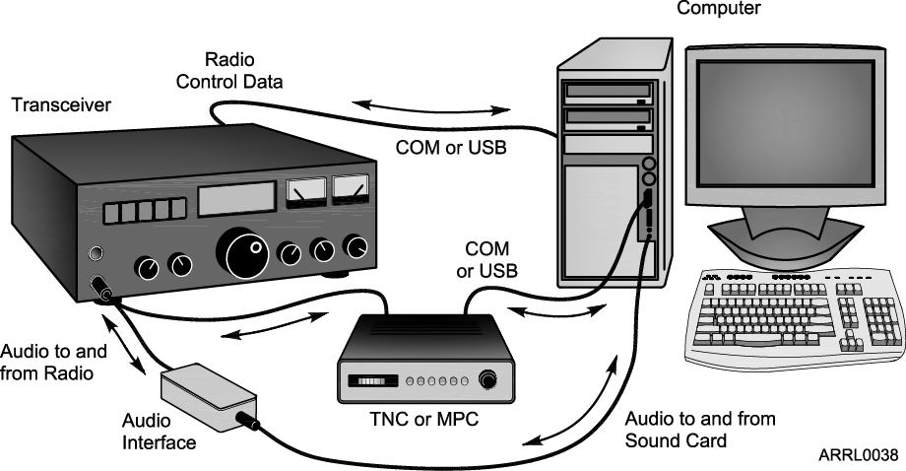
Data Station Setup
Notes:
Point out that a computer is an integral part of the amateur station and can be used for recordkeeping (logging, award tracking), sending and receiving CW, encoding and decoding digital modes, acting as a test instrument, controlling accessories, and more. (T4A02)

Slide 235
Internet Gateway
Notes:
Remind students that while the Internet and email can be accessed via ham radio, the rules prohibiting commercial traffic and content still apply. Ham radio is not for browsing the Internet! Email transferred via ham radio should never include commercial information, advertisements, etc.

Slide 236
Automatic Position Reporting System (APRS)
Notes:
Explain the APRS system and how it sends data from a GPS receiver (sometimes built into the radio) via packet radio to Internet gateways. The data sent by a station can then be viewed on maps like the one on the slide. APRS is used in support of public service activities as well as for individual tracking. APRS can also be used to send text messages.

Slide 237
What Happens During Radio Communication?
Transmitting (sending a signal):
Information (voice, data, video, commands, etc.) is converted to electronic form.
The information in electronic form is added to a radio wave.
The radio wave carrying the information is sent from the station antenna into space.

Slide 238
What Happens During Radio Communication?
Receiving:
The radio wave carrying the information is intercepted by the receiving station’s antenna.
The receiver extracts the information from the received wave.
The information is then presented to the user in a format that can be understood (sound, picture, words on a computer screen, response to a command, etc.).

Slide 239
What Happens During Radio Communication?
Adding and extracting the information can be simple or complex.
This makes ham radio fun…learning all about how radios work.
Don’t be intimidated. You will be required to only know the basics, but you can learn as much about the “art and science” of radio as you want.
Notes:
Note that radios can be very simple – for AM or CW – or very complex such as for digital modes. Show examples of a minimal low-power CW transmitter and a simple AM receiver.

Slide 240
Bandwidth
The carrier and sidebands have different frequencies, occupying a range of spectrum space.
The occupied range is the composite signal’s bandwidth.
Different types of modulation and information result in different signal bandwidths.
Notes:
Remind the students of the drawing in Module 2 that showed the signals arranged along the horizontal axis of the strength-versus-frequency graph. Ask them to recall how the receiver acted when being tuned across the signals, if that experiment was performed.

Slide 241
Adding Information – Modulation
When we add some information to the radio wave, (the carrier) we modulate the wave.
Turn the wave on and off (Morse code)
Speech or music
Data
Different modulation techniques vary different properties of the wave to add the information:
Amplitude, frequency, or phase
Notes:
You now need to make the jump from the discussion of radio spectrum to the concept of modulation. The important concept is understanding that modulation adds information to the carrier radio wave. There are different ways to add information to the carrier by varying different properties of the wave.

Slide 242
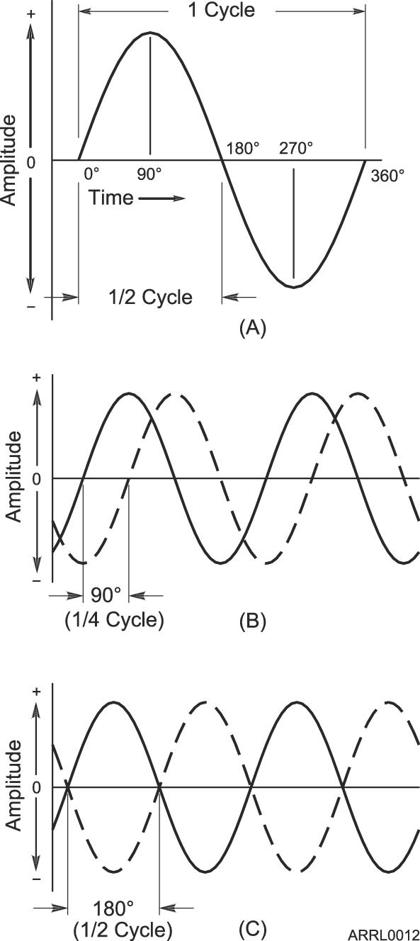
Phase
Along with frequency and period, another important property of waves is phase.
Phase is a position within a cycle.
Phase is also a relative position between two waves.
Notes:
Introduce the concept of phase as the position within a cycle or as a relative difference between two waves.
Note that phase is different from polarity, which is the convention that assigns positive and negative.

Slide 243
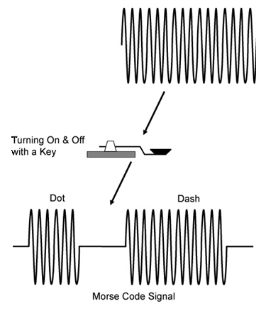
CW - Morse Code – On and Off

Slide 244
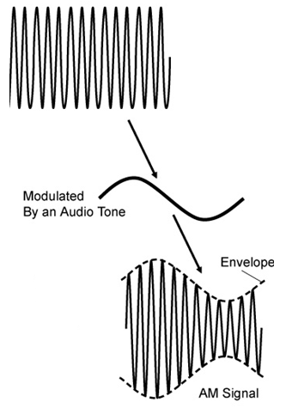
Amplitude Modulation (AM)
In AM, the amplitude of the carrier wave is modified in step with the waveform of the information (the tone shown here).
Notes:
The ARRL modulation board is an excellent resource that can be used to demonstrate the concept of modulation. This board uses amplitude modulation and demodulation circuits along with an oscilloscope to visually depict what happens during amplitude modulation.
If you have an oscilloscope, you can also use a regular ham transceiver to transmit into a dummy load. Connect the oscilloscope at the dummy load or to a wire wrapped several times around the coaxial cable to sample the output waveform.

Slide 245
Composite Signals
The process of adding information to an unmodulated radio wave creates additional signals called sidebands.
The sidebands and carrier work together to carry the information.
The combination of carrier and sidebands creates a composite signal.

Slide 246
Characteristics of Voice AM
AM signals consist of three components:
Carrier
Lower sideband (LSB)
Upper sideband (USB)
AM bandwidth is twice the information bandwidth.
Carrier
LSB
USB
Amplitude
799.4 800 800.6
Frequency (kHz)
AM signal being modulated by a 600 Hz tone
Notes:
Show how each of the sidebands is spaced equally from the carrier by the frequency of the tone information modulating the carrier. (800 – 0.6 = 799.4 kHz and 800 + 0.6 = 800.6 kHz)
Note the convention of presenting a single-frequency signal as a vertical line with the height of the line representing amplitude and horizontal position indicating frequency.
Review the abbreviations USB and LSB.
If asked, explain that for AM signals, the carrier is more powerful than either sideband and that is why the carrier line is higher. This is discussed later when SSB is introduced.

Slide 247
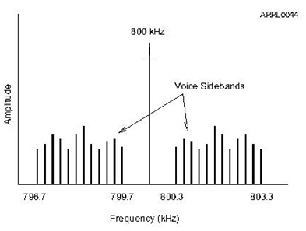
Characteristics of Voice Information
Sounds that make up voice are a complex mixture of multiple frequencies from 300–3000 Hz
Two mirror-image sets of sidebands are created, each up to 3000 Hz wide.
AM voice signal bandwidth 2 x 3000 Hz = 6000 Hz

Slide 248
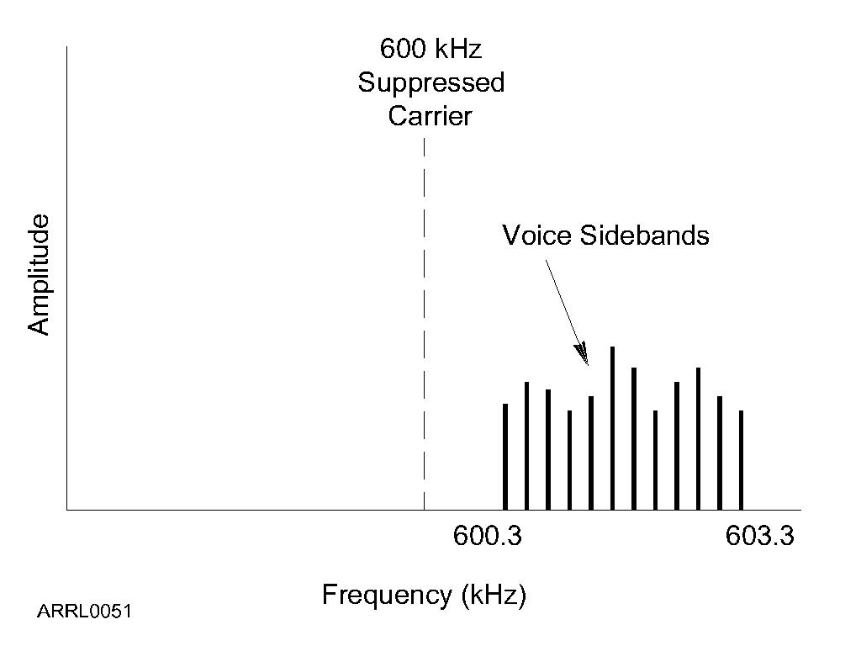
Single Sideband Modulation (SSB)
The two sets of voice sidebands carry duplicate information.
We can improve efficiency by transmitting only one sideband and reconstructing the missing carrier in the receiver.
SSB bandwidth is only 3000 Hz for voice signals.
Notes:
Note that above 10 MHz using USB is the standard, including on the VHF and UHF bands.
USB is also used on the 5 MHz band by rule.

Slide 249
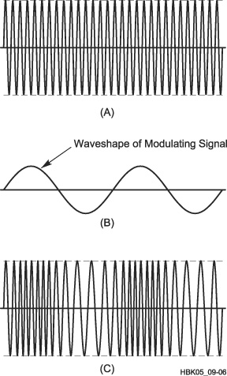
Frequency and Phase Modulation (FM and PM)
Instead of varying amplitude, if we use the information to vary the carrier’s frequency, frequency modulation (FM) is produced.
FM bandwidth (for voice) is between 5 and 15 kHz.
We can also shift the signal’s phase back and forth, creating phase modulation (PM) that is very similar to FM.
Notes:
Discuss the concept of deviation, the amount of frequency change from the carrier frequency determines the volume of the transmitted information. Discuss what happens if you over-deviate.
Also discuss that PM is produced by varying the phase of the carrier, creating a signal that is very similar to FM. Note that both FM and PM can be received by the same receiver although the effect on the extracted information is slightly different.
It is hard to distinguish between PM and FM. Don’t get into the dependence on amplitude and frequency of the modulating signal – it is not particularly important for the new ham.
This is a good opportunity to talk about the advantages and disadvantages of the different forms of modulation.

Slide 250
Typical Signal Bandwidths
Type of Signal | Typical Bandwidth
AM voice | 6 kHz
AM broadcast | 10 kHz
Commercial video broadcast | 6 MHz
SSB voice | 2 to 3 kHz
SSB digital | 500 to 3000 Hz (0.5 to 3 kHz)
CW | 150 Hz (0.15 kHz)
FM voice | 10 to 15 kHz
FM broadcast | 150 kHz

Slide 251
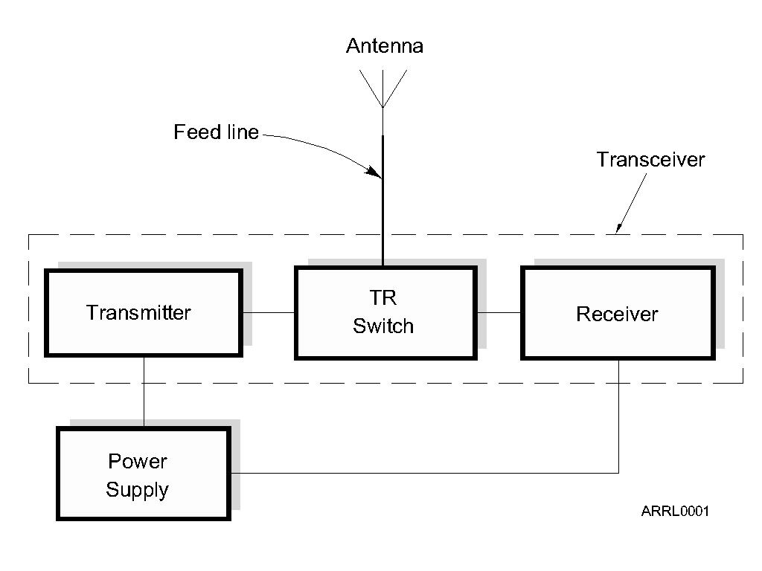
The Basic Transceiver
Combination of “transmitter” and “receiver”
Abbreviated “XCVR” (X = trans)
Antenna switched between transmitter and receiver by the TR switch
Notes:
Begin to work in bits of common jargon, like XCVR, so that students will have seen it. If you have pictures of older equipment, you can show them and compare to modern radios.

Slide 252
Transmit/Receive (TR) Switch
TR switch allows a single antenna to be switched to the transmitter when sending and to the receiver when receiving.
In a transceiver, the TR switch is inside the unit and operates automatically.
Transceivers cannot transmit and receive at the same time like a repeater.

Slide 253
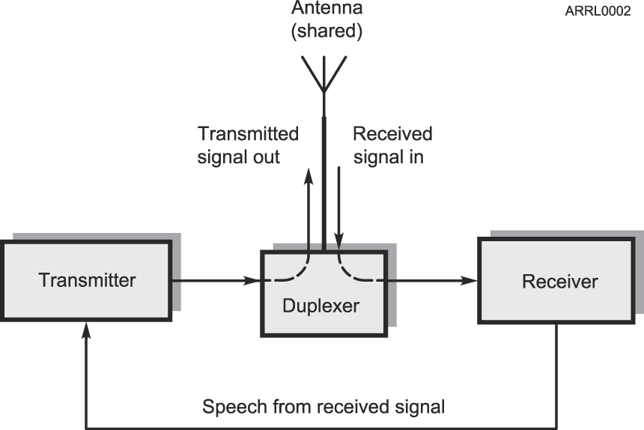
The Basic Repeater
Relays signals from low-power stations over a wide area
Simultaneously re-transmits received signal on the same band
TR switch replaced with duplexer which allows antenna to be shared without switching
Notes:
Contrast the duplexer with the TR switch in that the duplexer routes signals based on their frequency. The antenna is connected to both the transmitter and receiver at all times – there is no switching.

Slide 254
What Happens During Radio Communication? (Review)
Transmitting (sending a signal):
Information (voice, data, video, commands, etc.) is converted to electronic form.
The information in electronic form is added to a radio wave.
The radio wave carrying the information is sent from the station antenna into space.

Slide 255
What Happens During Radio Communication? (Review)
Receiving:
The radio wave carrying the information is intercepted by the receiving station’s antenna.
The receiver extracts the information from the received wave.
The information is then presented to the user in a format that can be understood (sound, picture, words on a computer screen, response to a command, etc.).

Slide 256
What Happens During Radio Communication? (Review)
Adding and extracting the information can be simple or complex.
This makes ham radio fun…learning all about how radios work.
Don’t be intimidated. You will be required to only know the basics, but you can learn as much about the “art and science” of radio as you want.
Notes:
Note that radios can be very simple – for AM or CW – or very complex such as for digital modes. Show examples of a minimal low-power CW transmitter and a simple AM receiver.

Slide 257
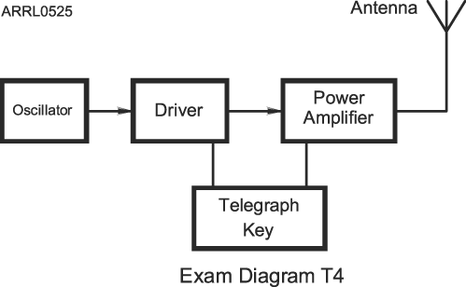
Simple Morse (CW) Transmitter Block Diagram
Notes:
Explain that each block is often called a “stage” and that signals generally progress from left to right.
Explain that a Driver is really just a low-power amplifier stage.

Slide 258
Filters
Circuits that act on signals differently according to their frequency.
Filters can reject, enhance, or modify signals.
Notes:
Although there are no questions on filters, they are so fundamental and widely encountered that this is a good opportunity to spend some time explaining the basic types.

Slide 259
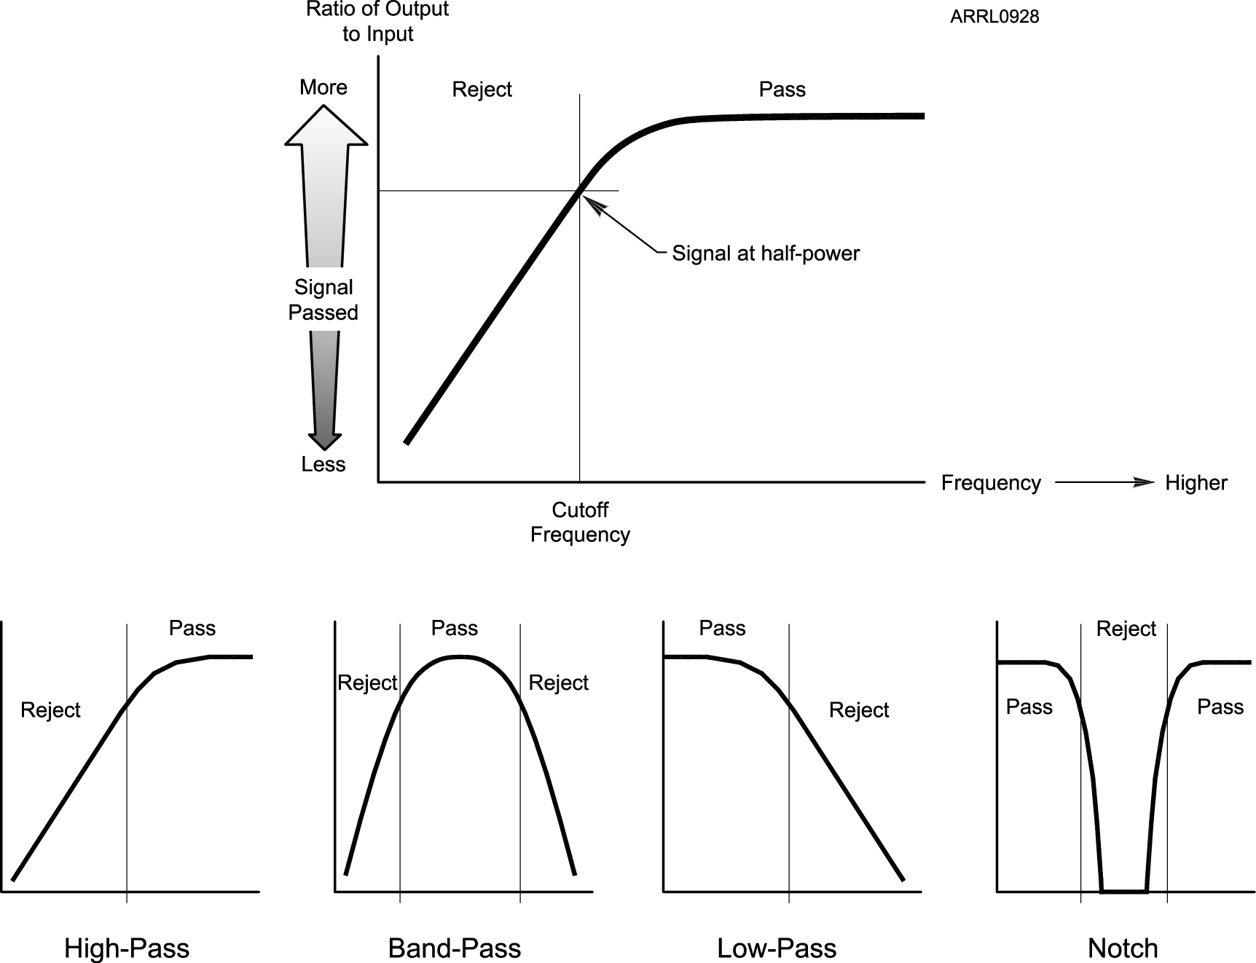
Types of Filters
Notes:
You can demonstrate the function of a filter by using an audio filter with a music source or spoken program. A radio with adjustable passband tuning or audio filters that is tuned to a clear, strong station will also work. Start with high-pass and low-pass. Change to band-pass and explain it as a combination of high- and low-pass. Then use the radio’s notch filter to remove a carrier or tone.

Slide 260
Adding Information - Modulation
When we add some information to the radio wave (the carrier), we modulate the wave.
Morse code (CW), speech, data
Different modulation techniques vary different properties of the wave to add the information:
Amplitude, frequency, or phase
Modulator and demodulator circuits
Modulators add information to an RF signal, demodulators recover the information
Notes:
Review the modulation coverage from Module 3. If you did not demonstrate modulation in Module 3, this would be a good time to do so.
Explain that modulation and demodulation are usually performed by specific circuits if modulation is performed electronically.
In a software-defined radio, modulation and demodulation are functions performed by a microprocessor on data but this is too advanced for the course. Be prepared to answer questions about SDR but do not spend significant class time explaining what it is.

Slide 261
Changing Frequency - Mixers
Signal frequencies can be changed by combining with another signal, called mixing
Also referred to as heterodyning
Two signals are combined in a mixer
Generates mixing product signals
Sum and difference of the input signals
Shifts frequency by adding or subtracting
Different than a multiplier which multiplies a signal’s frequency by some integer, usually 2 or 3
Notes:
You do not need to explain how a mixer works – only that it has two input signals and generates mixing products that are at the sum and difference of the input signal frequencies. Technically, there are an infinite number of output signals but again, this is not an appropriate topic for the course – keep it simple!

Slide 262
Sensitivity and Selectivity
Two essential tasks for a receiver:
Hear a signal and hear only one signal
Sensitivity is a measure of how well the receiver can detect weak signals
Selectivity is a measure of the receiver’s ability to discriminate between signals
Preamplifiers make a receiver more sensitive
Preamplifiers added between antenna and receiver
Notes:
Students will probably understand sensitivity already. Selectivity is best explained with a demonstration using wide and narrow filters or recording showing how filters can be used to eliminate or greatly reduce unwanted signals on nearby frequencies, leaving the desired signal clear and easy to understand.
Most preamps students will encounter are inside the radio. Explain that they are connected between the receiver’s antenna input and the rest of the receiver. If an external preamp is available, explain that it is installed as close to the antenna as possible and may have its own transmit-receive switch to allow use of the same antenna on receive and transmit, just like a TR switch in a transceiver.

Slide 263
Transverter
Short for “transceiving converter” (XVTR)
Converts a transceiver to operate on another band
Usually to a higher frequency
External mixers shift frequency
Typical examples
HF SSB/CW at 28 MHz converted to/from 222 MHz
VHF SSB/CW at 144 MHz converted to/from 10 GHz
Notes:
Download and show some product descriptions and photos for transverters. Note that transverters allow use of sophisticated transceiver features on bands for which it would be expensive to purchase a separate radio. A photo of a VHF/UHF rover station with several transverters would be interesting.

Slide 264
Practice Questions

Slide 265
Which of the following is a form of amplitude modulation?
A. Spread spectrum
B. Packet radio
C. Single sideband
D. Phase shift keying (PSK)
T8A01 HRLM (5 - 3)

Slide 266
Which of the following is a form of amplitude modulation?
A. Spread spectrum
B. Packet radio
C. Single sideband
D. Phase shift keying (PSK)
T8A01 HRLM (5 - 3)

Slide 267
What type of modulation is most commonly used for VHF packet radio transmissions?
A. FM
B. SSB
C. AM
D. PSK
T8A02 HRLM (5 - 4)

Slide 268
What type of modulation is most commonly used for VHF packet radio transmissions?
A. FM
B. SSB
C. AM
D. PSK
T8A02 HRLM (5 - 4)

Slide 269
Which type of voice mode is most often used for long-distance (weak signal) contacts on the VHF and UHF bands?
A. FM
B. DRM
C. SSB
D. PM
T8A03 HRLM (5 - 4)

Slide 270
Which type of voice mode is most often used for long-distance (weak signal) contacts on the VHF and UHF bands?
A. FM
B. DRM
C. SSB
D. PM
T8A03 HRLM (5 - 4)

Slide 271
Which type of modulation is most commonly used for VHF and UHF voice repeaters?
A. AM
B. SSB
C. PSK
D. FM
T8A04 HRLM (5 - 4)

Slide 272
Which type of modulation is most commonly used for VHF and UHF voice repeaters?
A. AM
B. SSB
C. PSK
D. FM
T8A04 HRLM (5 - 4)

Slide 273
What is an advantage of single sideband (SSB) over FM for voice transmissions?
A. SSB signals are easier to tune
B. SSB signals are less susceptible to interference
C. SSB signals have narrower bandwidth
D. All of these choices are correct
T8A07 HRLM (5 - 4)

Slide 274
What is an advantage of single sideband (SSB) over FM for voice transmissions?
A. SSB signals are easier to tune
B. SSB signals are less susceptible to interference
C. SSB signals have narrower bandwidth
D. All of these choices are correct
T8A07 HRLM (5 - 4)

Slide 275
Which of the following types of emission has the narrowest bandwidth?
A. FM voice
B. SSB voice
C. CW
D. Slow-scan TV
T8A05 HRLM (5 - 5)

Slide 276
Which of the following types of emission has the narrowest bandwidth?
A. FM voice
B. SSB voice
C. CW
D. Slow-scan TV
T8A05 HRLM (5 - 5)

Slide 277
Which sideband is normally used for 10 meter HF, VHF, and UHF single-sideband communications?
A. Upper sideband
B. Lower sideband
C. Suppressed sideband
D. Inverted sideband
T8A06 HRLM (5 - 5)

Slide 278
Which sideband is normally used for 10 meter HF, VHF, and UHF single-sideband communications?
A. Upper sideband
B. Lower sideband
C. Suppressed sideband
D. Inverted sideband
T8A06 HRLM (5 - 5)

Slide 279
What is the approximate bandwidth of a single sideband (SSB) voice signal?
A. 1 kHz
B. 3 kHz
C. 6 kHz
D. 15 kHz
T8A08 HRLM (5 - 5)

Slide 280
What is the approximate bandwidth of a single sideband (SSB) voice signal?
A. 1 kHz
B. 3 kHz
C. 6 kHz
D. 15 kHz
T8A08 HRLM (5 - 5)

Slide 281
What is the approximate bandwidth of a VHF repeater FM phone signal?
A. Less than 500 Hz
B. About 150 kHz
C. Between 10 and 15 kHz
D. Between 50 and 125 kHz
T8A09 HRLM (5 - 5)

Slide 282
What is the approximate bandwidth of a VHF repeater FM phone signal?
A. Less than 500 Hz
B. About 150 kHz
C. Between 10 and 15 kHz
D. Between 50 and 125 kHz
T8A09 HRLM (5 - 5)

Slide 283
What is the typical bandwidth of analog fast-scan TV transmissions on the 70 centimeter band?
A. More than 10 MHz
B. About 6 MHz
C. About 3 MHz
D. About 1 MHz
T8A10 HRLM (5 - 5)

Slide 284
What is the typical bandwidth of analog fast-scan TV transmissions on the 70 centimeter band?
A. More than 10 MHz
B. About 6 MHz
C. About 3 MHz
D. About 1 MHz
T8A10 HRLM (5 - 5)

Slide 285
What is the approximate maximum bandwidth required to transmit a CW signal?
A. 2.4 kHz
B. 150 Hz
C. 1000 Hz
D. 15 kHz
T8A11 HRLM (5 - 5)

Slide 286
What is the approximate maximum bandwidth required to transmit a CW signal?
A. 2.4 kHz
B. 150 Hz
C. 1000 Hz
D. 15 kHz
T8A11 HRLM (5 - 5)

Slide 287
Which of the following can be used to enter the operating frequency on a modern transceiver?
A. The keypad or VFO knob
B. The CTCSS or DTMF encoder
C. The Automatic Frequency Control
D. All of these choices are correct
T4B02 HRLM (5-6)

Slide 288
Which of the following can be used to enter the operating frequency on a modern transceiver?
A. The keypad or VFO knob
B. The CTCSS or DTMF encoder
C. The Automatic Frequency Control
D. All of these choices are correct
T4B02 HRLM (5-6)

Slide 289
What is the primary purpose of a dummy load?
A. To prevent the radiation of signals when making tests
B. To prevent over-modulation of your transmitter
C. To improve the efficiency of an antenna
D. To improve the signal to noise ratio of your receiver
T7C01 HRLM (5-7)

Slide 290
What is the primary purpose of a dummy load?
A. To prevent the radiation of signals when making tests
B. To prevent over-modulation of your transmitter
C. To improve the efficiency of an antenna
D. To improve the signal to noise ratio of your receiver
T7C01 HRLM (5-7)

Slide 291
Why should you not set your transmit frequency to be exactly at the edge of an amateur band or sub-band?
A. To allow for calibration error in the transmitter frequency display
B. So that modulation sidebands do not extend beyond the band edge
C. To allow for transmitter frequency drift
D. All of these choices are correct
FCC Rule: [97.101(a), 97.301(a-e)] T1B09 HRLM (5 - 7)

Slide 292
Why should you not set your transmit frequency to be exactly at the edge of an amateur band or sub-band?
A. To allow for calibration error in the transmitter frequency display
B. So that modulation sidebands do not extend beyond the band edge
C. To allow for transmitter frequency drift
D. All of these choices are correct
FCC Rule: [97.101(a), 97.301(a-e)] T1B09 HRLM (5 - 7)

Slide 293
What does a dummy load consist of?
A. A high-gain amplifier and a TR switch
B. A non-inductive resistor and a heat sink
C. A low voltage power supply and a DC relay
D. A 50 ohm reactance used to terminate transmission
T7C12 HRLM (5-7)

Slide 294
What does a dummy load consist of?
A. A high-gain amplifier and a TR switch
B. A non-inductive resistor and a heat sink
C. A low voltage power supply and a DC relay
D. A 50 ohm reactance used to terminate transmission
T7C12 HRLM (5-7)

Slide 295
What is a way to enable quick access to a favorite frequency on your transceiver?
A. Enable the CTCSS tones
B. Store the frequency in a memory channel
C. Disable the CTCSS tones
D. Use the scan mode to select the desired frequency
T4B04 HRLM (5-7)

Slide 296
What is a way to enable quick access to a favorite frequency on your transceiver?
A. Enable the CTCSS tones
B. Store the frequency in a memory channel
C. Disable the CTCSS tones
D. Use the scan mode to select the desired frequency
T4B04 HRLM (5-7)

Slide 297
What is meant by the term "PTT"?
A. Pre-transmission tuning to reduce transmitter harmonic emission
B. Precise tone transmissions used to limit repeater access to only certain signals
C. A primary transformer tuner use to match antennas
D. The push to talk function which switches between receive and transmit
T7A07 HRLM (5-7)

Slide 298
What is meant by the term "PTT"?
A. Pre-transmission tuning to reduce transmitter harmonic emission
B. Precise tone transmissions used to limit repeater access to only certain signals
C. A primary transformer tuner use to match antennas
D. The push to talk function which switches between receive and transmit
T7A07 HRLM (5-7)

Slide 299
What does the term "RIT" mean?
A. Receiver Input Tone
B. Receiver Incremental Tuning
C. Rectifier Inverter Test
D. Remote Input Transmitter
T4B07 HRLM (5-7)

Slide 300
What does the term "RIT" mean?
A. Receiver Input Tone
B. Receiver Incremental Tuning
C. Rectifier Inverter Test
D. Remote Input Transmitter
T4B07 HRLM (5-7)

Slide 301
What is an electronic keyer?
A. A device for switching antennas from transmit to receive
B. A device for voice activated switching from receive to transmit
C. A device that assists in manual sending of Morse code
D. An interlock to prevent unauthorized use of a radio
T8D14 HRLM (5 - 7)

Slide 302
What is an electronic keyer?
A. A device for switching antennas from transmit to receive
B. A device for voice activated switching from receive to transmit
C. A device that assists in manual sending of Morse code
D. An interlock to prevent unauthorized use of a radio
T8D14 HRLM (5 - 7)

Slide 303
What can you do if you are told your FM handheld or mobile transceiver is over-deviating?
A. Talk louder into the microphone
B. Let the transceiver cool off
C. Change to a higher power level
D. Talk farther away from the microphone
T7B01 HRLM (5-8)

Slide 304
What can you do if you are told your FM handheld or mobile transceiver is over-deviating?
A. Talk louder into the microphone
B. Let the transceiver cool off
C. Change to a higher power level
D. Talk farther away from the microphone
T7B01 HRLM (5-8)

Slide 305
What may happen if a transmitter is operated with the microphone gain set too high?
A. The output power might be too high
B. The output signal might become distorted
C. The frequency might vary
D. The SWR might increase
T4B01 HRLM (5-8)

Slide 306
What may happen if a transmitter is operated with the microphone gain set too high?
A. The output power might be too high
B. The output signal might become distorted
C. The frequency might vary
D. The SWR might increase
T4B01 HRLM (5-8)

Slide 307
What might be the problem if a repeater user says your transmissions are breaking up on voice peaks?
A. You have the incorrect offset
B. You need to talk louder
C. You are talking too loudly
D. Your transmit power is too high
T2B05 HRLM (5 - 8)

Slide 308
What might be the problem if a repeater user says your transmissions are breaking up on voice peaks?
A. You have the incorrect offset
B. You need to talk louder
C. You are talking too loudly
D. Your transmit power is too high
T2B05 HRLM (5 - 8)

Slide 309
What is the purpose of the squelch control on a transceiver?
A. To set the highest level of volume desired
B. To set the transmitter power level
C. To adjust the Automatic Gain Control
D. To mute receiver output noise when no signal is being received
T4B03 HRLM (5-9)

Slide 310
What is the purpose of the squelch control on a transceiver?
A. To set the highest level of volume desired
B. To set the transmitter power level
C. To adjust the Automatic Gain Control
D. To mute receiver output noise when no signal is being received
T4B03 HRLM (5-9)

Slide 311
What is the advantage of having multiple receive bandwidth choices on a multimode transceiver?
A. Permits monitoring several modes at once
B. Permits noise or interference reduction by selecting a bandwidth matching the mode
C. Increases the number of frequencies that can be stored in memory
D. Increases the amount of offset between receive and transmit frequencies
T4B08 HRLM (5-9)

Slide 312
What is the advantage of having multiple receive bandwidth choices on a multimode transceiver?
A. Permits monitoring several modes at once
B. Permits noise or interference reduction by selecting a bandwidth matching the mode
C. Increases the number of frequencies that can be stored in memory
D. Increases the amount of offset between receive and transmit frequencies
T4B08 HRLM (5-9)

Slide 313
Which of the following is an appropriate receive filter bandwidth for minimizing noise and interference for SSB reception?
A. 500 Hz
B. 1000 Hz
C. 2400 Hz
D. 5000 Hz
T4B09 HRLM (5-9)

Slide 314
Which of the following is an appropriate receive filter bandwidth for minimizing noise and interference for SSB reception?
A. 500 Hz
B. 1000 Hz
C. 2400 Hz
D. 5000 Hz
T4B09 HRLM (5-9)

Slide 315
Which of the following is an appropriate receive filter bandwidth for minimizing noise and interference for CW reception?
A. 500 Hz
B. 1000 Hz
C. 2400 Hz
D. 5000 Hz
T4B10 HRLM (5-9)

Slide 316
Which of the following is an appropriate receive filter bandwidth for minimizing noise and interference for CW reception?
A. 500 Hz
B. 1000 Hz
C. 2400 Hz
D. 5000 Hz
T4B10 HRLM (5-9)

Slide 317
What is the function of automatic gain control, or AGC?
A. To keep received audio relatively constant
B. To protect an antenna from lightning
C. To eliminate RF on the station cabling
D. an asymmetric goniometer control used for antenna matching
T4B11 HRLM (5-9)

Slide 318
What is the function of automatic gain control, or AGC?
A. To keep received audio relatively constant
B. To protect an antenna from lightning
C. To eliminate RF on the station cabling
D. an asymmetric goniometer control used for antenna matching
T4B11 HRLM (5-9)

Slide 319
Which term describes the ability of a receiver to detect the presence of a signal?
A. Linearity
B. Sensitivity
C. Selectivity
D. Total Harmonic Distortion
T7A01 HRLM (5-9)

Slide 320
Which term describes the ability of a receiver to detect the presence of a signal?
A. Linearity
B. Sensitivity
C. Selectivity
D. Total Harmonic Distortion
T7A01 HRLM (5-9)

Slide 321
Which term describes the ability of a receiver to discriminate between multiple signals?
A. Discrimination ratio
B. Sensitivity
C. Selectivity
D. Harmonic Distortion
T7A04 HRLM (5-9)

Slide 322
Which term describes the ability of a receiver to discriminate between multiple signals?
A. Discrimination ratio
B. Sensitivity
C. Selectivity
D. Harmonic Distortion
T7A04 HRLM (5-9)

Slide 323
Where is an RF preamplifier installed?
A. Between the antenna and receiver
B. At the output of the transmitter's power amplifier
C. Between a transmitter and antenna tuner
D. At the receiver's audio output
T7A11 HRLM (5-9)

Slide 324
Where is an RF preamplifier installed?
A. Between the antenna and receiver
B. At the output of the transmitter's power amplifier
C. Between a transmitter and antenna tuner
D. At the receiver's audio output
T7A11 HRLM (5-9)

Slide 325
What is the function of the SSB/CW-FM switch on a VHF power amplifier?
A. Change the mode of the transmitted signal
B. Set the amplifier for proper operation in the selected mode
C. Change the frequency range of the amplifier to operate in the proper portion of the band
D. Reduce the received signal noise
T7A09 HRLM (5 - 10)

Slide 326
What is the function of the SSB/CW-FM switch on a VHF power amplifier?
A. Change the mode of the transmitted signal
B. Set the amplifier for proper operation in the selected mode
C. Change the frequency range of the amplifier to operate in the proper portion of the band
D. Reduce the received signal noise
T7A09 HRLM (5 - 10)

Slide 327
What device increases the low-power output from a handheld transceiver?
A. A voltage divider
B. An RF power amplifier
C. An impedance network
D. All of these choices are correct
T7A10 HRLM (5-10)

Slide 328
What device increases the low-power output from a handheld transceiver?
A. A voltage divider
B. An RF power amplifier
C. An impedance network
D. All of these choices are correct
T7A10 HRLM (5-10)

Slide 329
Which of the following could be used to remove power line noise or ignition noise?
A. Squelch
B. Noise blanker
C. Notch filter
D. All of these choices are correct
T4B12 HRLM (5 - 10)

Slide 330
Which of the following could be used to remove power line noise or ignition noise?
A. Squelch
B. Noise blanker
C. Notch filter
D. All of these choices are correct
T4B12 HRLM (5 - 10)

Slide 331
Which of the following would reduce ignition interference to a receiver?
A. Change frequency slightly
B. Decrease the squelch setting
C. Turn on the noise blanker
D. Use the RIT control
T4B05 HRLM (5-10)

Slide 332
Which of the following would reduce ignition interference to a receiver?
A. Change frequency slightly
B. Decrease the squelch setting
C. Turn on the noise blanker
D. Use the RIT control
T4B05 HRLM (5-10)

Slide 333
Which of the following controls could be used if the voice pitch of a single-sideband signal seems too high or low?
A. The AGC or limiter
B. The bandwidth selection
C. The tone squelch
D. The receiver RIT or clarifier
T4B06 HRLM (5-10)

Slide 334
Which of the following controls could be used if the voice pitch of a single-sideband signal seems too high or low?
A. The AGC or limiter
B. The bandwidth selection
C. The tone squelch
D. The receiver RIT or clarifier
T4B06 HRLM (5-10)

Slide 335
What device converts the RF input and output of a transceiver to another band?
A. High-pass filter
B. Low-pass filter
C. Transverter
D. Phase converter
T7A06 HRLM (5-11)

Slide 336
What device converts the RF input and output of a transceiver to another band?
A. High-pass filter
B. Low-pass filter
C. Transverter
D. Phase converter
T7A06 HRLM (5-11)

Slide 337
What code is used when sending CW in the amateur bands?
A. Baudot
B. Hamming
C. International Morse
D. All of these choices are correct
T8D09 HRLM (5-11)

Slide 338
What code is used when sending CW in the amateur bands?
A. Baudot
B. Hamming
C. International Morse
D. All of these choices are correct
T8D09 HRLM (5-11)

Slide 339
How might a computer be used as part of an amateur radio station?
A. For logging contacts and contact information
B. For sending and/or receiving CW
C. For generating and decoding digital signals
D. All of these choices are correct
T4A02 HRLM (5-11)

Slide 340
How might a computer be used as part of an amateur radio station?
A. For logging contacts and contact information
B. For sending and/or receiving CW
C. For generating and decoding digital signals
D. All of these choices are correct
T4A02 HRLM (5-11)

Slide 341
Which of the following operating activities is supported by digital mode software in the WSJT suite?
A. Moonbounce or Earth-Moon-Earth
B. Weak-signal propagation beacons
C. Meteor scatter
D. All of these choices are correct
T8D10 HRLM (5 - 12)

Slide 342
Which of the following operating activities is supported by digital mode software in the WSJT suite?
A. Moonbounce or Earth-Moon-Earth
B. Weak-signal propagation beacons
C. Meteor scatter
D. All of these choices are correct
T8D10 HRLM (5 - 12)

Slide 343
Which of the following best describes Broadband-Hamnet™, also referred to as a high-speed multi-media network?
A. An amateur-radio-based data network using commercial Wi-Fi gear with modified firmware
B. A wide-bandwidth digital voice mode employing DRM protocols
C. A satellite communications network using modified commercial satellite TV hardware
D. An internet linking protocol used to network repeaters
T8D12 HRLM (5 - 12)

Slide 344
Which of the following best describes Broadband-Hamnet™, also referred to as a high-speed multi-media network?
A. An amateur-radio-based data network using commercial Wi-Fi gear with modified firmware
B. A wide-bandwidth digital voice mode employing DRM protocols
C. A satellite communications network using modified commercial satellite TV hardware
D. An internet linking protocol used to network repeaters
T8D12 HRLM (5 - 12)

Slide 345
What is FT8?
A. A wideband FM voice mode
B. A digital mode capable of operating in low signal-to-noise conditions that transmits on 15-second intervals
C. An eight channel multiplex mode for FM repeaters
D. A digital slow scan TV mode with forward error correction and automatic color compensation
T8D13 HRLM (5 - 12)

Slide 346
What is FT8?
A. A wideband FM voice mode
B. A digital mode capable of operating in low signal-to-noise conditions that transmits on 15-second intervals
C. An eight channel multiplex mode for FM repeaters
D. A digital slow scan TV mode with forward error correction and automatic color compensation
T8D13 HRLM (5 - 12)

Slide 347
Which of the following is a digital communications mode?
A. Packet radio
B. IEEE 802.11
C. JT65
D. All of these choices are correct
T8D01 HRLM (5 - 12)

Slide 348
Which of the following is a digital communications mode?
A. Packet radio
B. IEEE 802.11
C. JT65
D. All of these choices are correct
T8D01 HRLM (5 - 12)

Slide 349
What does the term APRS mean?
A. Automatic Packet Reporting System
B. Associated Public Radio Station
C. Auto Planning Radio Set-up
D. Advanced Polar Radio System
T8D02 HRLM (5-13)

Slide 350
What does the term APRS mean?
A. Automatic Packet Reporting System
B. Associated Public Radio Station
C. Auto Planning Radio Set-up
D. Advanced Polar Radio System
T8D02 HRLM (5-13)

Slide 351
Which of the following devices is used to provide data to the transmitter when sending automatic position reports from a mobile amateur radio station?
A. The vehicle speedometer
B. A WWV receiver
C. A connection to a broadcast FM sub-carrier receiver
D. A Global Positioning System receiver
T8D03 HRLM (5-13)

Slide 352
Which of the following devices is used to provide data to the transmitter when sending automatic position reports from a mobile amateur radio station?
A. The vehicle speedometer
B. A WWV receiver
C. A connection to a broadcast FM sub-carrier receiver
D. A Global Positioning System receiver
T8D03 HRLM (5-13)

Slide 353
What does the abbreviation PSK mean?
A. Pulse Shift Keying
B. Phase Shift Keying
C. Packet Short Keying
D. Phased Slide Keying
T8D06 HRLM (5-13)

Slide 354
What does the abbreviation PSK mean?
A. Pulse Shift Keying
B. Phase Shift Keying
C. Packet Short Keying
D. Phased Slide Keying
T8D06 HRLM (5-13)

Slide 355
Which of the following may be included in packet transmissions?
A. A check sum which permits error detection
B. A header which contains the call sign of the station to which the information is being sent
C. Automatic repeat request in case of error
D. All of these choices are correct
T8D08 HRLM (5-13)

Slide 356
Which of the following may be included in packet transmissions?
A. A check sum which permits error detection
B. A header which contains the call sign of the station to which the information is being sent
C. Automatic repeat request in case of error
D. All of these choices are correct
T8D08 HRLM (5-13)

Slide 357
What is an ARQ transmission system?
A. A special transmission format limited to video signals
B. A system used to encrypt command signals to an amateur radio satellite
C. A digital scheme whereby the receiving station detects errors and sends a request to the sending station to retransmit the information
D. A method of compressing the data in a message so more information can be sent in a shorter time
T8D11 HRLM (5-13)

Slide 358
What is an ARQ transmission system?
A. A special transmission format limited to video signals
B. A system used to encrypt command signals to an amateur radio satellite
C. A digital scheme whereby the receiving station detects errors and sends a request to the sending station to retransmit the information
D. A method of compressing the data in a message so more information can be sent in a shorter time
T8D11 HRLM (5-13)

Slide 359
Which of the following is an application of APRS (Automatic Packet Reporting System)?
A. Providing real-time tactical digital communications in conjunction with a map showing the locations of stations
B. Showing automatically the number of packets transmitted via PACTOR during a specific time interval
C. Providing voice over Internet connection between repeaters
D. Providing information on the number of stations signed into a repeater
T8D05 HRLM (5-14)

Slide 360
Which of the following is an application of APRS (Automatic Packet Reporting System)?
A. Providing real-time tactical digital communications in conjunction with a map showing the locations of stations
B. Showing automatically the number of packets transmitted via PACTOR during a specific time interval
C. Providing voice over Internet connection between repeaters
D. Providing information on the number of stations signed into a repeater
T8D05 HRLM (5-14)

Slide 361
What name is given to an amateur radio station that is used to connect other amateur stations to the Internet?
A. A gateway
B. A repeater
C. A digipeater
D. A beacon
T8C11 HRLM (5-15)

Slide 362
What name is given to an amateur radio station that is used to connect other amateur stations to the Internet?
A. A gateway
B. A repeater
C. A digipeater
D. A beacon
T8C11 HRLM (5-15)

Slide 363
Which computer sound card port is connected to a transceiver’s headphone or speaker output for operating digital modes?
A. Headphone output
B. Mute
C. Microphone or line input
D. PCI or SDI
T4A04 HRLM (5 - 15)

Slide 364
Which computer sound card port is connected to a transceiver’s headphone or speaker output for operating digital modes?
A. Headphone output
B. Mute
C. Microphone or line input
D. PCI or SDI
T4A04 HRLM (5 - 15)

Slide 365
Which of the following connections might be used between a voice transceiver and a computer for digital operation?
A. Receive and transmit mode, status, and location
B. Antenna and RF power
C. Receive audio, transmit audio, and push-to-talk (PTT)
D. NMEA GPS location and DC power
T4A06 HRLM (5 - 15)

Slide 366
Which of the following connections might be used between a voice transceiver and a computer for digital operation?
A. Receive and transmit mode, status, and location
B. Antenna and RF power
C. Receive audio, transmit audio, and push-to-talk (PTT)
D. NMEA GPS location and DC power
T4A06 HRLM (5 - 15)

Slide 367
How is a computer’s sound card used when conducting digital communications using a computer?
A. The sound card communicates between the computer CPU and the video display
B. The sound card records the audio frequency for video display
C. The sound card provides audio to the microphone input and converts received audio to digital form
D. All of these choices are correct
T4A07 HRLM (5-15)

Slide 368
How is a computer’s sound card used when conducting digital communications using a computer?
A. The sound card communicates between the computer CPU and the video display
B. The sound card records the audio frequency for video display
C. The sound card provides audio to the microphone input and converts received audio to digital form
D. All of these choices are correct
T4A07 HRLM (5-15)

Slide 369
Technician License Course Chapter 5
Power Sources and RF Interference (RFI)

Slide 370
Power Supplies
Most modern radio equipment runs from 12 volts dc.
Actual preferred voltage is 13.8 volts.
Household ac power is 120 volts ac.
Power supplies convert 120 volts ac to regulated, filtered dc.
If you use a lab-type 12 volt power supply, be sure it is adjustable to 13.8 volts.
Notes:
Note “power supply” generally refers to converting ac to dc of any voltage, not just 120 VAC to 12 VDC.
Review the reason for “12 V” radios actually requiring 13.8 V – see module 11.

Slide 371
Types of Power Supplies
Linear:
Use iron transformers
Heavy (physically)
Do not emit RF, generally immune to strong RF
Switching:
Electronics instead of transformers
Lightweight and small
Can emit RF if not properly filtered
Check product reviews
Notes:
Examples of the different kinds of supplies would be helpful to illustrate the differences.
Note that small switching supplies for consumer appliances (under-cabinet lighting, battery charging, etc) are often prolific generators of noise that interferes with communication. Replacing the supply with a linear type will eliminate the noise.

Slide 372
Power Supply Ratings Voltage and Current
Continuous duty – how much current can be supplied continuously.
Intermittent duty – how much current can be supplied for short surges, such as on voice peaks.
Regulation – how well the power supply maintains a constant output voltage.

Slide 373
Mobile Power Wiring Safety
Car batteries hold lots of energy – shorting a battery could cause a fire.
Special requirements for safe car wiring:
Fuse both positive and negative leads.
Connect radio’s negative lead to negative terminal or engine block ground strap.
Use grommets or protective sleeves to protect wires.
Don’t assume all metal in the car is grounded; modern cars are as much plastic as metal.
Notes:
The concept of fusing both the negative and positive leads of the equipment in a car installation might take some explanation. The vehicle manufacturer may have specific recommendations in a service bulletin – check with the dealer or an audio/radio installation shop.

Slide 374
Batteries
Create current through a chemical reaction
Individual cells connected in series or parallel
Cell chemistry determines voltage per cell
Battery types
Disposable (primary batteries)
Rechargeable (secondary batteries)
Storage
Energy capabilities rated in Ampere-hours
Amps X time (at a constant voltage)
Notes:
Examples of the different kinds of batteries will help illustrate this point. Discuss how the different kinds of batteries are used.

Slide 375
Battery Charging
Some batteries can be recharged, some cannot.
Use the proper charger for the battery being charged.
Batteries will lose capacity with each cycle.
Best if batteries are maintained fully charged.
Over-charging will cause heating and could damage the battery.
Lead-acid batteries release explosive hydrogen during charging or rapid discharge so adequate ventilation is required.
Notes:
Make sure the students understand that hazards from hydrogen buildup are real and ventilation is a must – no kidding!

Slide 376
Battery Charging
Automobiles can be a good emergency power source by recharging batteries
A 12-volt lead-acid station battery can be recharged by connecting it to an automobile’s electrical system
Monitor battery temperature
Make sure battery is well-ventilated

Slide 377
Handheld Transceivers
Battery packs – packages of several individual rechargeable batteries connected together.
NiCd (nickel-cadmium)
NiMH (nickel-metal hydride)
Li-ion (lithium-ion)
For emergencies, have a battery pack that can use disposable batteries (AA size).
Notes:
Show several types of battery packs, compare weight and other parameters such as self-discharge, total battery capacity, etc. Note that if commercial power is unavailable, conventional pack chargers won’t work. Need AA-cell packs or chargers that can run from a vehicle’s battery system.

Slide 378
Radio Frequency Interference (RFI)
Signals that interfere with radio reception.
Interference can be FROM your station or TO your station.
Solving the problem might take a little detective work!

Slide 379
Types of RFI
Direct detection – offending signals get into the electronic circuits to cause interference.
Overload – strong signal that overwhelms the ability of the receiver to reject it.
RF Current – can be picked up by cables of consumer equipment.
Transmitted harmonics – must be filtered out at the transmitter.
Notes:
Discuss briefly with the students these basic types of RFI, and how they might be able to distinguish between them. At the same time, discuss some techniques they might use to mitigate the effects of the interference.
Direct detection usually affects consumer electronic devices (telephones and audio equipment). Poor shielding allows signal to be received within the equipment. Very difficult to eliminate.
Common-mode RF current detection caused by consumer equipment cables picking up RF. Generally not the fault of the amateur. Can be mitigated by proper installation, filters, ferrite bead chokes, etc. ARRL Handbook RFI chapter has examples of using filters and chokes.
Overload – usually seen in fringe reception areas of TV signals. Not as much a problem now days with digital, satellite, and cable TV. Usually the problem can be mitigated by reducing transmitter power or filtering to reject transmitted signal at the receiver.
Harmonics – not common, sometimes due to misadjusted transmitter or bad connection in antenna system

Slide 380
Filters
Filters attenuate (reduce) signals
High-pass – reduce low-frequency signals
Low-pass – reduce high-frequency signals
Band-pass – only pass a range of signals
Notch – reduces a narrow range of signals
Selecting correct filter requires understanding the source of the interference
Notes:
Cover basics of each type of filter, show examples of receiving filters and a transmitting low-pass filter for HF.

Slide 381
Ferrite Chokes
Creates impedance (opposition to ac) on cables and wires.
Can be used to block RF current that causes interference to entertainment equipment, microphones, monitors, amplifiers, etc.
Wind cable through ferrite core to create blocking impedance.
Notes:
Show examples of ferrite cores and snap-on cores. Emphasize that the proper type (mix) of ferrite must be used.

Slide 382
Cable TV Interference
Usually the result of broken shielding somewhere in the cable.
Loose connections
Broken connections
Corroded connections
Usually solved by proper cable maintenance by cable supplier.
Notes:
Note that ham signals can interfere with cable channels or vice versa.

Slide 383
Noise Sources
Electrical arcs (motors, thermostats, electric fences, neon signs)
Power lines
Motor vehicle ignitions or alternators
Switching power supplies
Computers, networks and TV sets
Notes:
Discuss with the students other sources of interfering noise and give them techniques on how to seek out the source of the noise. In many cases of the fixed noise, simply turning off the potentially offending appliance will help identify the source. Power line noise mitigation is the responsibility of the power company. Motor vehicle ignition noise is generally short lived unless it is coming from the ham’s vehicle. Grounding and filtering in many of these cases will mitigate the noise.
Show students the ARRL website pages on interference.

Slide 384
RFI Guidelines
Operate your equipment properly.
Eliminate interference in your own home.
Use good station building practices to eliminate unwanted signals.
Shielded wire and cables
Shielded equipment
Good connections and filters

Slide 385
Dealing with RFI
Take interference complaints seriously.
Make sure that you’re really not the cause (demonstrate that you don’t interfere within your own home).
Offer to help eliminate the RFI, even if you are not at fault.
Consult ARRL RFI Resources for help and assistance.

Slide 386
Part 15 Rules
Applies only to unlicensed devices
Unlicensed devices may not interfere with licensed services, such as amateur radio
Unlicensed devices must accept any interference they receive from licensed services
RFI from and to unlicensed devices is the responsibility of the users of such devices

Slide 387
What the Rules Say
Bottom line – If your station is operating properly, you are protected against interference complaints
BUT – Be a good neighbor because they are probably not familiar with Part 15 rules and regulations
Notes:
Discuss with the students that though the law is probably on their side, their neighbors will not understand that and they will hold the ham responsible for the interference. It takes diplomacy to deal with RFI complaints.

Slide 388
Electrical Safety Grounding and Circuit Protection (in the Home)
Make sure your home is “up to code.”
Most ham equipment does not require special wiring or circuits.
Use 3-wire power cords.
Use circuit breakers, circuit breaker outlets, or Ground Fault Interrupter (GFI) circuit breakers.
Use proper fuse or circuit breaker size.
Don’t overload single outlets.
Notes:
It would be a good idea to show the students a properly wired 3-prong plug using proper color code wiring.

Slide 389
RF “Grounding”
Not the same as ac safety grounding
“Bonding” is more accurate
Keep all equipment at the same RF voltage
Current will not flow between pieces of equipment which can cause RF feedback
Minimizes RF “hot spots” (RF burns)
Use solid strap or wire for best RF connection
Notes:
Note that using coax braid is not recommended for RF connections/grounding because once removed from the jacket it begins to lose contact between the braid wires and they also start to oxidize. Use strap or solid wire.

Slide 390
Practice Questions

Slide 391
What must be considered to determine the minimum current capacity needed for a transceiver power supply?
A. Efficiency of the transmitter at full power output
B. Receiver and control circuit power
C. Power supply regulation and heat dissipation
D. All of these choices are correct
T4A01 HRLM (5 - 16)

Slide 392
What must be considered to determine the minimum current capacity needed for a transceiver power supply?
A. Efficiency of the transmitter at full power output
B. Receiver and control circuit power
C. Power supply regulation and heat dissipation
D. All of these choices are correct
T4A01 HRLM (5 - 16)

Slide 393
How much voltage does a mobile transceiver typically require?
A. About 12 volts
B. About 30 volts
C. About 120 volts
D. About 240 volts
T5A06 HRLM (5-16)

Slide 394
How much voltage does a mobile transceiver typically require?
A. About 12 volts
B. About 30 volts
C. About 120 volts
D. About 240 volts
T5A06 HRLM (5-16)

Slide 395
What type of circuit controls the amount of voltage from a power supply?
A. Regulator
B. Oscillator
C. Filter
D. Phase inverter
T6D05 HRLM (5-16)

Slide 396
What type of circuit controls the amount of voltage from a power supply?
A. Regulator
B. Oscillator
C. Filter
D. Phase inverter
T6D05 HRLM (5-16)

Slide 397
Why should wiring between the power source and radio be heavy-gauge wire and kept as short as possible?
A. To avoid voltage falling below that needed for proper operation
B. To provide a good counterpoise for the antenna
C. To avoid RF interference
D. All of these choices are correct
T4A03 HRLM (5 - 17)

Slide 398
Why should wiring between the power source and radio be heavy-gauge wire and kept as short as possible?
A. To avoid voltage falling below that needed for proper operation
B. To provide a good counterpoise for the antenna
C. To avoid RF interference
D. All of these choices are correct
T4A03 HRLM (5 - 17)

Slide 399
What is the source of a high-pitched whine that varies with engine speed in a mobile transceiver’s receive audio?
A. The ignition system
B. The alternator
C. The electric fuel pump
D. Anti-lock braking system controllers
T4A10 HRLM (5-17)

Slide 400
What is the source of a high-pitched whine that varies with engine speed in a mobile transceiver’s receive audio?
A. The ignition system
B. The alternator
C. The electric fuel pump
D. Anti-lock braking system controllers
T4A10 HRLM (5-17)

Slide 401
Where should the negative return connection of a mobile transceiver's power cable be connected?
A. At the battery or engine block ground strap
B. At the antenna mount
C. To any metal part of the vehicle
D. Through the transceiver’s mounting bracket
T4A11 HRLM (5-17)

Slide 402
Where should the negative return connection of a mobile transceiver's power cable be connected?
A. At the battery or engine block ground strap
B. At the antenna mount
C. To any metal part of the vehicle
D. Through the transceiver’s mounting bracket
T4A11 HRLM (5-17)

Slide 403
Which of the following battery types is rechargeable?
A. Nickel-metal hydride
B. Lithium-ion
C. Lead-acid gel-cell
D. All of these choices are correct
T6A10 HRLM (5-17)

Slide 404
Which of the following battery types is rechargeable?
A. Nickel-metal hydride
B. Lithium-ion
C. Lead-acid gel-cell
D. All of these choices are correct
T6A10 HRLM (5-17)

Slide 405
Which of the following battery types is not rechargeable?
A. Nickel-cadmium
B. Carbon-zinc
C. Lead-acid
D. Lithium-ion
T6A11 HRLM (5-17)

Slide 406
Which of the following battery types is not rechargeable?
A. Nickel-cadmium
B. Carbon-zinc
C. Lead-acid
D. Lithium-ion
T6A11 HRLM (5-17)

Slide 407
What can happen if a lead-acid storage battery is charged or discharged too quickly?
A. The battery could overheat, give off flammable gas, or explode
B. The voltage can become reversed
C. The memory effect will reduce the capacity of the battery
D. All of these choices are correct
T0A10 HRLM (5-19)

Slide 408
What can happen if a lead-acid storage battery is charged or discharged too quickly?
A. The battery could overheat, give off flammable gas, or explode
B. The voltage can become reversed
C. The memory effect will reduce the capacity of the battery
D. All of these choices are correct
T0A10 HRLM (5-19)

Slide 409
Technician License Course Chapter 6
Contacting Other Hams
Contact Basics, Band Plans, Making Contacts and Using Repeaters

Slide 410
The Typical Telephone Conversation
Greeting
Identify who is participating
Exchange information, generally taking turns
Salutations
End the conversation
Notes:
Communication is something that we do every day, but rarely to we think about communication in detail. Simply go through a short telephone conversation that the students might have and point out the parts.
Greeting: Hello
Identify: Mom? This is Ron.
Exchange information: I am having a really great time on my vacation….we have done….
Salutations: Well I better get going, I’ll call you tomorrow.
End the conversation: Bye

Slide 411
The Typical Ham Contact (QSO)
Greeting
Identify who is participating
Exchange information, generally taking turns
Salutations
End the conversation
Notes:
Take a moment to mention “Q” signals and what QSO means.
Now go over a fictitious ham contact and point out that it is the same as a telephone conversation except that there are a few procedural differences and some special vocabulary.
Greeting: CQ CQ CQ this is WA8SME.
Identify who is participating: WA8SME this is W6WBT Phil in Coleville calling.
Exchange information: Hi Phil, you have a good signal today from Coleville, you’re running 59 here in Bridgeport….
Salutations: Well Phil, I better get to some chores before it rains. Thanks for the contact and I hope to hear you again. 73 for now.
End the conversation: W6WBT this is WA8SME, clear.

Slide 412
Radio Manners
Speak clearly and distinctly
Remember – you can’t see the other person talking!
Use phonetics when needed
Assume all communications are public –choose topics accordingly
Notes:
Just like using the phone, when you talk on the radio you are communicating only with verbal information, there is no non-verbal feedback or communication. (The majority of communication while face-to-face is in non-verbal form) Therefore you need to make sure you speak clearly and distinctly (you won’t see the raised eyebrows that indicate that you are not being understood). Additionally there may be static and interfering signals or possibly language barriers and accents.
Other stations can hear your conversation and the person you are talking to could be in another country with different values. Therefore, choose your conversation topics wisely even on local contacts. Avoid controversial and or offensive topics. Avoid talking about religion, politics, off color content, dirty jokes and swearing.

Slide 413
Radio Manners
Before transmitting, be sure the frequency is clear and you are authorized to use it!
Station identification (10-minute rule)
Frequencies are shared
No one has a prior claim to a frequency
Schedules, nets, pre-planned events
Be flexible, always have a “Plan B”
Notes:
You will share the frequencies with other hams, and because of propagation, you may not hear both sides of a conversation going on. It is a good habit to get into to ask if the frequency is in use before you use it. Simply say, “Is this frequency in use?” and wait a few seconds for a reply. Sometimes, you will hear the questions asked twice – which is fine if there is time to wait. If no reply then go ahead.

Slide 414
Radio Manners
Signal reports
Power level
Avoid excess power
Location (QTH)
Grid locators
RST
Readability (1–5)
Strength (1–9)
Tone (CW only 1–9)
“Your signal is 58”
Notes:
Go over the meaning of RST. Talk with your students about adjusting the content and pace of the QSO according to the RST. If signals are strong and perfectly readable, “armchair copy” (explain this term), then carry on at a normal pace. If signals a weak and barely readable, give lost of repeats of important information, keep transmissions short and the content light. If the other station can’t hear you well, then there is no need to talk about the meaning of life.
Give the location of your station is one of the fundamental components of a QSO. Your location is usually referred to as your QTH. You can give your QTH as city and state, simply your state, major geographic landmarks and street intersections, or by grid square…depending of the context of the conversation. Note the various grid-locator programs online, including on the ARRL website.

Slide 415
Radio Manners
Advice and assistance
Radio and antenna tests or checks
Ham radio is self-regulated
ARRL Official Observers
Logging contacts – on paper or computer
QSLs and award programs
Notes:
Spend some time discussing with the students about how hams deal with unacceptable on-the-air behavior. Stress the importance of not confronting the violator on-the-air. One of the best strategies is to note the violation, but do not indicate to the offender that their behavior is being noticed…that gives them the audience that they are seeking and actually reinforces the bad behavior. Discuss the role of the OO program.
Though logging is no longer required, it is a good idea to keep records of your on-the-air activity even if just as an archive of those you have talked to or perhaps as a record of when your station was in use in case of an interference concern. Logging is a good habit. Logs can be submitted for contest operation.
Bring in some QSL cards and show them to the class. Also bring in some of the operating awards that you have and explain some of the award programs.

Slide 416
Band Plans
A band plan is a formal plan for organizing types of operation on a band
Informal agreement – not a regulation
Intended for normal circumstances
Be flexible in times of heavy band use (contests, special events, DXpeditions)
Always have a “Plan B”
Notes:
Discuss with the students the need for band plans, to bring organization and prevent potential chaos, but also a band plan allows us to find other hams to contact.
Pass out the band plan chart and explain how to extract information from the chart.
There are band allocations and band plans.
An allocation is the formal or legal plan is the regulated authorization and regulated use of specific frequency ranges (bands) for licensed use. These plans are established by governmental regulatory agencies (like the FCC). Violating the allocation could result in legal sanctions. Give examples of allocation rules.
A band plan is an informal organization of operating activities based on accepted practice. These plans are not legally binding but good operator practice and radio manners encourage hams to follow the informal band plans. These informal band plans are established by precedence and accepted practice.
Informal band plans are voluntary, but the FCC expects that good amateur practice means we follow those band plans under normal circumstances. When band loading is very heavy due to a big contest, DXpedition, or other special event, operation probably won’t follow the band plan for a while. Be flexible and normal operation will resume soon – have a Plan B so you have alternatives.

Slide 417
Making Contacts
Repeater operation
Listen to see how the regulars operate
To announce your presence, just say your call
Respond to a call with the station’s call followed by your own call
Often used by a club or group as a regional intercom
Notes:
Note that the “group intercom” use means that stations won’t always respond to a call from a non-member. Just be patient and an opportunity (a net, a multi-station contact, a station making an unanswered call, etc) will present itself.

Slide 418
Making Contacts
Repeater signal reports (examples)
Full-quieting: signal is strong enough that no noise is heard
Scratchy: occasional noise with your signal
Flutter: multi-path from a mobile station
In and out: occasionally copyable but mostly inaudible

Slide 419
Making Contacts
HF on CW or SSB
“CQ” means “I am calling anyone”
To answer give the station’s call followed by your call once or twice
Use of phonetics is common
Notes:
Explain the difference between channelized repeater operation and continuous tuning on HF.

Slide 420
Making Contacts
Taking turns
Nets
Roundtables
Shared contacts
Breaking in
Wait for a pause
Give your call

Slide 421
Making Contacts
Simplex FM
Each user takes turns to transmit
Works for stations close to each other
If you can hear the other station on the repeater input frequency, try simplex
2 meters: 146.52 MHz
70 cm: 446.00 MHz

Slide 422
Repeater Review
Specialized transmitter/receiver interconnected by a controller.
Generally located at a high place.
Receives and simultaneously retransmits your signal on a different frequency.
Dramatically extends line-of-sight range.

Slide 423
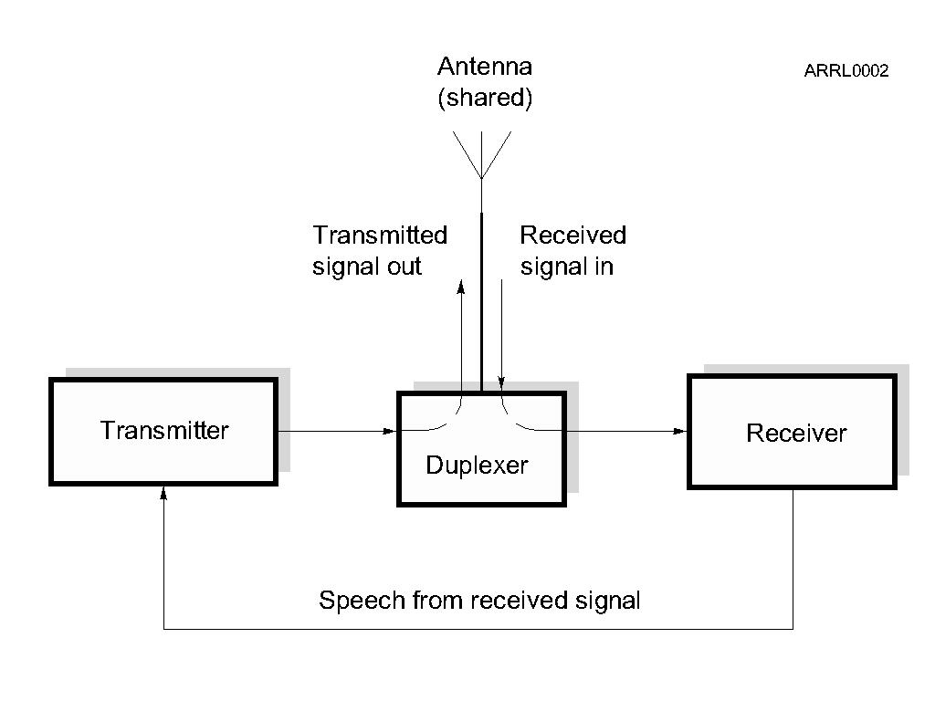
Repeater Review – How They Work

Slide 424
Duplex Communication
Transmitting on one frequency while simultaneously listening on a different frequency.
Repeaters use duplex communications.
Output frequency – the frequency the repeater transmits on and you listen to.
Input frequency – the frequency the repeater listens to and you transmit on.

Slide 425
Things to Know to Use a Repeater
Output frequency
Frequency offset
And therefore the input frequency
Repeater access tones (if any)

Slide 426
Repeater Output Frequency
Repeaters are frequently identified by their output frequency.
“Meet you on the 443.50 machine.”
Here the specific frequency is used.
“Let’s go to 94.”
Here an abbreviation for a standard repeater channel is used, meaning 146.94 MHz.
“How about the NARL repeater?”
Here the repeater is referenced by the sponsoring club name.
Notes:
Inform the students of various repeater directory source materials that are available either online or in print.

Slide 427
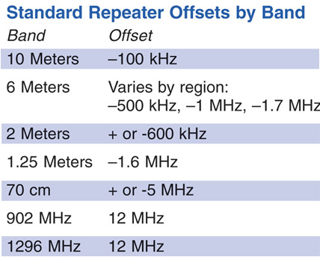
Repeater Frequency Offset
The offset frequencies (shifts or splits) are standardized to help facilitate repeater use.
There are + and – offsets depending on the plan.
Different bands have different standardized amounts of offset.
Notes:
The use of different terms for frequency offset might confuse students, let them know that all the terms refer to the same thing. Use the standard term – offset – consistently.
Discuss with the students that most modern radios will automatically set the standardized offset frequency when programmed, that they must specifically program in a non-standard split for those repeaters requiring it. Finally, let them know that the offset plan is not law, just a plan that is used by convention. There are some repeaters that use non standardized splits in order to limit or control use.

Slide 428
Repeater Access Tones
Prevents accessing multiple repeaters at once.
Subaudible low-frequency tone must be present before the repeater transmitter will turn on.
Tones have various names (depending on equipment manufacturer).
CTCSS (continuous tone coded squelch system)
PL (a Motorola trade name for CTCSS)
Privacy codes or tones
DCS (digital coded squelch)
Notes:
You will have to define what sub-audible means and give some examples of tone frequencies.

Slide 429
Repeater Access Tones
Access tones are usually published along with repeater frequencies.
Could also be announced when the repeater identifies.
“PL is 123.0” meaning 123.0 Hz
Tones are generally programmed into the radio along with frequency and offset.

Slide 430
Repeater Control
Repeater identification (Morse code or synthesized voice)
Same ID requirements as you have
Time-out protection
Protects against continuous transmission in the event of a stuck PTT or long-winded speaker
Usually three minutes
Courtesy beep or tone signals time-out timer reset
May have an autopatch system for phone calls
Notes:
Here you should cover some of the characteristics of the local repeaters that the students will encounter. Include in the discussion the different IDs used, what a courtesy tone is and what it means, the length of the time-out timers on some machines, and locally accepted uses of repeaters.

Slide 431
Common Problems
Off frequency: causes audio distortion
Low batteries: weak signal, audio distortion
Poor location: hear repeater OK, can’t make or maintain contact
Access tone off or wrong: repeater is strong but can’t access it
Repeater drops in and out of your receiver: squelch setting too high
Notes:
Go over some common problems, anything specific to your area, things you have encountered.

Slide 432
Digital Repeater Systems
Repeaters linked by the Internet
Use digital audio – Voice Over Internet Protocol (VOIP)
Similar to Skype
Allows communication world-wide
Internet Linking Relay Project (IRLP)
Echolink
Access codes on system websites
Notes:
Note there are many tutorials and explanations online for the digital repeater systems.

Slide 433
D-STAR
Both a repeater linking system and a digital voice protocol
DV: Digital Voice mode (voice + 1200 baud data)
DD: Digital Data mode (128 kbps data)
Repeaters linked together worldwide
Call user-to-user based on call sign
Currently an ICOM system
Yaesu and Kenwood also building digital systems

Slide 434
Practice Questions

Slide 435
What is a band plan, beyond the privileges established by the FCC?
A. A voluntary guideline for using different modes or activities within an amateur band
B. A mandated list of operating schedules
C. A list of scheduled net frequencies
D. A plan devised by a club to indicate frequency band usage
T2A10 HRLM (6 - 2)

Slide 436
What is a band plan, beyond the privileges established by the FCC?
A. A voluntary guideline for using different modes or activities within an amateur band
B. A mandated list of operating schedules
C. A list of scheduled net frequencies
D. A plan devised by a club to indicate frequency band usage
T2A10 HRLM (6 - 2)

Slide 437
What term describes an amateur station that is transmitting and receiving on the same frequency?
A. Full duplex
B. Diplex
C. Simplex
D. Multiplex
T2A11 HRLM (6 - 2)

Slide 438
What term describes an amateur station that is transmitting and receiving on the same frequency?
A. Full duplex
B. Diplex
C. Simplex
D. Multiplex
T2A11 HRLM (6 - 2)

Slide 439
Where may SSB phone be used in amateur bands above 50 MHz?
A. Only in sub-bands allocated to General class or higher licensees
B. Only on repeaters
C. In at least some portion of all these bands
D. On any band as long as power is limited to 25 watts
T2B13 HRLM (6 - 2)

Slide 440
Where may SSB phone be used in amateur bands above 50 MHz?
A. Only in sub-bands allocated to General class or higher licensees
B. Only on repeaters
C. In at least some portion of all these bands
D. On any band as long as power is limited to 25 watts
T2B13 HRLM (6 - 2)

Slide 441
What brief statement indicates that you are listening on a repeater and looking for a contact?
A. The words “Hello test” followed by your call sign
B. Your call sign
C. The repeater call sign followed by your call sign
D. The letters “QSY” followed by your call sign
T2A09 HRLM (6 - 4)

Slide 442
What brief statement indicates that you are listening on a repeater and looking for a contact?
A. The words “Hello test” followed by your call sign
B. Your call sign
C. The repeater call sign followed by your call sign
D. The letters “QSY” followed by your call sign
T2A09 HRLM (6 - 4)

Slide 443
What is an appropriate way to call another station on a repeater if you know the other station's call sign?
A. Say "break, break," then say the station's call sign
B. Say the station's call sign, then identify with your call sign
C. Say "CQ" three times, then the other station's call sign
D. Wait for the station to call CQ, then answer it
T2A04 HRLM (6 - 4)

Slide 444
What is an appropriate way to call another station on a repeater if you know the other station's call sign?
A. Say "break, break," then say the station's call sign
B. Say the station's call sign, then identify with your call sign
C. Say "CQ" three times, then the other station's call sign
D. Wait for the station to call CQ, then answer it
T2A04 HRLM (6 - 4)

Slide 445
What might be a problem if you receive a report that your audio signal through the repeater is distorted or unintelligible?
A. Your transmitter is slightly off frequency
B. Your batteries are running low
C. You are in a bad location
D. All of these choices are correct
T7B10 HRLM (6 - 5)

Slide 446
What might be a problem if you receive a report that your audio signal through the repeater is distorted or unintelligible?
A. Your transmitter is slightly off frequency
B. Your batteries are running low
C. You are in a bad location
D. All of these choices are correct
T7B10 HRLM (6 - 5)

Slide 447
What is the national calling frequency for FM simplex operations in the 2 meter band?
A. 146.520 MHz
B. 145.000 MHz
C. 432.100 MHz
D. 446.000 MHz
T2A02 HRLM (6 - 6)

Slide 448
What is the national calling frequency for FM simplex operations in the 2 meter band?
A. 146.520 MHz
B. 145.000 MHz
C. 432.100 MHz
D. 446.000 MHz
T2A02 HRLM (6 - 6)

Slide 449
What is the meaning of the procedural signal “CQ”?
A. Call on the quarter hour
B. A new antenna is being tested (no station should answer)
C. Only the called station should transmit
D. Calling any station
T2A08 HRLM (6 - 6)

Slide 450
What is the meaning of the procedural signal “CQ”?
A. Call on the quarter hour
B. A new antenna is being tested (no station should answer)
C. Only the called station should transmit
D. Calling any station
T2A08 HRLM (6 - 6)

Slide 451
What is the most common use of the “reverse split” function of a VHF/UHF transceiver?
A. Reduce power output
B. Increase power output
C. Listen on a repeater’s input frequency
D. Listen on a repeater’s output frequency
T2B01 HRLM (6 - 6)

Slide 452
What is the most common use of the “reverse split” function of a VHF/UHF transceiver?
A. Reduce power output
B. Increase power output
C. Listen on a repeater’s input frequency
D. Listen on a repeater’s output frequency
T2B01 HRLM (6 - 6)

Slide 453
Why are simplex channels designated in the VHF/UHF band plans?
A. So that stations within mutual communications range can communicate without tying up a repeater
B. For contest operation
C. For working DX only
D. So that stations with simple transmitters can access the repeater without automated offset
T2B12 HRLM (6 - 6)

Slide 454
Why are simplex channels designated in the VHF/UHF band plans?
A. So that stations within mutual communications range can communicate without tying up a repeater
B. For contest operation
C. For working DX only
D. So that stations with simple transmitters can access the repeater without automated offset
T2B12 HRLM (6 - 6)

Slide 455
If a station is not strong enough to keep a repeater’s receiver squelch open, which of the following might allow you to receive the station’s signal?
A. Open the squelch on your radio
B. Listen on the repeater input frequency
C. Listen on the repeater output frequency
D. Increase your transmit power
T2B03 HRLM (6 - 6)

Slide 456
If a station is not strong enough to keep a repeater’s receiver squelch open, which of the following might allow you to receive the station’s signal?
A. Open the squelch on your radio
B. Listen on the repeater input frequency
C. Listen on the repeater output frequency
D. Increase your transmit power
T2B03 HRLM (6 - 6)

Slide 457
How should you respond to a station calling CQ?
A. Transmit "CQ" followed by the other station’s call sign
B. Transmit your call sign followed by the other station’s call sign
C. Transmit the other station’s call sign followed by your call sign
D. Transmit a signal report followed by your call sign
T2A05 HRLM (6 - 7)

Slide 458
How should you respond to a station calling CQ?
A. Transmit "CQ" followed by the other station’s call sign
B. Transmit your call sign followed by the other station’s call sign
C. Transmit the other station’s call sign followed by your call sign
D. Transmit a signal report followed by your call sign
T2A05 HRLM (6 - 7)

Slide 459
Which of the following is a guideline when choosing an operating frequency for calling CQ?
A. Listen first to be sure that no one else is using the frequency
B. Ask if the frequency is in use
C. Make sure you are in your assigned band
D. All of these choices are correct
T2A12 HRLM (6 - 7)

Slide 460
Which of the following is a guideline when choosing an operating frequency for calling CQ?
A. Listen first to be sure that no one else is using the frequency
B. Ask if the frequency is in use
C. Make sure you are in your assigned band
D. All of these choices are correct
T2A12 HRLM (6 - 7)

Slide 461
Which Q signal indicates that you are receiving interference from other stations?
A. QRM
B. QRN
C. QTH
D. QSB
T2B10 HRLM (6 - 7)

Slide 462
Which Q signal indicates that you are receiving interference from other stations?
A. QRM
B. QRN
C. QTH
D. QSB
T2B10 HRLM (6 - 7)

Slide 463
Which Q signal indicates that you are changing frequency?
A. QRU
B. QSY
C. QSL
D. QRZ
T2B11 HRLM (6 - 7)

Slide 464
Which Q signal indicates that you are changing frequency?
A. QRU
B. QSY
C. QSL
D. QRZ
T2B11 HRLM (6 - 7)

Slide 465
What is a grid locator?
A. A letter-number designator assigned to a geographic location
B. A letter-number designator assigned to an azimuth and elevation
C. An instrument for neutralizing a final amplifier
D. An instrument for radio direction finding
T8C05 HRLM (6 - 8)

Slide 466
What is a grid locator?
A. A letter-number designator assigned to a geographic location
B. A letter-number designator assigned to an azimuth and elevation
C. An instrument for neutralizing a final amplifier
D. An instrument for radio direction finding
T8C05 HRLM (6 - 8)

Slide 467
What operating activity involves contacting as many stations as possible during a specified period?
A. Contesting
B. Net operations
C. Public service events
D. Simulated emergency exercises
T8C03 HRLM (6 - 9)

Slide 468
What operating activity involves contacting as many stations as possible during a specified period?
A. Contesting
B. Net operations
C. Public service events
D. Simulated emergency exercises
T8C03 HRLM (6 - 9)

Slide 469
Which of the following is good procedure when contacting another station in a radio contest?
A. Sign only the last two letters of your call if there are many other stations calling
B. Contact the station twice to be sure that you are in his log
C. Send only the minimum information needed for proper identification and the contest exchange
D. All of these choices are correct
T8C04 HRLM (6 - 9)

Slide 470
Which of the following is good procedure when contacting another station in a radio contest?
A. Sign only the last two letters of your call if there are many other stations calling
B. Contact the station twice to be sure that you are in his log
C. Send only the minimum information needed for proper identification and the contest exchange
D. All of these choices are correct
T8C04 HRLM (6 - 9)

Slide 471
What type of transmission is indicated by the term "NTSC?"
A. A Normal Transmission mode in Static Circuit
B. A special mode for earth satellite uplink
C. An analog fast scan color TV signal
D. A frame compression scheme for TV signals
T8D04 HRLM (6 - 10)

Slide 472
What type of transmission is indicated by the term "NTSC?"
A. A Normal Transmission mode in Static Circuit
B. A special mode for earth satellite uplink
C. An analog fast scan color TV signal
D. A frame compression scheme for TV signals
T8D04 HRLM (6 - 10)

Slide 473
Which of the following methods is used to locate sources of noise interference or jamming?
A. Echolocation
B. Doppler radar
C. Radio direction finding
D. Phase locking
T8C01 HRLM (6 - 10)

Slide 474
Which of the following methods is used to locate sources of noise interference or jamming?
A. Echolocation
B. Doppler radar
C. Radio direction finding
D. Phase locking
T8C01 HRLM (6 - 10)

Slide 475
Which of these items would be useful for a hidden transmitter hunt?
A. Calibrated SWR meter
B. A directional antenna
C. A calibrated noise bridge
D. All of these choices are correct
T8C02 HRLM (6 - 10)

Slide 476
Which of these items would be useful for a hidden transmitter hunt?
A. Calibrated SWR meter
B. A directional antenna
C. A calibrated noise bridge
D. All of these choices are correct
T8C02 HRLM (6 - 10)

Slide 477
Which of the following is a use for the scanning function of an FM transceiver?
A. To check incoming signal deviation
B. To prevent interference to nearby repeaters
C. To scan through a range of frequencies to check for activity
D. To check for messages left on a digital bulletin board
T4B13 HRLM (6 - 10)

Slide 478
Which of the following is a use for the scanning function of an FM transceiver?
A. To check incoming signal deviation
B. To prevent interference to nearby repeaters
C. To scan through a range of frequencies to check for activity
D. To check for messages left on a digital bulletin board
T4B13 HRLM (6 - 10)

Slide 479
What is meant by "repeater offset?"
A. The difference between a repeater’s transmit frequency and its receive frequency
B. The repeater has a time delay to prevent interference
C. The repeater station identification is done on a separate frequency
D. The number of simultaneous transmit frequencies used by a repeater
T2A07 HRLM (6 - 12)

Slide 480
What is meant by "repeater offset?"
A. The difference between a repeater’s transmit frequency and its receive frequency
B. The repeater has a time delay to prevent interference
C. The repeater station identification is done on a separate frequency
D. The number of simultaneous transmit frequencies used by a repeater
T2A07 HRLM (6 - 12)

Slide 481
Which of the following is a common repeater frequency offset in the 2 meter band?
A. Plus or minus 5 MHz
B. Plus or minus 600 kHz
C. Plus or minus 500 kHz
D. Plus or minus 1 MHz
T2A01 HRLM (6 - 12)

Slide 482
Which of the following is a common repeater frequency offset in the 2 meter band?
A. Plus or minus 5 MHz
B. Plus or minus 600 kHz
C. Plus or minus 500 kHz
D. Plus or minus 1 MHz
T2A01 HRLM (6 - 12)

Slide 483
What is a common repeater frequency offset in the 70 cm band?
A. Plus or minus 5 MHz
B. Plus or minus 600 kHz
C. Plus or minus 500 kHz
D. Plus or minus 1 MHz
T2A03 HRLM (6 - 12)

Slide 484
What is a common repeater frequency offset in the 70 cm band?
A. Plus or minus 5 MHz
B. Plus or minus 600 kHz
C. Plus or minus 500 kHz
D. Plus or minus 1 MHz
T2A03 HRLM (6 - 12)

Slide 485
Which of the following describes a linked repeater network?
A. A network of repeaters where signals received by one repeater are repeated by all the repeaters
B. A repeater with more than one receiver
C. Multiple repeaters with the same owner
D. A system of repeaters linked by APRS
T2B14 HRLM (6 - 12)

Slide 486
Which of the following describes a linked repeater network?
A. A network of repeaters where signals received by one repeater are repeated by all the repeaters
B. A repeater with more than one receiver
C. Multiple repeaters with the same owner
D. A system of repeaters linked by APRS
T2B14 HRLM (6 - 12)

Slide 487
What term describes the use of a sub-audible tone transmitted along with normal voice audio to open the squelch of a receiver?
A. Carrier squelch
B. Tone burst
C. DTMF
D. CTCSS
T2B02 HRLM (6 - 13)

Slide 488
What term describes the use of a sub-audible tone transmitted along with normal voice audio to open the squelch of a receiver?
A. Carrier squelch
B. Tone burst
C. DTMF
D. CTCSS
T2B02 HRLM (6 - 13)

Slide 489
Which of the following could be the reason you are unable to access a repeater whose output you can hear?
A. Improper transceiver offset
B. The repeater may require a proper CTCSS tone from your transceiver
C. The repeater may require a proper DCS tone from your transceiver
D. All of these choices are correct
T2B04 HRLM (6 - 13)

Slide 490
Which of the following could be the reason you are unable to access a repeater whose output you can hear?
A. Improper transceiver offset
B. The repeater may require a proper CTCSS tone from your transceiver
C. The repeater may require a proper DCS tone from your transceiver
D. All of these choices are correct
T2B04 HRLM (6 - 13)

Slide 491
What is meant by Voice Over Internet Protocol (VoIP) as used in amateur radio?
A. A set of rules specifying how to identify your station when linked over the internet to another station
B. A set of guidelines for contacting DX stations during contests using internet access
C. A technique for measuring the modulation quality of a transmitter using remote sites monitored via the internet
D. A method of delivering voice communications over the internet using digital techniques
T8C07 HRLM (6 - 14)

Slide 492
What is meant by Voice Over Internet Protocol (VoIP) as used in amateur radio?
A. A set of rules specifying how to identify your station when linked over the internet to another station
B. A set of guidelines for contacting DX stations during contests using internet access
C. A technique for measuring the modulation quality of a transmitter using remote sites monitored via the internet
D. A method of delivering voice communications over the internet using digital techniques
T8C07 HRLM (6 - 14)

Slide 493
What is the Internet Radio Linking Project (IRLP)?
A. A technique to connect amateur radio systems, such as repeaters, via the internet using Voice Over Internet Protocol (VoIP)
B. A system for providing access to websites via amateur radio
C. A system for informing amateurs in real time of the frequency of active DX stations
D. A technique for measuring signal strength of an amateur transmitter via the internet
T8C08 HRLM (6 - 14)

Slide 494
What is the Internet Radio Linking Project (IRLP)?
A. A technique to connect amateur radio systems, such as repeaters, via the internet using Voice Over Internet Protocol (VoIP)
B. A system for providing access to websites via amateur radio
C. A system for informing amateurs in real time of the frequency of active DX stations
D. A technique for measuring signal strength of an amateur transmitter via the internet
T8C08 HRLM (6 - 14)

Slide 495
How might you obtain a list of active nodes that use VoIP?
A. By subscribing to an on line service
B. From on line repeater lists maintained by the local repeater frequency coordinator
C. From a repeater directory
D. All of these choices are correct
T8C09 HRLM (6 - 14)

Slide 496
How might you obtain a list of active nodes that use VoIP?
A. By subscribing to an on line service
B. From on line repeater lists maintained by the local repeater frequency coordinator
C. From a repeater directory
D. All of these choices are correct
T8C09 HRLM (6 - 14)

Slide 497
What must be done before you may use the EchoLink system to communicate using a repeater?
A. You must complete the required EchoLink training
B. You must have purchased a license to use the EchoLink software
C. You must be sponsored by a current EchoLink user
D. You must register your call sign and provide proof of license
T8C10 HRLM (6 - 15)

Slide 498
What must be done before you may use the EchoLink system to communicate using a repeater?
A. You must complete the required EchoLink training
B. You must have purchased a license to use the EchoLink software
C. You must be sponsored by a current EchoLink user
D. You must register your call sign and provide proof of license
T8C10 HRLM (6 - 15)

Slide 499
How is access to some IRLP nodes accomplished?
A. By obtaining a password that is sent via voice to the node
B. By using DTMF signals
C. By entering the proper internet password
D. By using CTCSS tone codes
T8C06 HRLM (6 - 15)

Slide 500
How is access to some IRLP nodes accomplished?
A. By obtaining a password that is sent via voice to the node
B. By using DTMF signals
C. By entering the proper internet password
D. By using CTCSS tone codes
T8C06 HRLM (6 - 15)

Slide 501
Which of the following best describes DMR (Digital Mobile Radio)?
A. A technique for time-multiplexing two digital voice signals on a single 12.5 kHz repeater channel
B. An automatic position tracking mode for FM mobiles communicating through repeaters
C. An automatic computer logging technique for hands-off logging when communicating while operating a vehicle
D. A digital technique for transmitting on two repeater inputs simultaneously for automatic error correction
T8D07 HRLM (6 - 15)

Slide 502
Which of the following best describes DMR (Digital Mobile Radio)?
A. A technique for time-multiplexing two digital voice signals on a single 12.5 kHz repeater channel
B. An automatic position tracking mode for FM mobiles communicating through repeaters
C. An automatic computer logging technique for hands-off logging when communicating while operating a vehicle
D. A digital technique for transmitting on two repeater inputs simultaneously for automatic error correction
T8D07 HRLM (6 - 15)

Slide 503
What type of tones are used to control repeaters linked by the Internet Relay Linking Project (IRLP) protocol?
A. DTMF
B. CTCSS
C. EchoLink
D. Sub-audible
T2B06 HRLM (6 - 15)

Slide 504
What type of tones are used to control repeaters linked by the Internet Relay Linking Project (IRLP) protocol?
A. DTMF
B. CTCSS
C. EchoLink
D. Sub-audible
T2B06 HRLM (6 - 15)

Slide 505
How can you join a digital repeater’s “talk group”?
A. Register your radio with the local FCC office
B. Join the repeater owner’s club
C. Program your radio with the group’s ID or code
D. Sign your call after the courtesy tone
T2B07 HRLM (6 - 15)

Slide 506
How can you join a digital repeater’s “talk group”?
A. Register your radio with the local FCC office
B. Join the repeater owner’s club
C. Program your radio with the group’s ID or code
D. Sign your call after the courtesy tone
T2B07 HRLM (6 - 15)

Slide 507
What is a “talk group” on a DMR digital repeater?
A. A group of operators sharing common interests
B. A way for groups of users to share a channel at different times without being heard by other users on the channel
C. A protocol that increases the signal-to-noise ratio when multiple repeaters are linked together
D. A net that meets at a particular time
T2B09 HRLM (6 - 15)

Slide 508
What is a “talk group” on a DMR digital repeater?
A. A group of operators sharing common interests
B. A way for groups of users to share a channel at different times without being heard by other users on the channel
C. A protocol that increases the signal-to-noise ratio when multiple repeaters are linked together
D. A net that meets at a particular time
T2B09 HRLM (6 - 15)

Slide 509
Technician License Course Chapter 6
Communicating with Other Hams
Nets, Emergency Communications, Special Modes and Techniques
Notes:
These lessons would benefit from demonstrations. It might be difficult to come up with demonstrations of all the latest and greatest things that ham radio has to offer.
Usually someone in the area is passionate about one of the operating modes and you can tap them as a demonstration resource. This will add substantially to class time.
The goal is not to make the students experts in each of the modes, it is to briefly introduce them to the wide variety of modes available to make them aware of the many opportunities available in ham radio.

Slide 510
Nets
Net is short for “Network”
Evolved over the years to share and exchange information in an organized and efficient way
Social nets
Traffic nets
Emergency and public service nets
Notes:
Discuss with the students the purpose of nets and some of the nets that are in your area. Invite the students to listen to the nets during the course of the class. Play a recorded net check-in session.
Discuss here the purpose and theme of some of the social nets in your area.

Slide 511
Traffic Nets
Traffic refers to formal messages that are relayed via Amateur Radio
Radiogram structured to ensure accuracy
National Traffic System (NTS)
Procedures
Accountability
Notes:
Give the students a copy of the radiogram form and go over the various sections of the form, but not in too much detail. The idea here is to give the students the sense that the NTS system and associate procedures are developed to ensure accuracy and accountability of the messages being handled within the system.

Slide 512
Emergency and Public Service Nets
Public service nets – training for emergency nets
Training for ham operators as well as emergency groups and managers supported by Amateur Radio
Emergency nets
Notes:
Discuss some of the public service nets that are common in your area and how they are related to training for emergency communications while providing a valuable public service.
Discuss some of the emergency net operations that are involved in your area. More detail on emergency communications, of which emergency nets are a part, will be discussed a little later.

Slide 513
Net Structure
Net Control Station (NCS)
Traffic cop who controls the flow of information
Check-in and check-out procedures
Priority/Emergency access to Net Control
Communications discipline vital
Learn and follow procedures
Speak only when directed, and only to whom directed
Follow through with your commitments
Notes:
Discuss with the students the structure and general operating procedures of a net. Emphasize the need for communication discipline, particularly for traffic and emergency nets. (Social nets are a different matter)
If you have time, role playing may help to demonstrate the point. You might even consider using HTs or FRS/GMRS radios on a simplex frequency to demonstrate net check-in/check-out procedures and even run through a short script of passing some traffic during a simulated emergency net.

Slide 514
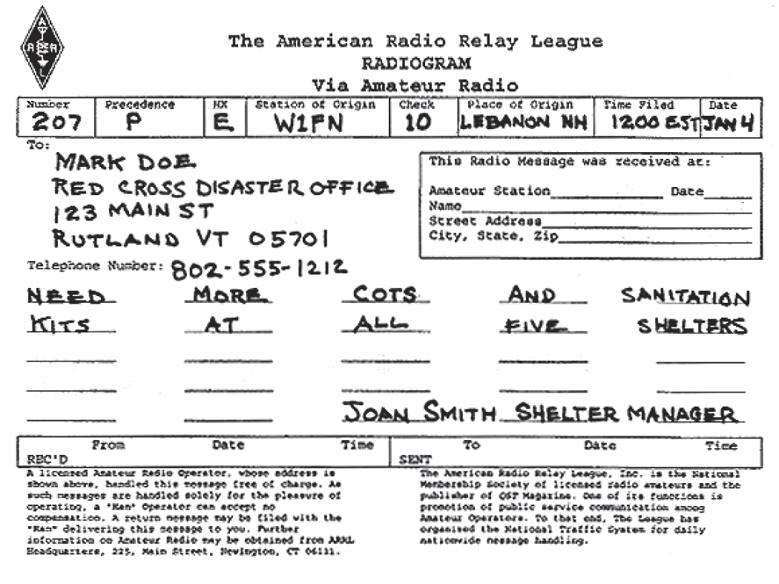
The Radiogram

Slide 515
Supporting Emergency Operations
One of the most important reasons for the existence of Amateur Radio.
Get involved and use what you have learned.
Know where you fit in the overall emergency management team.
Notes:
Here is where you can bring some of your own reasons for participating in emergency communications activities. However, stress the realistic role that ham radio plays in emergency management - don’t give false impressions that ham radio is the sole and primary communications method used by emergency managers. Don’t rely too heavily on “When All Else Fails…”
Note that the use of the term “emergency communications” is changing. Consult with ARRL HQ and review the instructor resources website for materials that help explain the various categories of assistance hams can render, such as public service, disaster relief, and emergency communications.
Ham radio frequently is used as a back-up system that is employed when the primary systems fail. In reality, if ham radio is never used during an emergency, that is a good thing, because that means the primary systems worked as planned.
One way to look at it is that ham radio provides some redundant capability – a “force multiplier” that will allow emergency managers to deploy and employ their professional resources in a more effective manner than if the redundant communications reserves provided by ham radio were not available.

Slide 516
Emergency Communications Organizations
Radio Amateur Civil Emergency Service (RACES).
Supports civil emergencies
National in scope
Amateur Radio Emergency Service ® (ARES®).
Local and regional in scope
Supports non-governmental agencies
Notes:
Discuss the two organizations and how they are similar and how they are dissimilar (this depends on your local organizations).

Slide 517
Emergency Communication Tips
Don’t become part of the problem.
You are a communicator, not a decision or policy maker.
Don’t give out unauthorized information.
Know your abilities and limitations — keep yourself safe.
Follow radio discipline and net procedures.
Protect personal information — Amateur Radio communications is public.
Notes:
De-emphasize the jargon “emcomm” and use “emergency communications” instead. See slide 7 about using a variety of terms to describe what we can do.
Then discuss these practical tips.

Slide 518
Emergency Declarations
FCC may declare a Temporary State of Communications Emergency.
Includes details of conditions and rules to be followed.
Specifics communicated through web sites and ARRL bulletins, the NTS, and on-the-air.
Avoid operating on restricted frequencies unless engaged in relief efforts.
Notes:
Discuss with the students how this works. Hurricane relief operations are the most common communication emergency that they might encounter. Give them the frequencies used and encourage them to listen in on the relief efforts as a learning exercise. The Hurricane Watch Net website (www.hwn.org) is a good place for information.

Slide 519
Making and Answering Distress Calls
Rule number one – speak in plain language!
Mayday (voice); SOS (Morse code)
Identify
Give location
State the situation
Describe assistance required
Provide other important information
Notes:
Again, role playing will help to illustrate the major concepts in making and answering a distress call.

Slide 520
Tactical Communications
Tactical Identifiers
Facilitate communications
Location- or function-specific
Transcends operator changes
FCC ID rules still apply
Give your FCC call sign every 10 minutes and when changing operators
Notes:
The term “tactical call signs” is over-used. Strictly speaking, these aren’t call signs (which are only assigned by the FCC).
Because students will frequently hear tactical identifiers being used, it is a good idea to discuss their proper use and show how to stay in compliance with FCC station ID rules and regulations.
Role playing here is a good way to illustrate this point and an opportunity for you to model the correct way to use tactical identifiers.

Slide 521
Emergency Equipment
“Go-kits”
Portable Amateur Radio equipment
Emergency power sources
Personal survival supplies and equipment
Notes:
Some examples of “go-kits” will help students see what type of equipment is appropriate in your area. Don’t forget to discuss personal survival gear, emphasize that personal survival considerations is part of “Not becoming part of the problem” that was mentioned earlier.

Slide 522
Emergency Communications Training
If you are going to participate, get training.
Actively participate in training and drill activities.
Nets
Public service activities
Attend community meetings and get involved in your community.
Take emergency communication courses.
ARRL courses
FEMA courses on NIMS and other topics
May be required for your participation
Notes:
Review training opportunities in your area.

Slide 523
Awards, DXing, Contests
On-the-air activities provide incentive to get on the radio.
Learn about propagation as you search for specific stations on various bands.
Improve operating skills.
Fun!

Slide 524
Awards
WAC
Contacting all six inhabited continents
WAS
Contacting 50 states
VUCC
Contacting 100 grid squares on VHF/UHF
Notes:
Bring in awards for show and tell. These are just a few of the major operating awards that are available. Discuss with the students that awards usually require QSL card confirmation of the contact. Also introduce the students to the Logbook of the World as an alternative to QSL cards. Bring in a stack of QSL cards to show the students. Hand out your own QSL card for the students to keep start their collection.
One post class activity that you can do related to QSLing is to make first contacts with the students after they get their licenses. Make it a big deal. Have the class reassemble as a group and pass around an HT for their first contacts. At the end of the class, present QSL cards and First Contact Certificates to each participant as a memento.

Slide 525
DXing
Contacting stations far away – a tradition since the first days of radio.
On HF, usually means contacting stations in other countries.
On VHF/UHF, means contacting stations outside your normal coverage area.

Slide 526
Contests
ARRL Rookie Roundup
North American QSO Parties (ncjweb.com)
State QSO Parties
VHF/UHF Contests
CQ World Wide DX Contest (a big one!)
Contest Calendars
Notes:
The object of a radio contest is to contact as many different stations in a defined period of time, using specific frequencies and modes, and exchange some information. Results are published for the major contests. Contests test operator radio operating skills as well as technical skills.
Point out that there are usually at least one contest opportunity each weekend and how to find out about upcoming contests. ARRL Web contest results would be helpful to illustrate the popularity of contesting in the hobby.
This list of contests is suitable for beginners.

Slide 527
Field Day
Emergency communications training with a competitive spirit.
Set up portable station and antenna (in the field, mobile, anywhere!) and make as many contacts as possible.
Get started with your local club or group – great way to get involved.
Notes:
Field Day is not technically a contest, but it is treated as such by most ham operators. It is an easy way to get a look at HF operating and many different types of ham radio.
GOTA (Get On The Air) stations are set up with a mentor to help new hams make contacts and get a little experience.

Slide 528
Special Events
Special Event stations are set up to commemorate some significant local event.
Usually stations are demonstration stations set up for public display.
Commemorative certificates are awarded for contacting the stations.
Notes:
Bring in some of the special event certificates that you have on hand for show and tell. Bring in the latest QST listing or show the ARRL special event search web page to illustrate the variety of special event themes and the number of special events and call signs.

Slide 529
Radio Direction Finding
Useful for locating interference or noise sources.
Works best with a directional antenna.
“Fox hunting” competitions offer a fun opportunity to learn and practice.
Good training for search and rescue.
Notes:
Good combination of outdoor activities and radio training. DF-ing can be local and informal or large competitions that are popular around the world.
IARU Region II ARDF - www.ardf-r2.org
Homing In - www.homingin.com

Slide 530
Amateur Satellites
OSCAR
Orbiting Satellites Carrying Amateur Radio
Modes
FM
Analog (SSB and CW)
Digital
International Space Station
Notes:
Satellite operating might interest some hams of the hams. Briefly describe the station equipment required to effectively operate through a satellite and the type of satellite modes available. Discuss some of the technical challenges that have to be considered to operate satellites; finding and tracking the satellite, Doppler compensation, working with transponder equipment, etc.
If you are lucky, an ISS “pass” will be visible during one of your classes. Use heavens-above.com to find visible passes in your area.

Slide 531
Satellite Terms
Uplink – Earth stations transmit to satellite
Downlink – Satellite transmits to stations on Earth
Beacon – Signal from satellite with information about satellite operating conditions
Doppler Shift – Shift in frequency due to relative motion between satellite and Earth station
LEO – Low Earth Orbit

Slide 532
Satellite Terms
Spin fading – caused by rotation of satellite
Pacsat – packet radio satellite
Tracking software – gives beam heading and times when satellite is in view
Mode – bands satellite is using for uplink and downlink (eg Mode U/V = 70 cm uplink, 2 meters downlink)

Slide 533
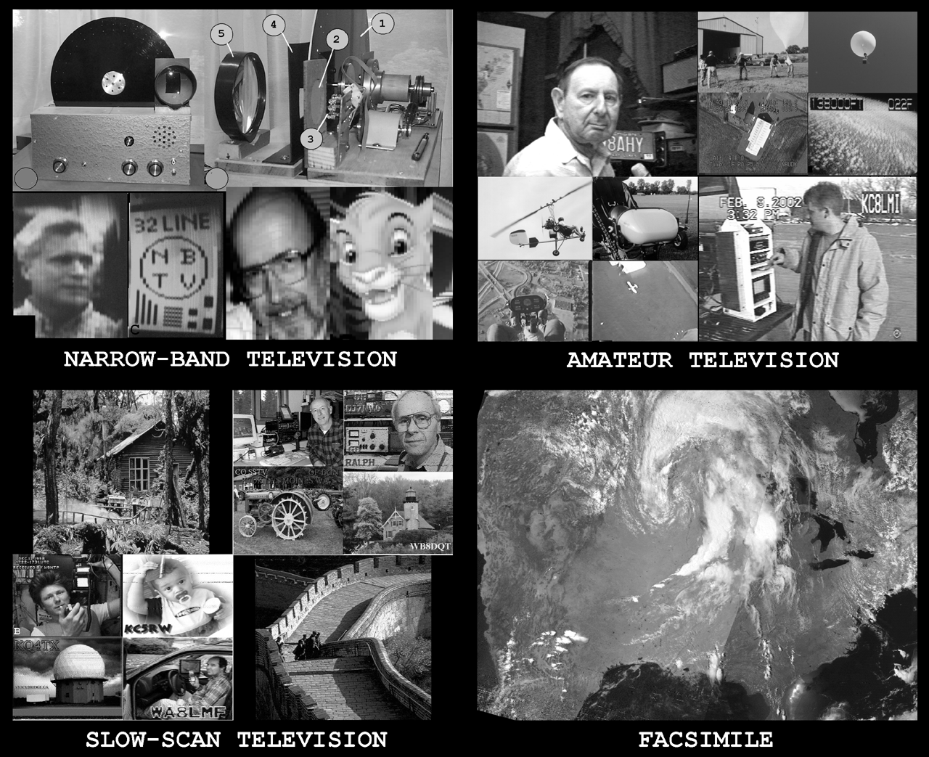
Other Special Modes
Slow Scan TV (SSTV)
Sending snap-shot pictures
One frame every few seconds
Amateur TV (ATV)
Similar to commercial TV imagery
Uses analog TV format (NTSC)

Slide 534
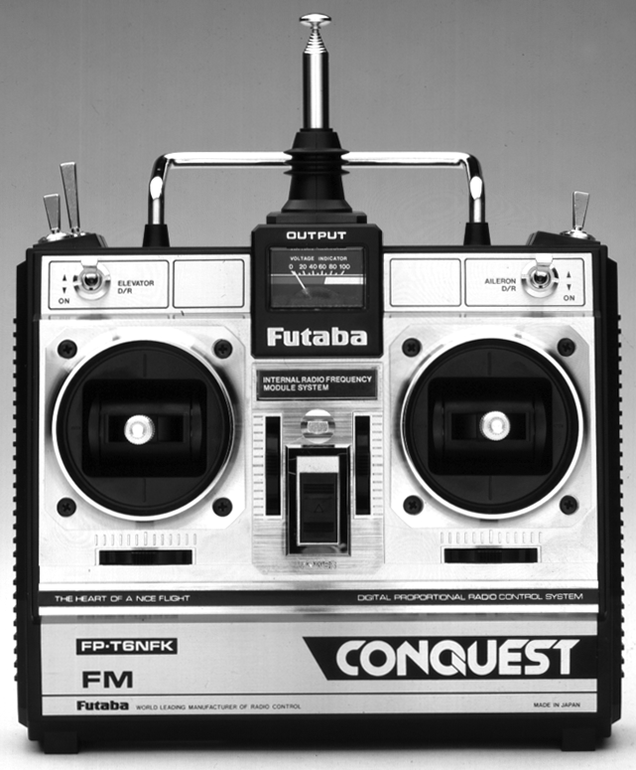
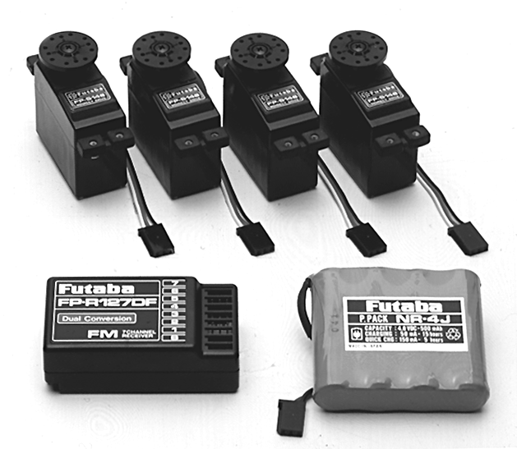
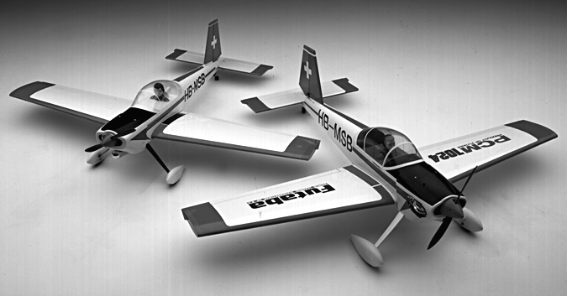
Other Special Modes
Radio Control (RC)
Telecommand
50 MHz band
Notes:
Note that amateurs have a special set of frequencies for RC that are unavailable to unlicensed modelers.

Slide 535
Practice Questions

Slide 536
What does the term “traffic” refer to in net operation?
A. Formal messages exchanged by net stations
B. The number of stations checking in and out of a net
C. Operation by mobile or portable stations
D. Requests to activate the net by a served agency
T2C05 HRLM (6 - 15)

Slide 537
What does the term “traffic” refer to in net operation?
A. Formal messages exchanged by net stations
B. The number of stations checking in and out of a net
C. Operation by mobile or portable stations
D. Requests to activate the net by a served agency
T2C05 HRLM (6 - 15)

Slide 538
Which of the following is an accepted practice to get the immediate attention of a net control station when reporting an emergency?
A. Repeat "SOS" three times followed by the call sign of the reporting station
B. Press the push-to-talk button three times
C. Begin your transmission by saying "Priority" or "Emergency" followed by your call sign
D. Play a pre-recorded emergency alert tone followed by your call sign
T2C06 HRLM (6 - 16)

Slide 539
Which of the following is an accepted practice to get the immediate attention of a net control station when reporting an emergency?
A. Repeat "SOS" three times followed by the call sign of the reporting station
B. Press the push-to-talk button three times
C. Begin your transmission by saying "Priority" or "Emergency" followed by your call sign
D. Play a pre-recorded emergency alert tone followed by your call sign
T2C06 HRLM (6 - 16)

Slide 540
Which of the following is an accepted practice for an amateur operator who has checked into a net?
A. Provided that the frequency is quiet, announce the station call sign and location every 5 minutes
B. Move 5 kHz away from the net's frequency and use high power to ask other hams to keep clear of the net frequency
C. Remain on frequency without transmitting until asked to do so by the net control station
D. All of these choices are correct
T2C07 HRLM (6 - 16)

Slide 541
Which of the following is an accepted practice for an amateur operator who has checked into a net?
A. Provided that the frequency is quiet, announce the station call sign and location every 5 minutes
B. Move 5 kHz away from the net's frequency and use high power to ask other hams to keep clear of the net frequency
C. Remain on frequency without transmitting until asked to do so by the net control station
D. All of these choices are correct
T2C07 HRLM (6 - 16)

Slide 542
Which of the following is a characteristic of good traffic handling?
A. Passing messages exactly as received
B. Making decisions as to whether messages are worthy of relay or delivery
C. Ensuring that any newsworthy messages are relayed to the news media
D. All of these choices are correct
T2C08 HRLM (6 - 16)

Slide 543
Which of the following is a characteristic of good traffic handling?
A. Passing messages exactly as received
B. Making decisions as to whether messages are worthy of relay or delivery
C. Ensuring that any newsworthy messages are relayed to the news media
D. All of these choices are correct
T2C08 HRLM (6 - 16)

Slide 544
What is meant by the term "NCS" used in net operation?
A. Nominal Control System
B. Net Control Station
C. National Communications Standard
D. Normal Communications Syntax
T2C02 HRLM (6 - 16)

Slide 545
What is meant by the term "NCS" used in net operation?
A. Nominal Control System
B. Net Control Station
C. National Communications Standard
D. Normal Communications Syntax
T2C02 HRLM (6 - 16)

Slide 546
What information is contained in the preamble of a formal traffic message?
A. The email address of the originating station
B. The address of the intended recipient
C. The telephone number of the addressee
D. The information needed to track the message
T2C10 HRLM (6 - 17)

Slide 547
What information is contained in the preamble of a formal traffic message?
A. The email address of the originating station
B. The address of the intended recipient
C. The telephone number of the addressee
D. The information needed to track the message
T2C10 HRLM (6 - 17)

Slide 548
What is meant by the term “check,” in reference to a formal traffic message?
A. The number of words or word equivalents in the text portion of the message
B. The value of a money order attached to the message
C. A list of stations that have relayed the message
D. A box on the message form that indicates that the message was received and/or relayed
T2C11 HRLM (6 - 17)

Slide 549
What is meant by the term “check,” in reference to a formal traffic message?
A. The number of words or word equivalents in the text portion of the message
B. The value of a money order attached to the message
C. A list of stations that have relayed the message
D. A box on the message form that indicates that the message was received and/or relayed
T2C11 HRLM (6 - 17)

Slide 550
What should be done when using voice modes to ensure that voice messages containing unusual words are received correctly?
A. Send the words by voice and Morse code
B. Speak very loudly into the microphone
C. Spell the words using a standard phonetic alphabet
D. All of these choices are correct
T2C03 HRLM (6 - 17)

Slide 551
What should be done when using voice modes to ensure that voice messages containing unusual words are received correctly?
A. Send the words by voice and Morse code
B. Speak very loudly into the microphone
C. Spell the words using a standard phonetic alphabet
D. All of these choices are correct
T2C03 HRLM (6 - 17)

Slide 552
What do RACES and ARES have in common?
A. They represent the two largest ham clubs in the United States
B. Both organizations broadcast road and weather information
C. Neither may handle emergency traffic supporting public service agencies
D. Both organizations may provide communications during emergencies
T2C04 HRLM (6 - 18)

Slide 553
What do RACES and ARES have in common?
A. They represent the two largest ham clubs in the United States
B. Both organizations broadcast road and weather information
C. Neither may handle emergency traffic supporting public service agencies
D. Both organizations may provide communications during emergencies
T2C04 HRLM (6 - 18)

Slide 554
When do the FCC rules NOT apply to the operation of an amateur station?
A. When operating a RACES station
B. When operating under special FEMA rules
C. When operating under special ARES rules
D. Never, FCC rules always apply
FCC Rule: [97.103(a)] T2C01 HRLM (6 - 18)

Slide 555
When do the FCC rules NOT apply to the operation of an amateur station?
A. When operating a RACES station
B. When operating under special FEMA rules
C. When operating under special ARES rules
D. Never, FCC rules always apply
FCC Rule: [97.103(a)] T2C01 HRLM (6 - 18)

Slide 556
What is the Amateur Radio Emergency Service (ARES)?
A. Licensed amateurs who have voluntarily registered their qualifications and equipment for communications duty in the public service
B. Licensed amateurs who are members of the military and who voluntarily agreed to provide message handling services in the case of an emergency
C. A training program that provides licensing courses for those interested in obtaining an amateur license to use during emergencies
D. A training program that certifies amateur operators for membership in the Radio Amateur Civil Emergency Service
T2C12 HRLM (6 - 18)

Slide 557
What is the Amateur Radio Emergency Service (ARES)?
A. Licensed amateurs who have voluntarily registered their qualifications and equipment for communications duty in the public service
B. Licensed amateurs who are members of the military and who voluntarily agreed to provide message handling services in the case of an emergency
C. A training program that provides licensing courses for those interested in obtaining an amateur license to use during emergencies
D. A training program that certifies amateur operators for membership in the Radio Amateur Civil Emergency Service
T2C12 HRLM (6 - 18)

Slide 558
Which of the following describes the Radio Amateur Civil Emergency Service (RACES)?
A. A radio service using amateur frequencies for emergency management or civil defense communications
B. A radio service using amateur stations for emergency management or civil defense communications
C. An emergency service using amateur operators certified by a civil defense organization as being enrolled in that organization
D. All of these choices are correct
FCC Rule: [97.3(a)(38), 97.407] T1A10 HRLM (6 - 18)

Slide 559
Which of the following describes the Radio Amateur Civil Emergency Service (RACES)?
A. A radio service using amateur frequencies for emergency management or civil defense communications
B. A radio service using amateur stations for emergency management or civil defense communications
C. An emergency service using amateur operators certified by a civil defense organization as being enrolled in that organization
D. All of these choices are correct
FCC Rule: [97.3(a)(38), 97.407] T1A10 HRLM (6 - 18)

Slide 560
Are amateur station control operators ever permitted to operate outside the frequency privileges of their license class?
A. No
B. Yes, but only when part of a FEMA emergency plan
C. Yes, but only when part of a RACES emergency plan
D. Yes, but only if necessary in situations involving the immediate safety of human life or protection of property
T2C09 HRLM (6 - 18)

Slide 561
Are amateur station control operators ever permitted to operate outside the frequency privileges of their license class?
A. No
B. Yes, but only when part of a FEMA emergency plan
C. Yes, but only when part of a RACES emergency plan
D. Yes, but only if necessary in situations involving the immediate safety of human life or protection of property
T2C09 HRLM (6 - 18)

Slide 562
Which amateur radio stations may make contact with an amateur radio station on the International Space Station (ISS) using 2 meter and 70 cm band frequencies?
A. Only members of amateur radio clubs at NASA facilities
B. Any amateur holding a Technician or higher-class license
C. Only the astronaut's family members who are hams
D. Contacts with the ISS are not permitted on amateur radio frequencies
FCC Rule: [97.301, 97.207(c)] T1B02 HRLM (6-22)

Slide 563
Which amateur radio stations may make contact with an amateur radio station on the International Space Station (ISS) using 2 meter and 70 cm band frequencies?
A. Only members of amateur radio clubs at NASA facilities
B. Any amateur holding a Technician or higher-class license
C. Only the astronaut's family members who are hams
D. Contacts with the ISS are not permitted on amateur radio frequencies
FCC Rule: [97.301, 97.207(c)] T1B02 HRLM (6-22)

Slide 564
Who may be the control operator of a station communicating through an amateur satellite or space station?
A. Only an Amateur Extra Class operator
B. A General class or higher licensee who has a satellite operator certification
C. Only an Amateur Extra Class operator who is also an AMSAT member
D. Any amateur whose license privileges allow them to transmit on the satellite uplink frequency
FCC Rule: [97.301, 97.207(c)] T1E02 HRLM (6-22)

Slide 565
Who may be the control operator of a station communicating through an amateur satellite or space station?
A. Only an Amateur Extra Class operator
B. A General class or higher licensee who has a satellite operator certification
C. Only an Amateur Extra Class operator who is also an AMSAT member
D. Any amateur whose license privileges allow them to transmit on the satellite uplink frequency
FCC Rule: [97.301, 97.207(c)] T1E02 HRLM (6-22)

Slide 566
What is a satellite beacon?
A. The primary transmit antenna on the satellite
B. An indicator light that shows where to point your antenna
C. A reflective surface on the satellite
D. A transmission from a satellite that contains status information
T8B05 HRLM (6 - 22)

Slide 567
What is a satellite beacon?
A. The primary transmit antenna on the satellite
B. An indicator light that shows where to point your antenna
C. A reflective surface on the satellite
D. A transmission from a satellite that contains status information
T8B05 HRLM (6 - 22)

Slide 568
What is the FCC Part 97 definition of a "space station"?
A. Any satellite orbiting the earth
B. A manned satellite orbiting the earth
C. An amateur station located more than 50 km above the Earth's surface
D. An amateur station using amateur radio satellites for relay of signals
FCC Rule: [97.3(a)(41)] T1A07 HRLM (6-23)

Slide 569
What is the FCC Part 97 definition of a "space station"?
A. Any satellite orbiting the earth
B. A manned satellite orbiting the earth
C. An amateur station located more than 50 km above the Earth's surface
D. An amateur station using amateur radio satellites for relay of signals
FCC Rule: [97.3(a)(41)] T1A07 HRLM (6-23)

Slide 570
Which of the following are inputs to a satellite tracking program?
A. The weight of the satellite
B. The Keplerian elements
C. The last observed time of zero Doppler shift
D. All of these choices are correct
T8B06 HRLM (6 - 23)

Slide 571
Which of the following are inputs to a satellite tracking program?
A. The weight of the satellite
B. The Keplerian elements
C. The last observed time of zero Doppler shift
D. All of these choices are correct
T8B06 HRLM (6 - 23)

Slide 572
With regard to satellite communications, what is Doppler shift?
A. A change in the satellite orbit
B. A mode where the satellite receives signals on one band and transmits on another
C. An observed change in signal frequency caused by relative motion between the satellite and the earth station
D. A special digital communications mode for some satellites
T8B07 HRLM (6 - 23)

Slide 573
With regard to satellite communications, what is Doppler shift?
A. A change in the satellite orbit
B. A mode where the satellite receives signals on one band and transmits on another
C. An observed change in signal frequency caused by relative motion between the satellite and the earth station
D. A special digital communications mode for some satellites
T8B07 HRLM (6 - 23)

Slide 574
Which of the following are provided by satellite tracking programs?
A. Maps showing the real-time position of the satellite track over the earth
B. The time, azimuth, and elevation of the start, maximum altitude, and end of a pass
C. The apparent frequency of the satellite transmission, including effects of Doppler shift
D. All of these choices are correct
T8B03 HRLM (6 - 23)

Slide 575
Which of the following are provided by satellite tracking programs?
A. Maps showing the real-time position of the satellite track over the earth
B. The time, azimuth, and elevation of the start, maximum altitude, and end of a pass
C. The apparent frequency of the satellite transmission, including effects of Doppler shift
D. All of these choices are correct
T8B03 HRLM (6 - 23)

Slide 576
What causes spin fading of satellite signals?
A. Circular polarized noise interference radiated from the sun
B. Rotation of the satellite and its antennas
C. Doppler shift of the received signal
D. Interfering signals within the satellite uplink band
T8B09 HRLM (6 - 23)

Slide 577
What causes spin fading of satellite signals?
A. Circular polarized noise interference radiated from the sun
B. Rotation of the satellite and its antennas
C. Doppler shift of the received signal
D. Interfering signals within the satellite uplink band
T8B09 HRLM (6 - 23)

Slide 578
What do the initials LEO tell you about an amateur satellite?
A. The satellite battery is in Low Energy Operation mode
B. The satellite is performing a Lunar Ejection Orbit maneuver
C. The satellite is in a Low Earth Orbit
D. The satellite uses Light Emitting Optics
T8B10 HRLM (6 - 23)

Slide 579
What do the initials LEO tell you about an amateur satellite?
A. The satellite battery is in Low Energy Operation mode
B. The satellite is performing a Lunar Ejection Orbit maneuver
C. The satellite is in a Low Earth Orbit
D. The satellite uses Light Emitting Optics
T8B10 HRLM (6 - 23)

Slide 580
What telemetry information is typically transmitted by satellite beacons?
A. The signal strength of received signals
B. Time of day accurate to plus or minus 1/10 second
C. Health and status of the satellite
D. All of these choices are correct
T8B01 HRLM (6 - 24)

Slide 581
What telemetry information is typically transmitted by satellite beacons?
A. The signal strength of received signals
B. Time of day accurate to plus or minus 1/10 second
C. Health and status of the satellite
D. All of these choices are correct
T8B01 HRLM (6 - 24)

Slide 582
What is the impact of using too much effective radiated power on a satellite uplink?
A. Possibility of commanding the satellite to an improper mode
B. Blocking access by other users
C. Overloading the satellite batteries
D. Possibility of rebooting the satellite control computer
T8B02 HRLM (6 - 24)

Slide 583
What is the impact of using too much effective radiated power on a satellite uplink?
A. Possibility of commanding the satellite to an improper mode
B. Blocking access by other users
C. Overloading the satellite batteries
D. Possibility of rebooting the satellite control computer
T8B02 HRLM (6 - 24)

Slide 584
What mode of transmission is used by amateur radio satellites?
A. SSB
B. FM
C. CW/data
D. All of these choices are correct
T8B04 HRLM (6 - 24)

Slide 585
What mode of transmission is used by amateur radio satellites?
A. SSB
B. FM
C. CW/data
D. All of these choices are correct
T8B04 HRLM (6 - 24)

Slide 586
What is meant by the statement that a satellite is operating in mode U/V?
A. The satellite uplink is in the 15 meter band and the downlink is in the 10 meter band
B. The satellite uplink is in the 70 centimeter band and the downlink is in the 2 meter band
C. The satellite operates using ultraviolet frequencies
D. The satellite frequencies are usually variable
T8B08 HRLM (6 - 24)

Slide 587
What is meant by the statement that a satellite is operating in mode U/V?
A. The satellite uplink is in the 15 meter band and the downlink is in the 10 meter band
B. The satellite uplink is in the 70 centimeter band and the downlink is in the 2 meter band
C. The satellite operates using ultraviolet frequencies
D. The satellite frequencies are usually variable
T8B08 HRLM (6 - 24)

Slide 588
Who may receive telemetry from a space station?
A. Anyone who can receive the telemetry signal
B. A licensed radio amateur with a transmitter equipped for interrogating the satellite
C. A licensed radio amateur who has been certified by the protocol developer
D. A licensed radio amateur who has registered for an access code from AMSAT
T8B11 HRLM (6 - 24)

Slide 589
Who may receive telemetry from a space station?
A. Anyone who can receive the telemetry signal
B. A licensed radio amateur with a transmitter equipped for interrogating the satellite
C. A licensed radio amateur who has been certified by the protocol developer
D. A licensed radio amateur who has registered for an access code from AMSAT
T8B11 HRLM (6 - 24)

Slide 590
Which of the following is a good way to judge whether your uplink power is neither too low nor too high?
A. Check your signal strength report in the telemetry data
B. Listen for distortion on your downlink signal
C. Your signal strength on the downlink should be about the same as the beacon
D. All of these choices are correct
T8B12 HRLM (6 - 24)

Slide 591
Which of the following is a good way to judge whether your uplink power is neither too low nor too high?
A. Check your signal strength report in the telemetry data
B. Listen for distortion on your downlink signal
C. Your signal strength on the downlink should be about the same as the beacon
D. All of these choices are correct
T8B12 HRLM (6 - 24)

